Slide 1

Dynamics of Organizational Change Management
DR. MD. SABUR KHAN
CHAIRMAN, BOARD OF TRUSTEES,
DAFFODIL INTERNATIONAL UNIVERSITY.
CHAIRMAN, DAFFODIL FAMILY

Slide 2
About this template
Change Management
Change management is the discipline that guides how we prepare, equip and support individuals to successfully adopt change in order to drive organizational success and outcomes.
While all changes are unique and all individuals are unique, decades of research shows there are actions we can take to influence people in their individual transitions. Change management provides a structured approach for supporting the individuals in your organization to move from their own current states to their own future states.
It focuses on transitioning individuals, teams, and organizations from a current state to a desired future state.

Slide 3
IMPACT OF CHANGE MANAGEMENT
When you introduce a change to the organization, you are ultimately going to be impacting one or more of the following:
Processes
Systems
Organization structure
Job roles

Slide 4
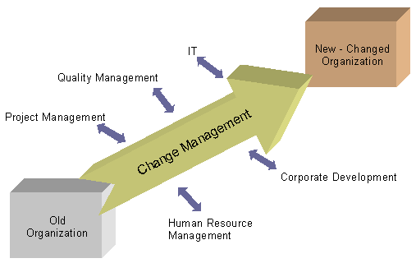
CHALLENGES OF CHANGE MANAGEMENT
Perception barrier
Risk-aversion
Lack of support
Lack of complete and correct information
Lack of Employee Involvement
Lack of Effective Communication Strategy
Shifting the Planning
Unknown Current State
Organization Complexity

Slide 5
Three core levels of Organizational Change Management (OCM)
Let’s review some concepts
Individual Change Management
This segment is designed to assist the people who need to make a transition, or change successfully within their roles. Using methodology from psychology and neuroscience, the company developed the ADKAR® Model, which is one of the most widely used models for managing individual change in the world today.
.
Organizational/Initiative Change Management
This level goes a step up from the individual and focuses more on the project level; where teams of people are coached along to better align with transitions tied to their project management..
Enterprise Change Management Capability
The third level takes the most holistic approach to change, as it aims to provide a set of best practices for enterprise organizations to evolve their roles, structures, processes, projects and culture for the better. This level of change deeply affects all embedded initiatives within the enterprise, and requires key strategic planning and execution to achieve successful buy-in and adoption from executives, management and mid-level employees.
.

Slide 6
Few Examples of
Organizational Change Dynamics
You can also split your content
Organization-wide Versus Subsystem Change
Examples of organization-wide change might be a major restructuring, collaboration or “rightsizing.” Usually, organizations must undertake organization-wide change to evolve to a different level in their life cycle,
Transformational Versus Incremental Change
An example of transformational (or radical, fundamental) change might be changing an organization’s structure and culture from the traditional top-down, hierarchical structure to a large amount of self-directing teams.

Slide 7
Few Examples of
Organizational Change Dynamics (Contd….)
You can also split your content
Remedial Versus Developmental Change
Change can be intended to remedy current situations, for example, to improve the poor performance of a product or the entire organization, reduce burnout in the workplace, help the organization to become much more proactive and less reactive, or address large budget deficits.
Unplanned Versus Planned Change
Unplanned change usually occurs because of a major, sudden surprise to the organization, which causes its members to respond in a highly reactive and disorganized fashion.

Slide 8
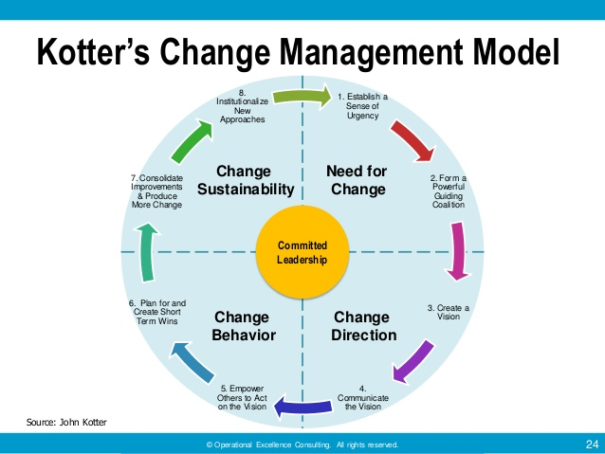
Kotter's approach
Kotter analysed hundreds of change management attempts in large and small organizations over 10 years and has distilled the principles of change into eight strategic steps.
All eight steps need to be present and in the right order for the change process to be successful.

Slide 9
Kotter's 8-Step Change Model
Step 1: Create Urgency
Step 2: Form a Powerful Coalition
Step 3: Create a Vision for Change
Step 4: Communicate the Vision
Step 5: Remove Obstacles
Step 6: Create Short-Term Wins
Step 7: Build on the Change
Step 8: Anchor the Changes in Corporate Culture

Slide 10
Prosci ADKAR Change Management Methodology
Let’s review some concepts
The Prosci ADKAR Model is an individual change management model. It outlines five building blocks of successful change, whether that change occurs at home, in the community or at work. The name “ADKAR” is an acronym based on the five building blocks-
Awareness of the need for change
Desire to participate and support the change
Knowledge on how to change
Ability to implement required skills and behaviors
Reinforcement to sustain the change

Slide 11
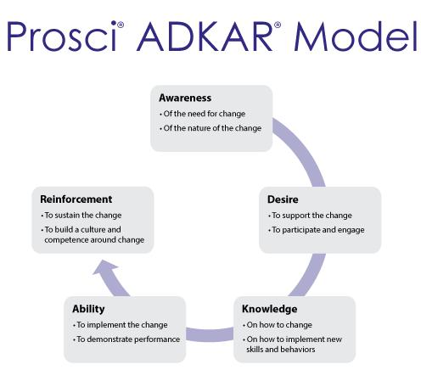
The five building blocks are sequential. Successful change begins with Awareness. After Awareness comes the personal decision to participate, Desire. Following Desire comes the Knowledge and Ability to make the change. And finally, in order for the change to stay in place, Reinforcement is needed.

Slide 12

Process of Successful Change
Awareness
Desire
Knowledge
Ability
Reinforcement

Slide 13
Explanation-
Awareness:
it needs to know how to use washroom properly,
use water up to the limit we need
carefulness to save the earth from the greenhouse effect
consciousness of avoiding all kinds of health hazard
save time consumption of cleaners so that they are properly utilized
take care of longevity of materials
aware of all fittings and accessories, towels are in the right place

Slide 14
Explanation-
Desire:
using washroom reflects your personality and class
what kind of people you are
your intention
where you are throwing the towel
Knowledge:
you have proper knowledge how to use washroom, towel and other gadgets

Slide 15
Explanation-
Ability:
you have capacity, you have ability
you don't waste more than you need
you use things properly & solve your purpose
Reinforcement:
you are able to replicate this system by using washroom accessories, towel, water properly
you don't waste anything that ensures further and longer use of washroom by other users
cleaners can do their job properly as you consume properly
water & other accessories are restored for others

Slide 16
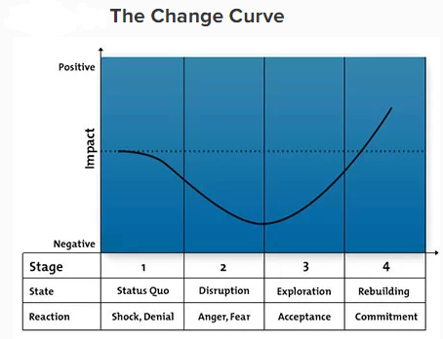
Change Curve Model
Let’s review some concepts
The Change Curve is widely used in business and change management, developed by American-Swiss psychiatrist Elisabeth Kubler-Ross, which describes the four stages most people go through as they adjust to change.
Stage 1: When a change is first introduced, people's initial reaction may be shock or denial, as they react to the challenge to the status quo.
Stage 2: Once the reality of the change starts to hit, people tend to react negatively
Stage 3: They begin testing and exploring what the changes mean, and start to accept the changes
Stage 4: they accept the changes and rebuild their ways of working with commitment. At this stage the final goal of change management can be achieved.

Slide 17
About this template
Quantum Model
Generally, quantum model refer to present a quantum approach to time and change as a framework for understanding organizational complexity and the common decision-making errors that lead to organizational failures within uncertain environments. this perspective has a natural affinity to quantum probability theories derived from quantum mechanics (Greene, 2004, 2011), which also begin with an undefined state, and it offers an innovative approach for understanding the unfolding of complex organizational phenomena.

Slide 18
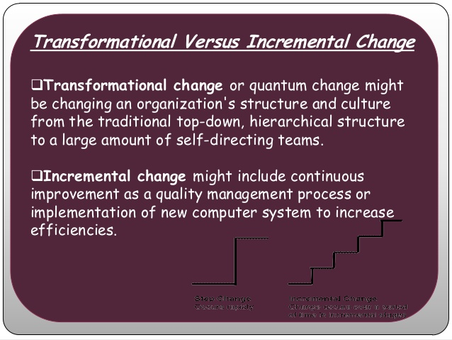

Slide 19
Quantum Approach to Time and Change (QATC)
About this template
QATC provides a novel perspective for theory building in organizational science by emphasizing that the future is often qualitatively different from the present or past. As such, it provides an understanding of dynamic organizational phenomena, considering how organizational life, and life in general, can change by developing in many different ways as individuals and collectives interact with their environment.
Strong change management of the future will be those that can take a quantum view and have systems in place that support the multi-dimensional and interconnected nature of the business they are working within.

Slide 20
Stakeholders for Sustainable Change Management
Team members/employee
Sponsor
Business leaders and managers
Customers/Clients
Impacted employees
Support partners (human resources, finance, testing and operations, etc.)
Regulators
Other interested parties

Slide 21
WAYS OF IMPROVING ACCEPTANCE OF CHANGES
Be open-minded for new ideas. Do not sort out options and ideas until a final decision has to be taken
Protect new ideas from criticism
Listen to suggestions and appreciate good ideas
Eliminate the culture of saying that “We have always done it that way“
Learn from mistakes done in the past
Focus on the good aspects of a new idea rather than on potential problems
Share risks and build upon ideas
Do not make your judgment on ideas and suggestions too early
Let your employees participate in all phases of the change process
Build a culture of commitment

Slide 22

Manage Multi-tasking
Learn to say NO
Leave a NO, gain a YES

Slide 23
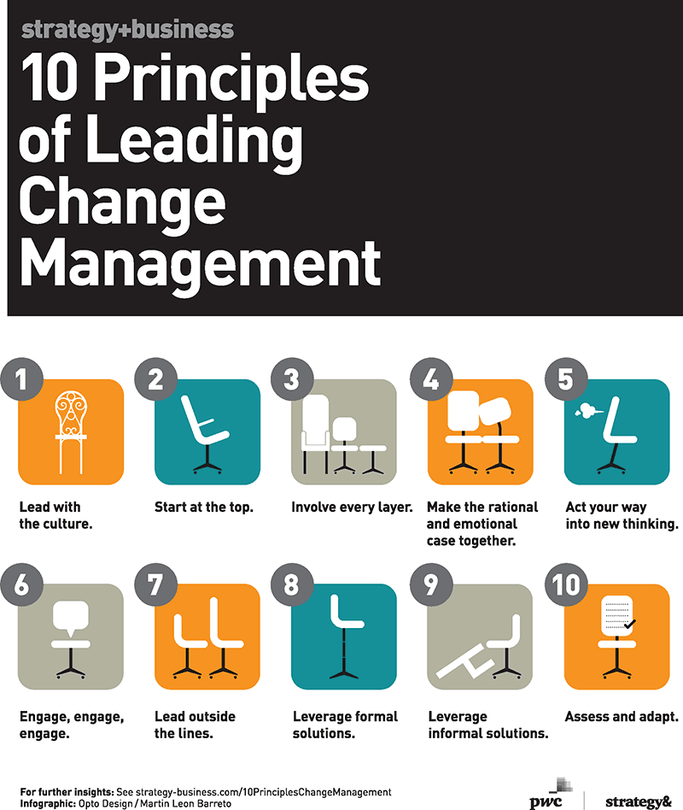
1. Address “human side”
2. Start at the top.
3. Involve every layer.
4. Make the formal case.
5. Create ownership.
6. Communicate the message.
7. Assess the cultural landscape.
8. Address culture explicitly.
9. Prepare for the unexpected.
10. Speak to the individual.

Slide 24
Source (s):
https://www.google.com/search?q=Prosci+change+management+methodology&source=lnms&tbm=isch&sa=X&ved=0ahUKEwjznd_MvJXYAhXGso8KHYDsCDAQ_AUICigB&biw=1366&bih=662#imgrc=L5MNmozvrgkB7M:
https://managementhelp.org/misc/types-of-orgl-change.pdf
http://www.eurogeography.eu/SoC/guidelines/changemanagement.html
http://www.tolerosolutions.com/what-iwhat-is-change-management-why-is-it-important-to-your-organization/
https://www.mindtools.co
https://managementhelp.org/misc/types-of-orgl-change.pdf
http://www.eurogeography.eu/SoC/guidelines/changemanagement.html
m/pages/article/newPPM_96.htm
http://www.consultparagon.com/blog/10-benefits-of-an-organizational-change-management-plan
https://www.prosci.com/change-management/thought-leadership-library/change-management-definition
http://www.themanager.org/Strategy/Change_Problems.htm
https://www.isixsigma.com/implementation/change-management-implementation/sustaining-change-requires-focus-stakeholders/
https://www.sunviewsoftware.com/blog/understanding-it-change-management-vs.-organizational-change

Slide 25
Source (s):
https://www.google.com/search?q=Prosci+change+management+methodology&source=lnms&tbm=isch&sa=X&ved=0ahUKEwjznd_MvJXYAhXGso8KHYDsCDAQ_AUICigB&biw=1366&bih=662#imgrc=L5MNmozvrgkB7M:
https://managementhelp.org/misc/types-of-orgl-change.pdf
http://www.eurogeography.eu/SoC/guidelines/changemanagement.html
http://www.tolerosolutions.com/what-iwhat-is-change-management-why-is-it-important-to-your-organization/
https://www.mindtools.co
https://managementhelp.org/misc/types-of-orgl-change.pdf
http://www.eurogeography.eu/SoC/guidelines/changemanagement.html
m/pages/article/newPPM_96.htm
http://www.consultparagon.com/blog/10-benefits-of-an-organizational-change-management-plan
https://www.prosci.com/change-management/thought-leadership-library/change-management-definition
http://www.themanager.org/Strategy/Change_Problems.htm
https://www.isixsigma.com/implementation/change-management-implementation/sustaining-change-requires-focus-stakeholders/
https://www.sunviewsoftware.com/blog/understanding-it-change-management-vs.-organizational-change
Thank you

