Slide 1
“Money Matters Matter”
Mid-Morning Session by
DR. MD. SABUR KHAN
CHAIRMAN, BOARD OF TRUSTEES,
DAFFODIL INTERNATIONAL UNIVERSITY.
CHAIRMAN, DAFFODIL FAMILY

Slide 2

Money Matters, What is it?
IT’S ALL ABOUT-
• Financial responsibility
• Savings
• Budgeting,
• Debt and credit
Interestingly, only 26% of 13-21 year olds say that their parents taught them how to manage money.

Slide 3




3
Why does money matter?
Let’s take a test…..Tick your answer:
When it comes to saving money
A. I know I ought to be saving, but I never seem to be able to
B. I really enjoy saving. In fact, I spend a lot of time and energy thinking about how to save.
C. I have trouble saving money, and l worry about it sometimes.
D. I only save for things I really want or need.

Slide 4
4
Why does money matter?
Let’s take a test… . .Tick your answer:
If I won a million pounds in the lottery, l would be
A. Totally overwhelmed. I would have no idea how to handle it.
B. Very happy. I would start thinking about how to invest my winnings.
C. Wildly excited. From now on I could buy anything I wanted.
D. Feeling a little guilty. I would think about how to use some of my money to help others happiness.
When I’m feeling down in the dumps:
A. Spending money does not cheer me up.
B. Thinking of ways to make more money makes me feel better
C. I always spend money to cheer me up.
D. Spending just makes me feel worse. Spending has nothing to do with happiness

Slide 5
5
SO HOW DID YOU GO?
If you answered mostly-
• As – you are an AVOIDER – you put off making money decisions.
• Bs – you are a COLLECTOR – you like to see your money make money.
• Cs – you are a SPENDER – you enjoy spending and think little about how to pay for your purchases.
• Ds – you are a THINKER – you care about others who have less than you, and you often feel guilty about having more than they do.
But to get success you have to be “Collector”! We appreciate the “Thinker” as well!

Slide 6

Make specific to what you want within a certain time period:
6
HOW TO ENSURE EFFECTIVE MANAGEMENT OF MONEY?
Identify and write down your financial goals
Organize your financial goals
Educate yourself
Evaluate your progress

Slide 7

7
Create Spending Plan:
Plan for meeting expenses in a given period of time
Daily Expenditure Diary
Keep track of your daily spending
Determine your monthly income and expenses
Find ways to decrease spending
Find ways to increase income

Slide 8


8
Create an Expense Worksheet:
List all the expenses
Fixed expenses do not change from month to month.
Flexible expenses often change from month to month
Monthly Payment Schedule:
Complete Monthly Payment Schedule.
Enter the income sources and date received.
Enter the expenses, due dates, and amounts

Slide 9

9
Determine Income and Expenses
Complete Monthly Income and Expenses worksheet.
List monthly income sources and income amounts to the left.
List monthly expenses and amounts to the right.
Decreasing spending increases your cash flow
What are some ways you can cut back on your spending?

Slide 10
USE THE BUDGETING TOOLS
1..
To successfully use any budgeting tool, you must keep accurate records.
Complete Monthly Payment Schedule.
2..
3.
Enter the income sources and date received.
Enter the expenses, due dates, and amounts.

Slide 11
Budgeting Tools:
Make a list of all sources of income
Make a list of all anticipated expenses
Identify shortfalls
Do you have a Plan B for emergencies?
Develop a plan
Keep it simple & realistic!
Implement plan!
Revisit and revise quarterly

Slide 12

DO YOU KNOW MODERN DEFINITION OF SAVINGS
It’s not all about Money!
Saving means perfect utilization of time, knowledge, asset, and wealth for future!
Most importantly,
to have a “Plan” for future!

Slide 13

WHY SET GOALS OR HAVE A PLAN?
If you aim at nothing,
you’ll hit it every time

Slide 14
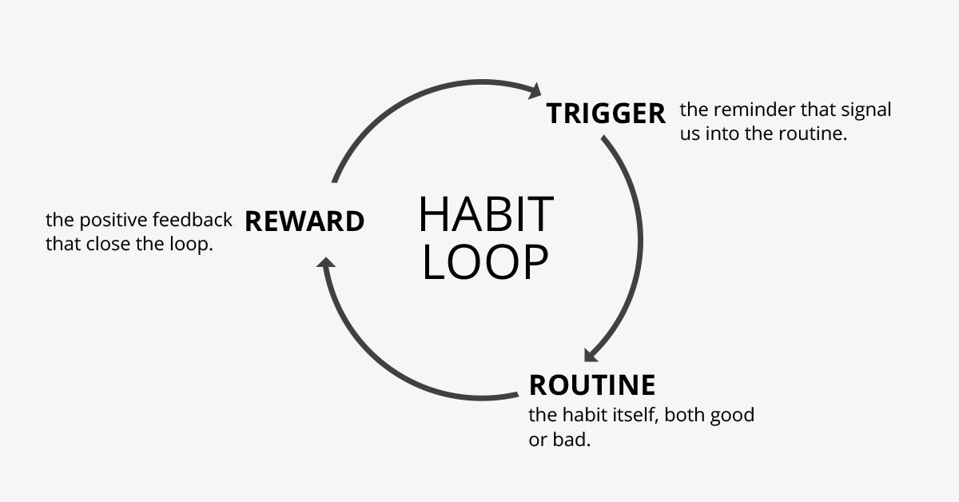
SAVING HABITS: HOW TO DEVELOP IT?
“Money Saved is the money earned” So you have to save money
It’s not about how much money you make, it’s about how much money you keep
As cash flow comes in, you have to be watchful in spending to track and control your finances.

Slide 15

TO REACH YOUR FINANCIAL GOALS, YOU NEED TO KNOW
What you already have for the goal
How much money it will take to reach the goal
Where your money is going now

Slide 16


MY SAVINGS STORY!
How did I save and what I Saved?

