Slide 1



TAKEAWAY!
Dr. Md. Sabur Khan, Chairman, BoT,
Daffodil International University

Slide 2

Your
Takeaways from this
Mega Event?

Slide 3
http://gg.gg/ICTCarnival2018
Submit your feedback/ suggestions
for the
NEXT ICT Carnival

Slide 4

FINDINGS?

Slide 5
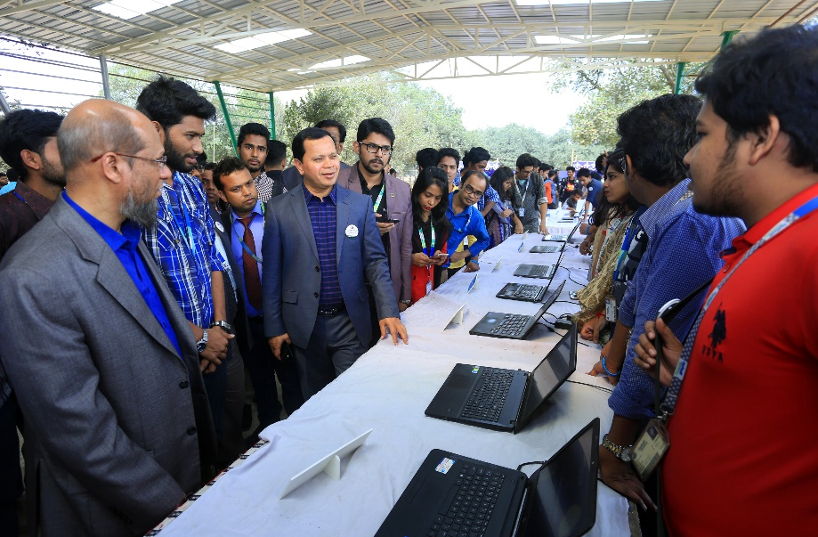
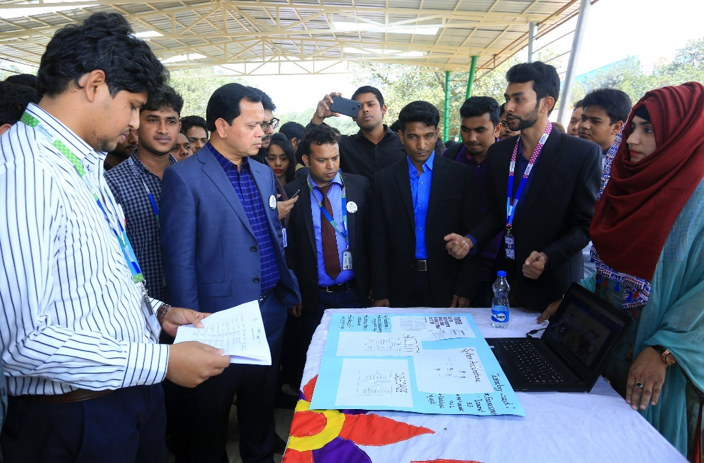
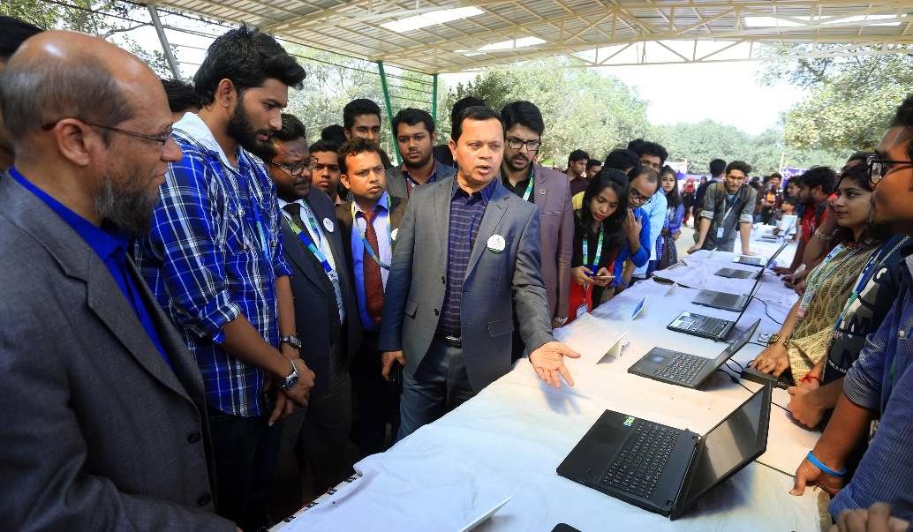
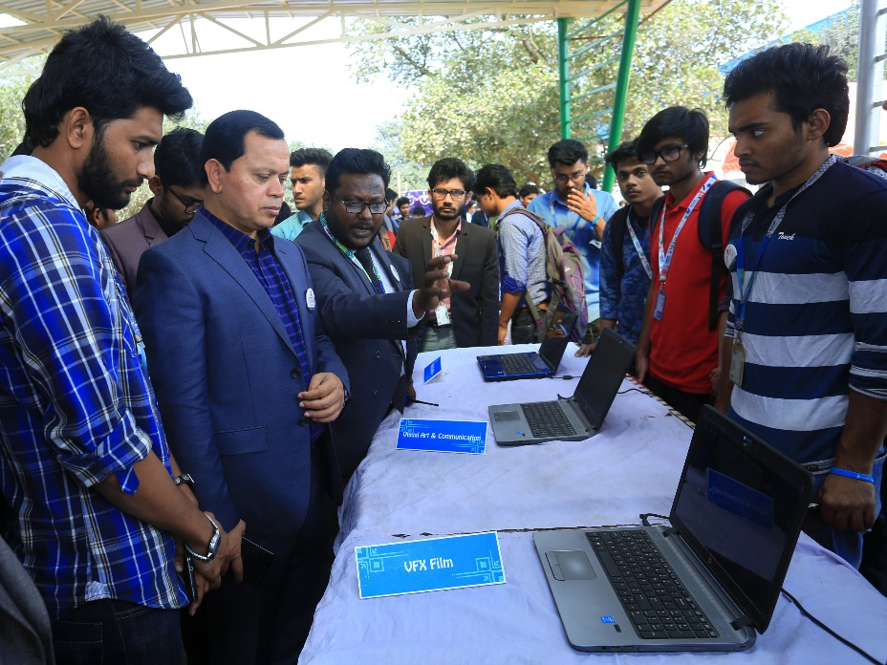
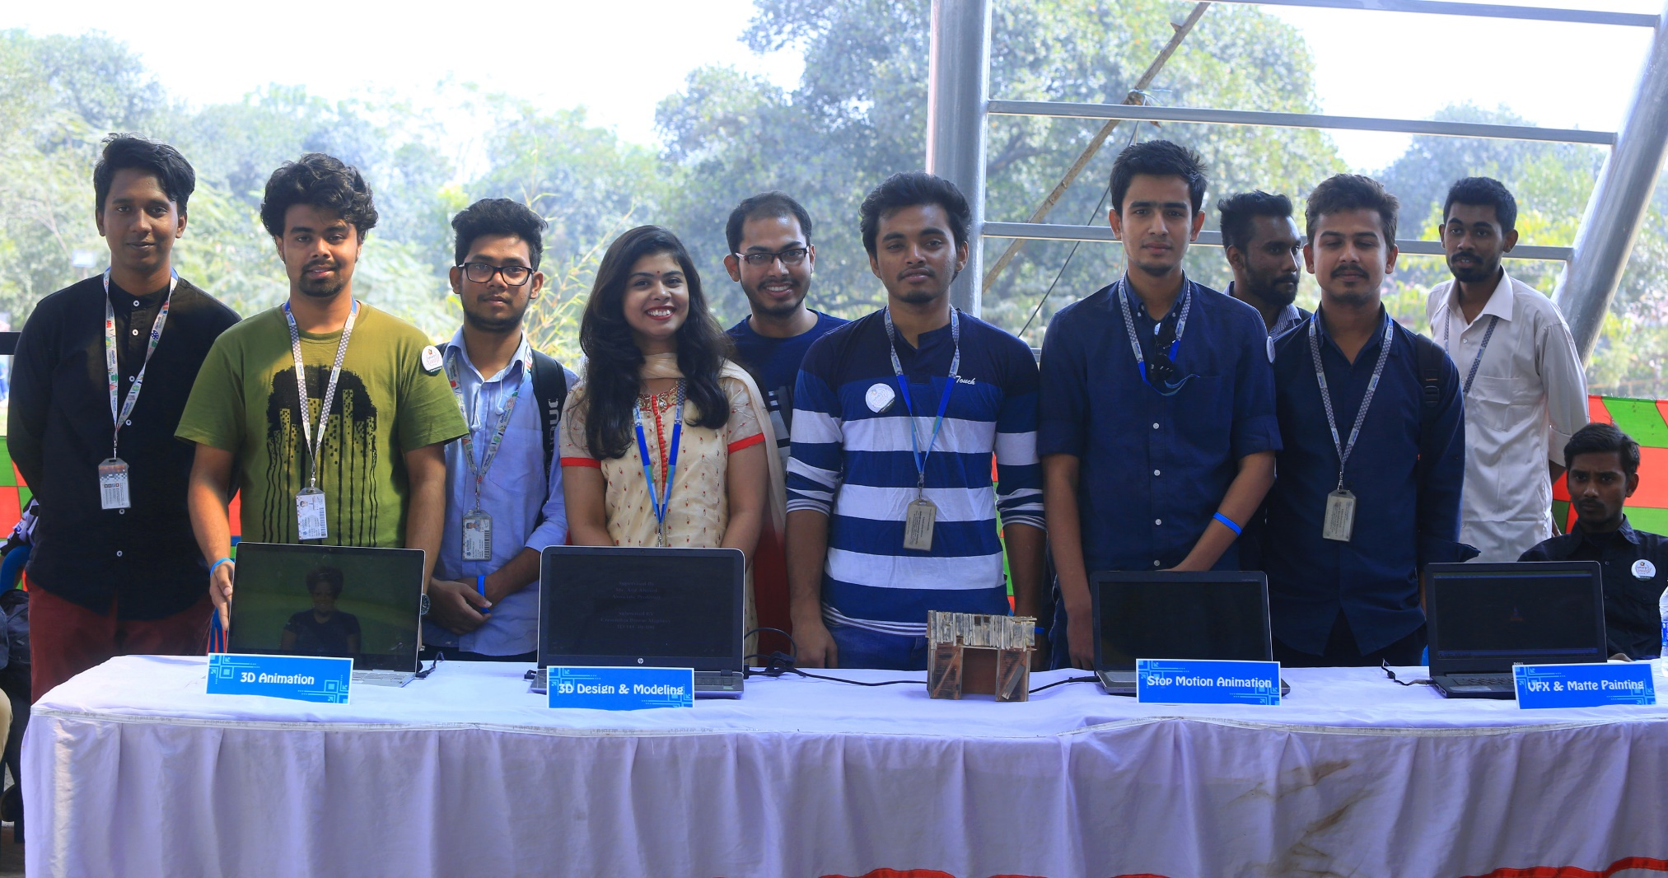
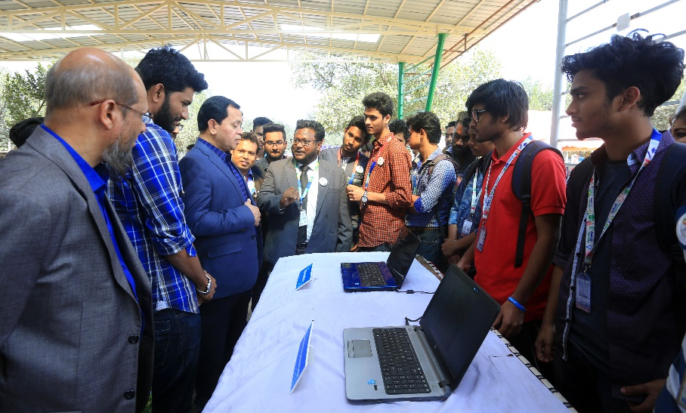
Check Projects
VIABILITY

Slide 6

Nobody has chosen a Company/Specific Target to implement their PROJECTS

Slide 7


Collaborative
Project

Slide 8
HEALTH
Project
Medilab
Desilab
Doctor Finder
Maa
Personal Health Record & Management
Hepatitis Test

Slide 9
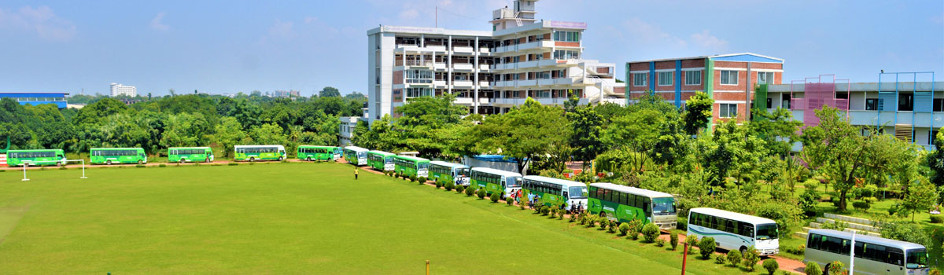
Transport
Project

Slide 10

EDUCATION
Apps

Slide 11
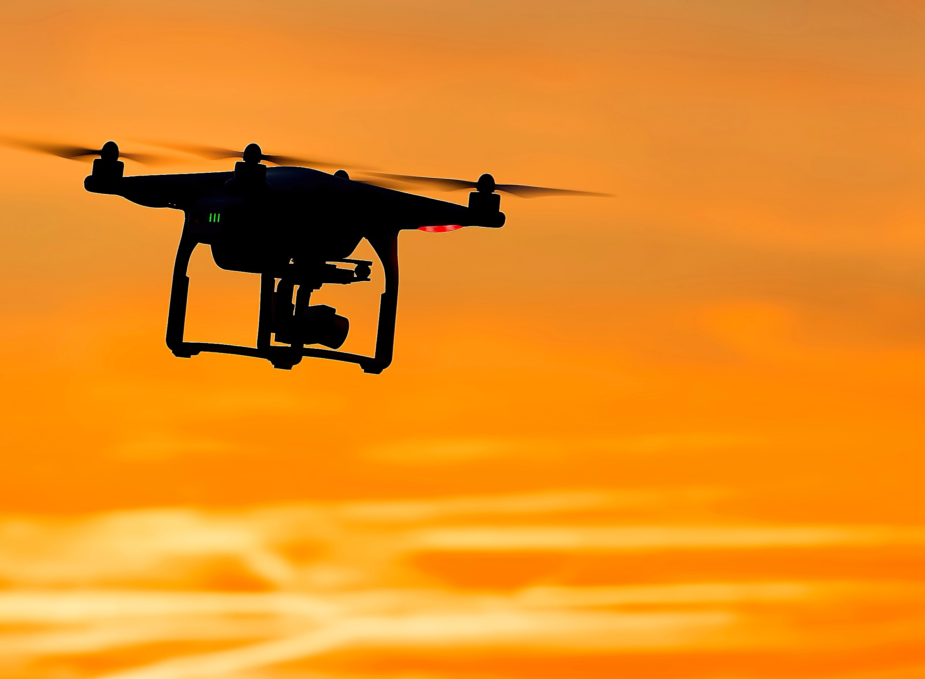
Drone
Project
Identify the
specific
“SECTOR”

Slide 12
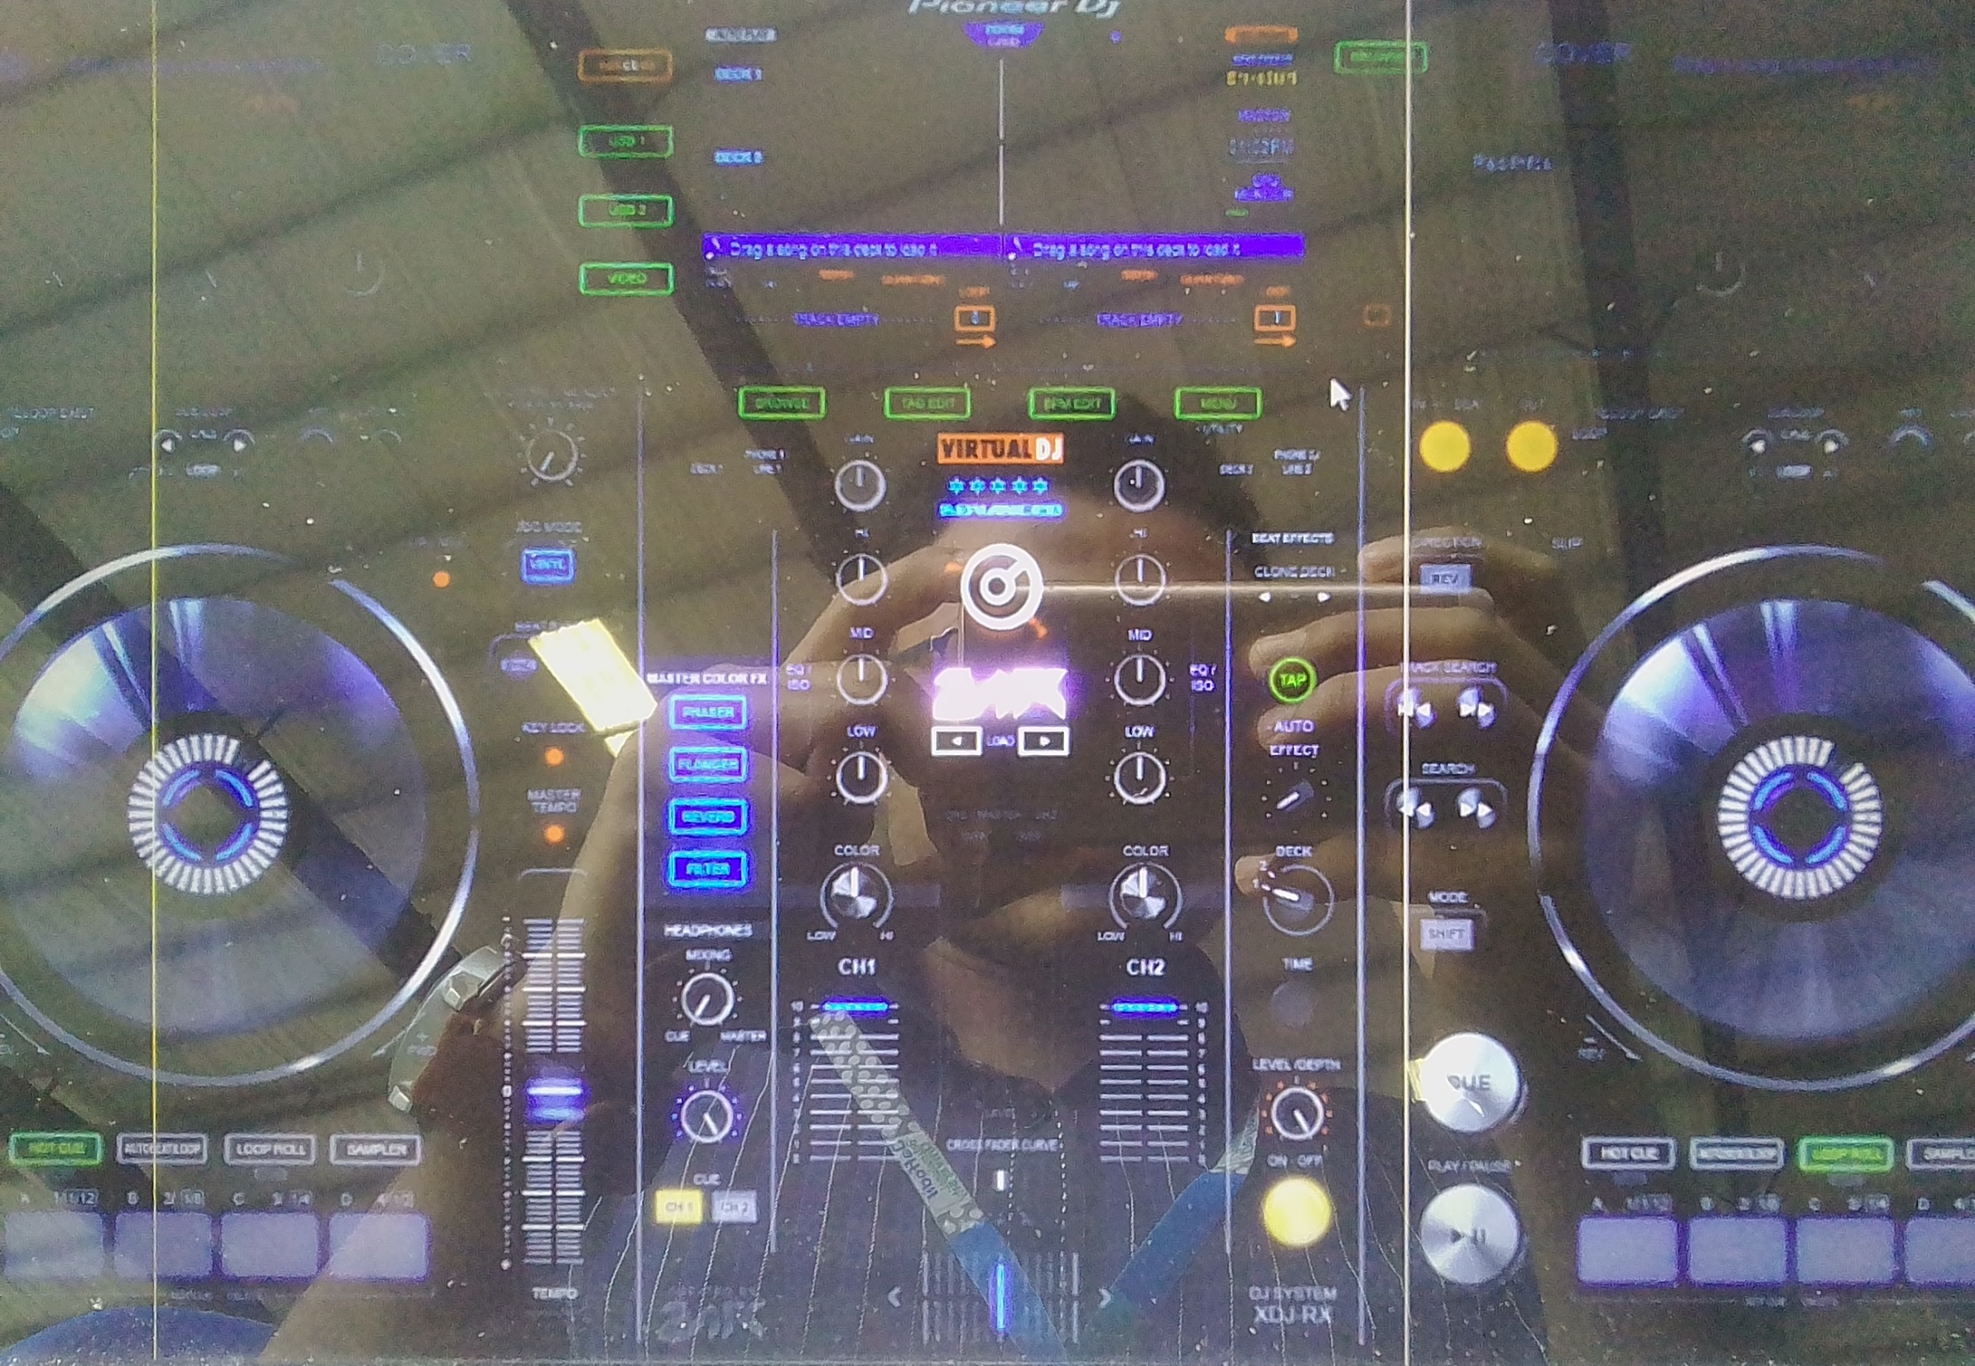


Slide 13

Complete
Product
Will give YOU
Degree

Slide 14
THANK YOU!

