Slide 1
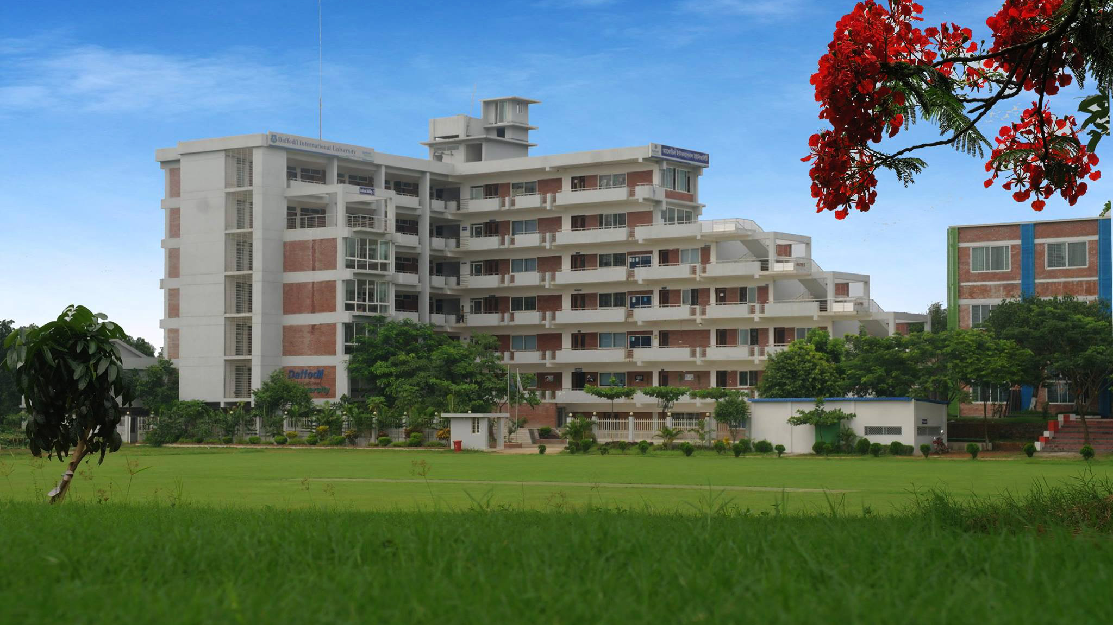
SDG 9
Technology, Innovation, Infrastructure, and Industry
With Special Reference to Bangladesh
Dr. Md. Sabur Khan
Chairman, Board of Trustees (BoT)
Daffodil International University
13th Knowledge Globalization Conference, Bangladesh.

Slide 2
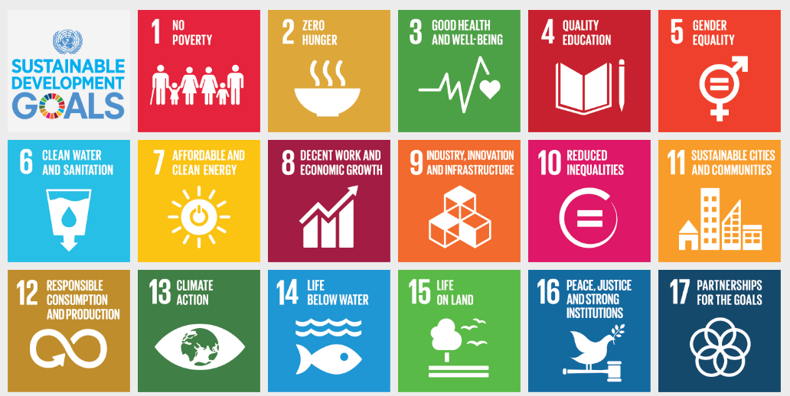
2030 Agenda for Sustainable Development’, adopted by world leaders in September 2015, at an historic UN Summit, officially came into force during 1 January 2016. The SDGs, were build on the success of the Millennium Development Goals (MDGs) and aim to eradicate all forms of poverty. SDG goals are unique as all countries need to act in promoting prosperity.

Slide 3

Create a data repository for monitoring the implementation of the SDGs and other national development goals
www.sdg.gov.bd
Improve situation analysis and performance monitoring
To monitor the national programmes, integrated with Sustainable Development Goals (SDGs), Government of Bangladesh has launched technology-based integrated platform. With objectives to…
Facilitate the tracking of progress against each goal and target
Enable predictive analysis for achieving the goals within the set time-frame

Slide 4

Access to Information
A2I helps government officials analyze and redesign workflows within and between ministries in order to optimize end-to-end processes and automate non-value-added tasks.
Established over 5,000 Digital Centres which provide internet access for all throughout the country.

Slide 5

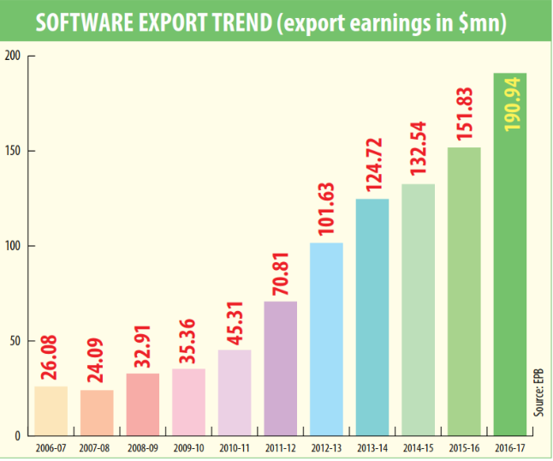
ICT as stimulator of innovation and ICT Industry of Bangladesh
Bangladesh targets to reach of earning $1 billion from exports by 2018. Bangladesh government will build internet literacy centres across the country to increase internet penetration, which is 40 percent now.

Slide 6
Government Policy
Private equity fund
Impact fund
Venture capital fund
Alternative Investment Rule 2015

Slide 7

BUSINESS INCUBATION
for the development of START-UPS
in BANGLADESH

Slide 8

Daffodil Business Incubator (DBI)
Spurs the Innovation

Slide 9
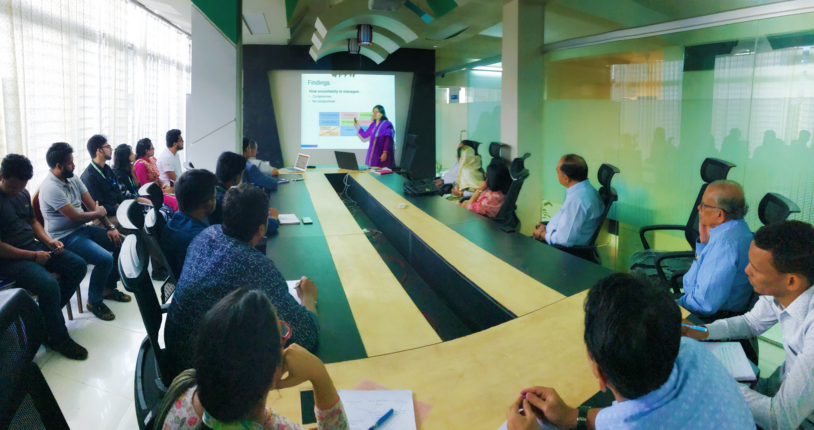

VENTURE CAPITAL
Bangladesh
Bangladesh Venture Capital Limited aims to make an investment eco-system for the start-ups, based in Bangladesh fostering a healthy economic culture for all the stakeholders. It encourages entrepreneurs to come up with innovation, in view to contribute to the national economy and facilitates the potential entrepreneurs at every stage of their business development and channels capital requirements to drive for sustainable growth.

Slide 10

Bangladesh needs to institutionalize the innovation and encourage both public and private sectors to create entrepreneur enabling environment, to fully utilize the prevailing opportunities.

Slide 11


The young generation is ready to take the responsibility to move the country forward.

Slide 12

The country also needs to work in existing education policy and curriculum in a way which would make the students innovative and creative so that the youth can feel encouraged to set their goals to become entrepreneurs.

Slide 13
REFERENCES
Anisya S. Thomas and Stephen L. Mueller. (2000). A Case for Comparative Entrepreneurship: Assessing the Relevance of Culture. Palgrave Macmillan Journals.
Daniel Mankani. (2003). Technopreneurship: The Successful Entrepreneur in the New Economy. Pearson/Prentice Hall
Entrepreneurship: Values and Responsibility. (2009). edited by Wojciech W. Gasparski, Csv Leo Ryan, Stefan M. Kwiatkowski. Transaction Publishers. USA
Hisrich, Peters and Shepherd. (1994). Entrepreneurship. McGraw-Hill Education. USA
John Thompson and Bill Bolton. Entrepreneurs (2nd Edition). (2004). Routledge. United Kingdom
Joseph Alois Schumpeter. (2011). The Entrepreneur: Classic Texts by Joseph A. Schumpeter. Stanford University Press, USA.
Rangarirai Mbizi. (2012). Principles of Innovation and Technopreneurship: Innovation and Technology Commercialization. LAP LAMBERT Academic Publishing

Slide 14
REFERENCES
Bangladesh Development Forum in Dhaka next week. (2017). The Daily Star. Retrieved from http://www.thedailystar.net/business/bangladesh-development-forum-dhaka-next-week-1516561
Special steps needed to finance SDGs: Muhith. (2018). The Daily Star. Retrieved from http://www.thedailystar.net/business/special-steps-needed-finance-sdgs-muhith-1522066
UNCTAD B2C e-commerce index 2017. Retrieved from http://unctad.org/en/PublicationsLibrary/tn_unctad_ict4d09_en.pdf
Website of Access to Information (a2i) Programme, Government of Bangladesh. Retrieved from http://a2i.pmo.gov.bd/
Website of SDG Tracker. . Retrieved from http://www.sdg.gov.bd/

