Slide 1




Sustainability in Career
Md. Sabur Khan, Chairman
Jobsbd.com & Daffodil Family
Inspire Young 7th Session
September 25, 2017
British Council Auditorium

Slide 2

BE SUSTAINABLE

Slide 3



Slide 4

WHO AM I

Slide 5

DREAM BIG

Slide 6

SKY IS THE LIMIT

Slide 7

CULTIVATE YOUR DREAM

Slide 8


Slide 9

SET GOAL/TARGET

Slide 10


Slide 11

DON’T DESPAIR FROM HOPE/DREAM

Slide 12

EVALUATE YOURSELF

Slide 13

STUDY ON THE COMPANY
SUBMIT ANALYZED PROFILE TO THE MANAGEMENT

Slide 14

SOCIAL MEDIA CHARACTER CERTIFICATE

Slide 15

STUDY/KNOW THE SUCCESS STORY

Slide 16

DON’T WAIT FOR A JOB
ASK FOR A WORK

Slide 17

START FROM LITTLE

Slide 18

MAKE YOURSELF
EMPLOYABLE

Slide 19

FAITH IN ALMIGHTY

Slide 20

IDENTIFY YOUR SKILLS & CAPABILITIES

Slide 21
‘NO’
NEXT OPPORTUNITY

Slide 22

DON’T BE ANGRY, BE CALM

Slide 23

TAKE REVENGE BY RESULT

Slide 24

BE PATIENT

Slide 25

LOVE/ENJOY YOUR WORK

Slide 26

SWOT ANALYSIS

Slide 27

KNOW THE WORLD

Slide 28

CHOOSE THE RIGHT WAY

Slide 29

RESPECT
PARENTS
&
FAMILY

Slide 30


Slide 31

NOTHING IS IMPOSSIBLE

Slide 32

PROBLEM=OPPORTUNITY

Slide 33
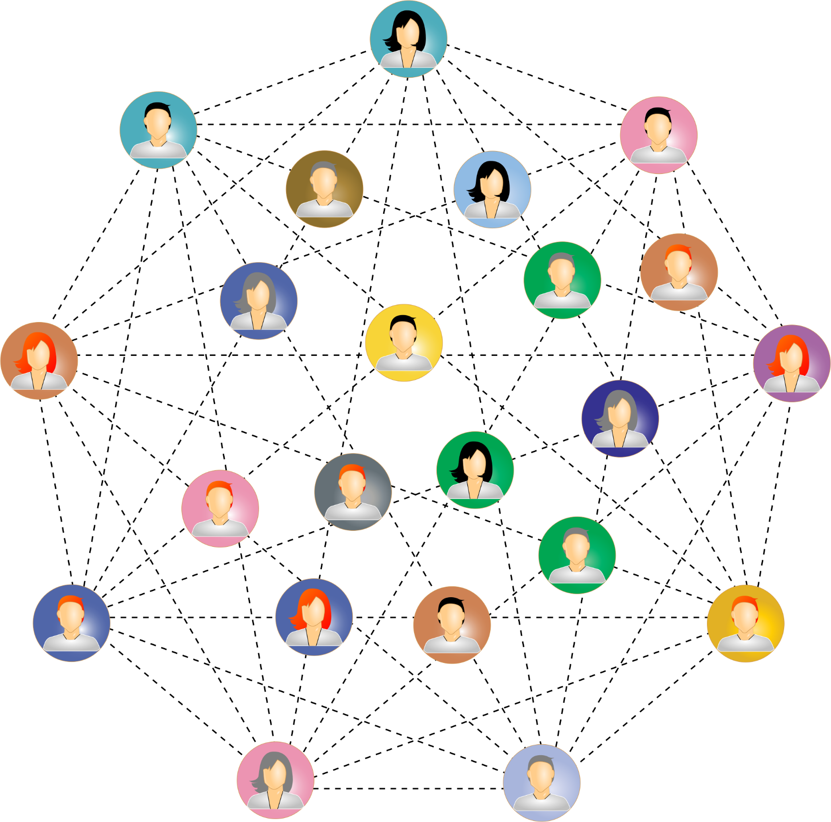
INCREASE NETWORKING

Slide 34

BE POSITIVE ALWAYS

Slide 35

BE GLOBAL

Slide 36

MULTITASKING

Slide 37

BE UNIQUE/DIFFERENT FROM OTHERS

Slide 38

BE A CREATIVE THINKER

Slide 39

CATCH OPPORTUNITY IN RIGHT TIME

Slide 40

3 C OF LIFE

Slide 41

TO SAY ‘SORRY’
IS AN ART

Slide 42

TEAM

Slide 43
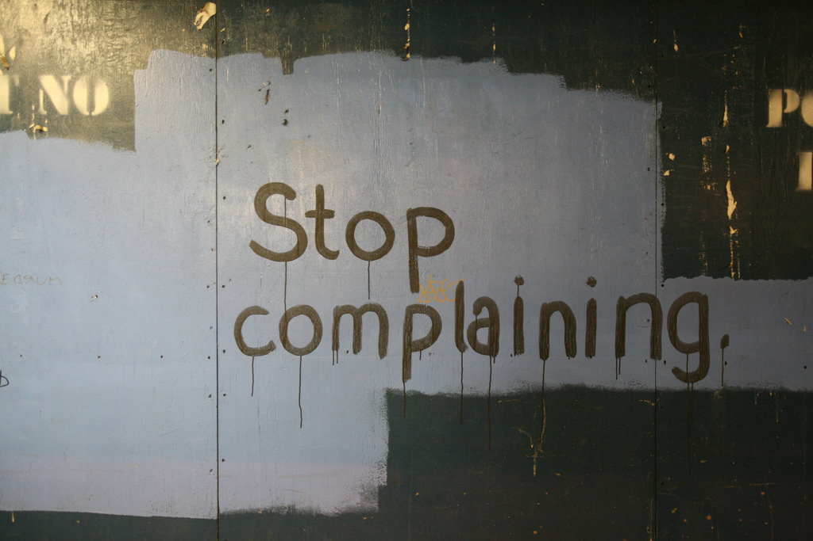
STOP COMPLAINING

Slide 44

AVOID CRITICISM

Slide 45

www.jobsbd.com

