Slide 1
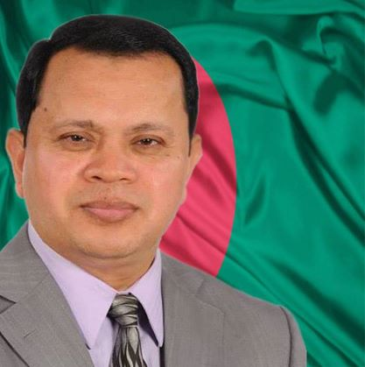
Md. Sabur khan
www.saburkhan.info
Born in 1965
Studied at Jahangirnagar University
Team member of Daffodil Group family
Current Position:
Chairman Board of Trustees at Daffodil International
University & Chairman of Daffodil Group
My passion is my work
My interest is in ICT & Education
My dream is to see more visionary leaders….

Slide 2
The reason for choosing business career?
I always wanted to be recognized by my work. My business activity was biased by a deep thought inside and that is after our life how we would be remembered for? What is my contribution to this world? Or I would be just like another entity to this world.

Slide 3
I started my business career in 1990 after completing my study and it was possible since from my young age I aimed to position my foot step to the business world.
The Start of my Business Career
In 1990 I set Daffodil Computers Ltd. when ICT was not at all focused in Bangladesh. It took several years to create awareness on ICT potentials. Then I felt the importance of ICT expert human resources so I decided to set my vision to start Education Network
Challenges in my career

Slide 4

To develop a sustainable economy through growing competent human resources with quality education, skills and attitude, creating awareness on ICT potentials, lead this sector and extend the ICT knowledge and creating young entrepreneurs so that they can contribute in national and global economy.

Slide 5

The huge population of Bangladesh (160 Million)
Perspective of my Business Vision
Youth/workable population ration in total population
The life style of the people and leadership skills to face any challenges
Scope and opportunity that ICT provides to become self-dependent

Slide 6
My business activity is based on a moral question “What type of society we would like to build and what would be our contribution for the society?”
International Standard Education at affordable reach
Help to explore the talents
Skills
Support Education through Daffodil Foundation
Develop young Generation with education, training and attitude
Knowledge
Creating Young Entrepreneurs
Bridging Digital divide & bringing women in ICT Sectors
Attitude
My Social Commitment

Slide 7













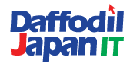










Education Concern
ICT Concern

Slide 8

CORE FOCUS
ICT Sector Development
Education Sector
Developing the young generations
Creating Entrepreneurs
Empowering People
Developing competent human resources

Slide 9
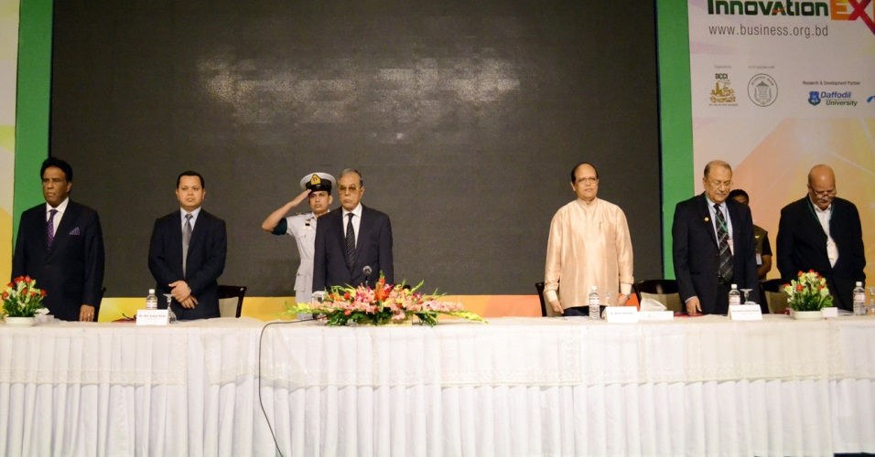
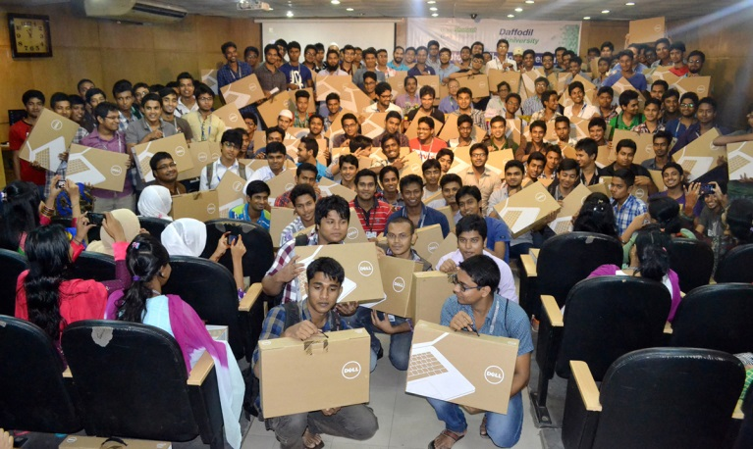
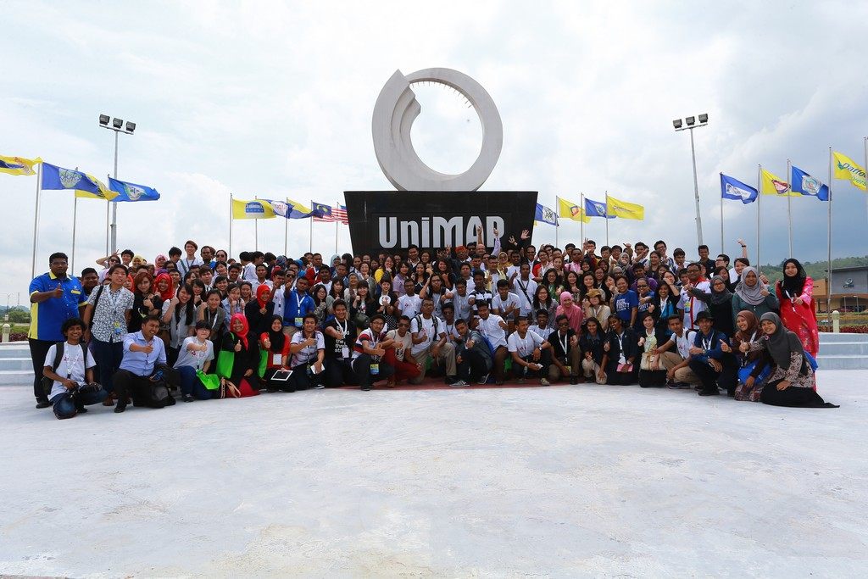
Effort to Reach My Vision
Introduced One Student, One Laptop project
Introduced “Vocation Training for
Initiated “ICT Scholarship for Generation”
Creating 2000 Entrepreneur project as DCCI President
“Promoting Computer Literacy Amongst Women for Self Employment” with Ministry of Women & Children Affairs
Collaborative effort for internationalization of Education Systems
Working with Government initiative under Public/Private partnership model.

Slide 10
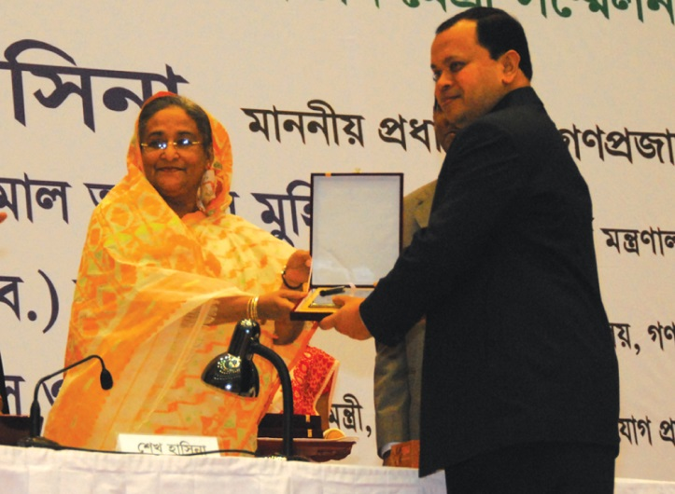
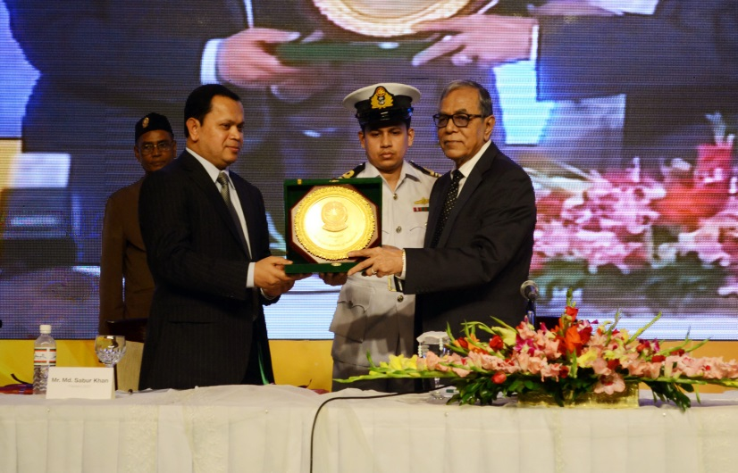
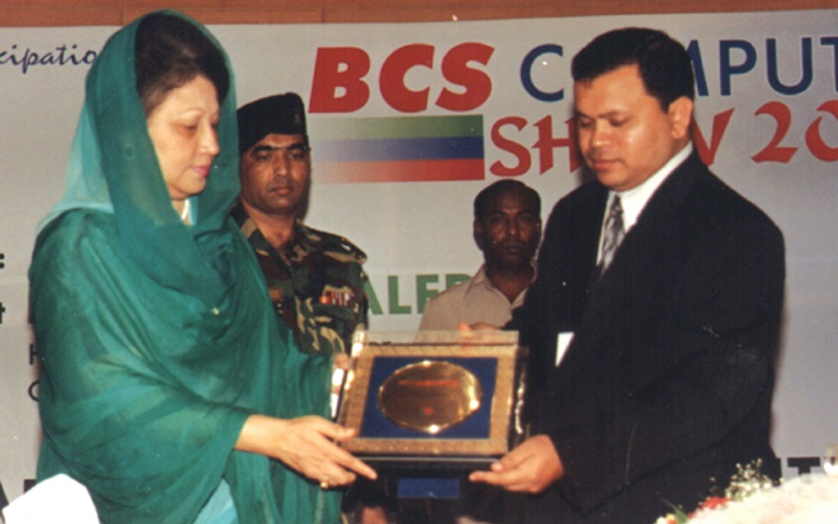
Effort in ICT Sector Development
As BCS President convinced the Prime Minister, the Finance Minister and Parliament Members to withdraw 7.5% TAX/VAT on IT Industry
Met with the Prime Minister to convince her to withdraw TAX / VAT on ICT products
As a member of the Prime Minister ICT Task Force I worked to design national ICT Policy, Submarine Cable.
Played vital role to convince the Prime Minister to rename the ICT Ministry as Ministry of Science and ICT.
Worked in ASOCIO and WITSA to promote our National Flag globally

Slide 11
Some of My Best Projects Which I lead
Computerized Seat Reservation and Ticketing Project for Bangladesh Railway.
The first biggest Computerization project that covered total ICT solution for Bangladesh Road Transport Authority (BRTA) under Ministry of Communication.
Computerization of Dhaka City Corporation (DCC) is another big software project for computerization of various activities of City Corporation
Creating 2000 Entrepreneur Project with DCCI

Slide 12









My Social Position
Chairman- FBCCI H.R.D. Standing Committee
Member
Immediate Past President
President
Convener
Convener
Malaysia Bangladesh Business Council
Australia Bangladesh Business Council
Common Wealth Business Council
Member
Member

Slide 13
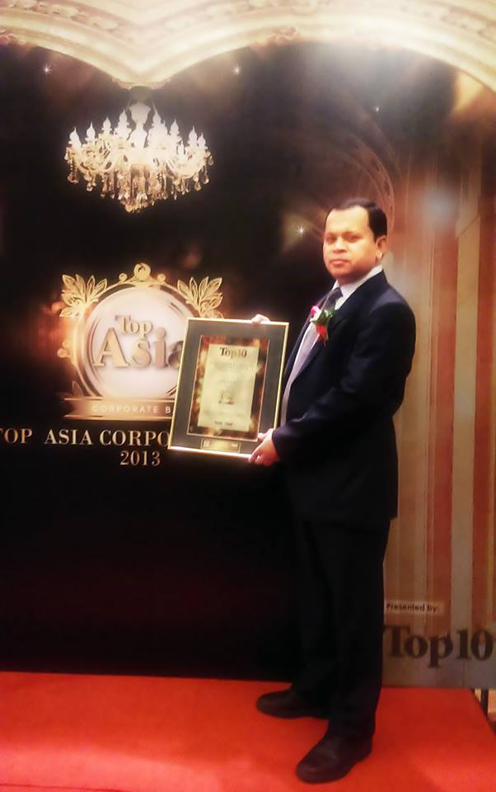
My Awards
World Quality Congress and Awards 2014
Asia's most inspiring Nation Builder Award by Top 10 of Asia and Top 10 of Malaysia.
World Education Congress Global Award
Leadership Award by BASIS
Recognition by Junior Chamber International
Life Time Achievement Award by Bangladesh Computer Samity for Outstanding Contribution in IT sector
Prime Minister’s Award for Beautification of Traffic Island in the Mirpur Road
HSBC Gold Award and many more….

Slide 14
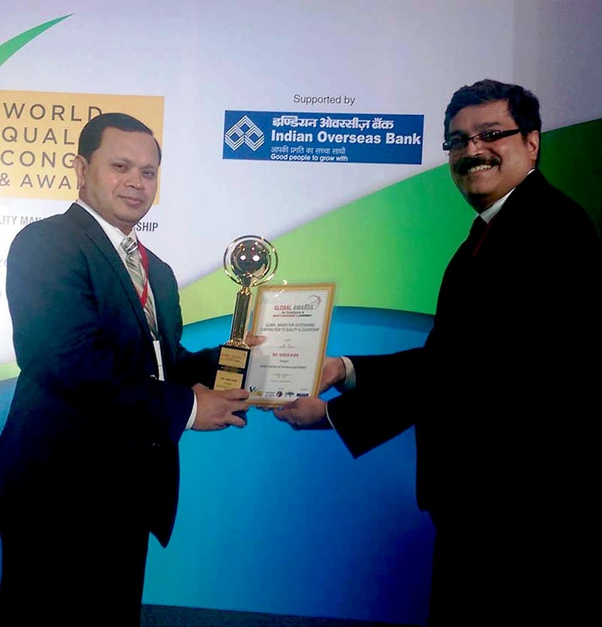
My Awards
World Quality Congress and Awards 2014
Asia's most inspiring Nation Builder Award by Top 10 of Asia and Top 10 of Malaysia.
World Education Congress Global Award
Leadership Award by BASIS
Recognition by Junior Chamber International
Life Time Achievement Award by Bangladesh Computer Samity for Outstanding Contribution in IT sector
Prime Minister’s Award for Beautification of Traffic Island in the Mirpur Road
HSBC Gold Award and many more….

Slide 15
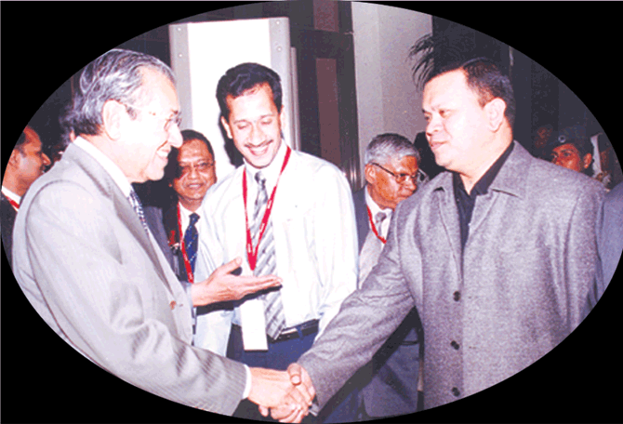
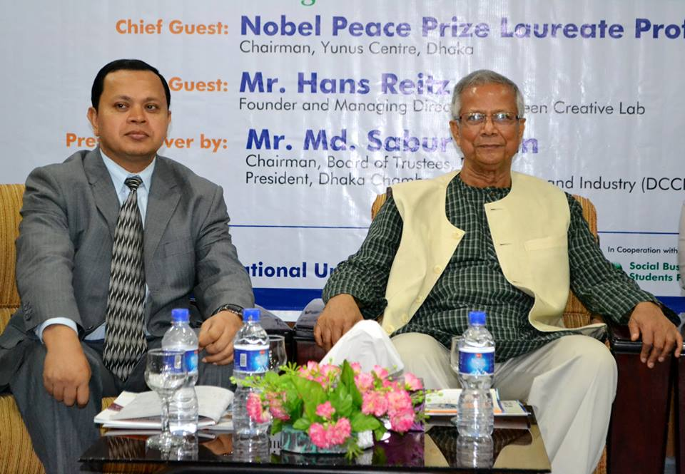
My Recognition
Life Time Achievement for ICT Journalism 2013 BCS Computer City
For valuable contribution to DCCI’s development & progress as Director during 2004-06 by
Best IT Entrepreneur by Dhaka Sub-Editors Council in 2006
Was Nominated for Best ICT Entrepreneur in the world (nominated) by WITSA in 2004
Excellence-New Millennium Personality by Asia –Pacific Trade Leaders Club in 2002
Best ICT Organizer by IMART International in 2000
Man of the Year Computer Education by The Bangladesh Rotaract Club in 1999

Slide 16
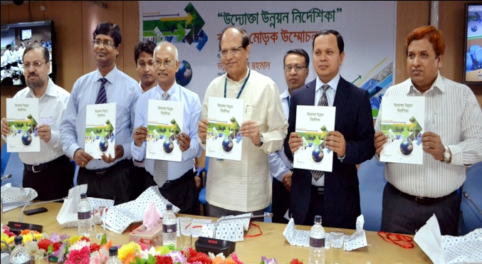
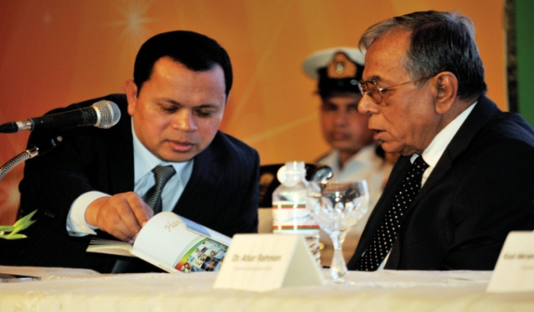
My Publications
“Handbook of Entrepreneurship Development” has been published in the Presence of Honorable President of Bangladesh
“Uddokta Unnoyon Nirdeshika” (Entrepreneurship Development Guideline) in Bengali published in the presence of the Governor of Bangladesh Bank

Slide 17
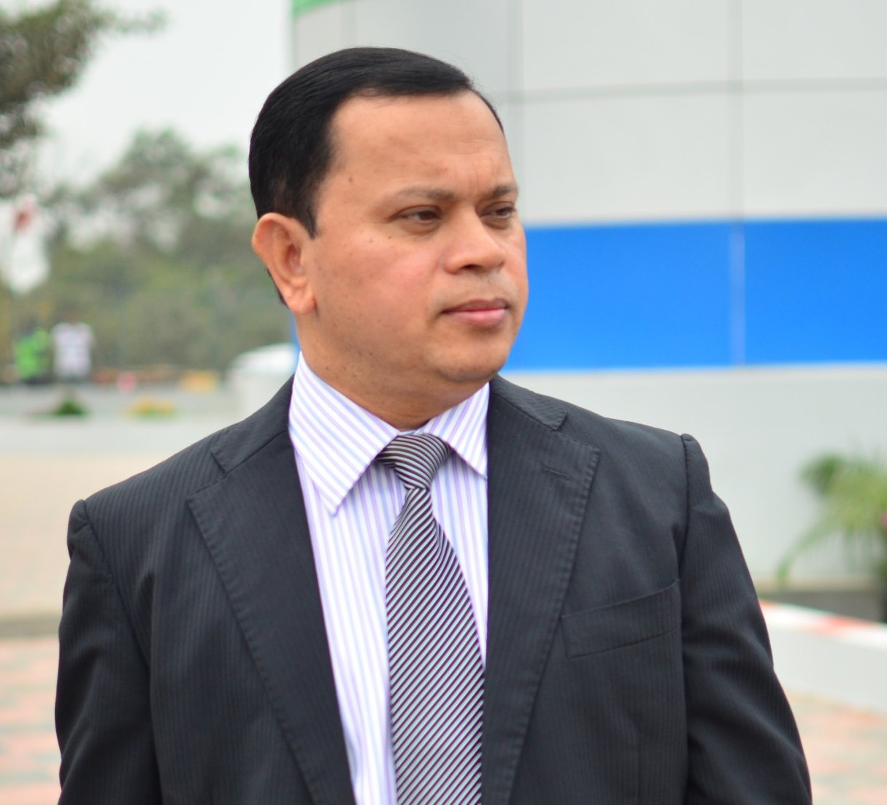
My Commitment
Together we will address the opportunity and challenges of Globalization
To actively participate in the development of ICT Industry and ensuring it
To ensure best practices through sharing and encouraging practices
To encourage young generation in ICT entrepreneurship
To set common policy agenda across national boundary
To initiate programs to promote ICT, a Common platform to share ICT uses, to encourage the deprived nation and help in Global trade & Commerce.

