Slide 1


MODERN TOURISM INDUSTRY
&
ENTREPRENEURSHIP
Mr. Md. Sabur Khan
Chairman, BoT,
Daffodil International University

Slide 2

Are you on the right track?
Are you following the modern trends?
What do you think
?

Slide 3

The speed of CHANGE is 10X FASTER now than it was a decade ago...

Slide 4
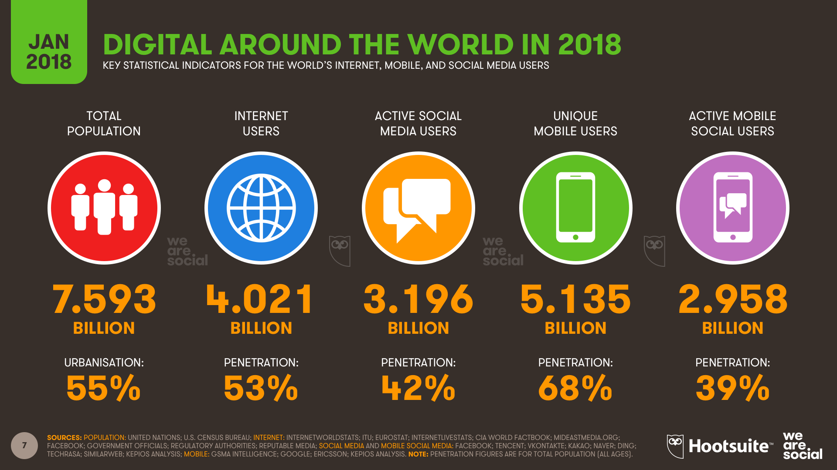

Slide 5

Do you know?
In 24 Hours

Slide 6


In 24 Hours
5+ Billion Google Search

Slide 7


1.2+ Million Cars Rented
In 24 Hours

Slide 8

15+
Million User Rides
In 24 Hours
In 24 Hours

Slide 9

22.7+ Million People passing through AIRPORT

Slide 10

100K Flights

Slide 11

23+
Million Visitors on
In 24 Hours

Slide 12

73K
People Cruising

Slide 13

2+ Billion GDS Transaction

Slide 14
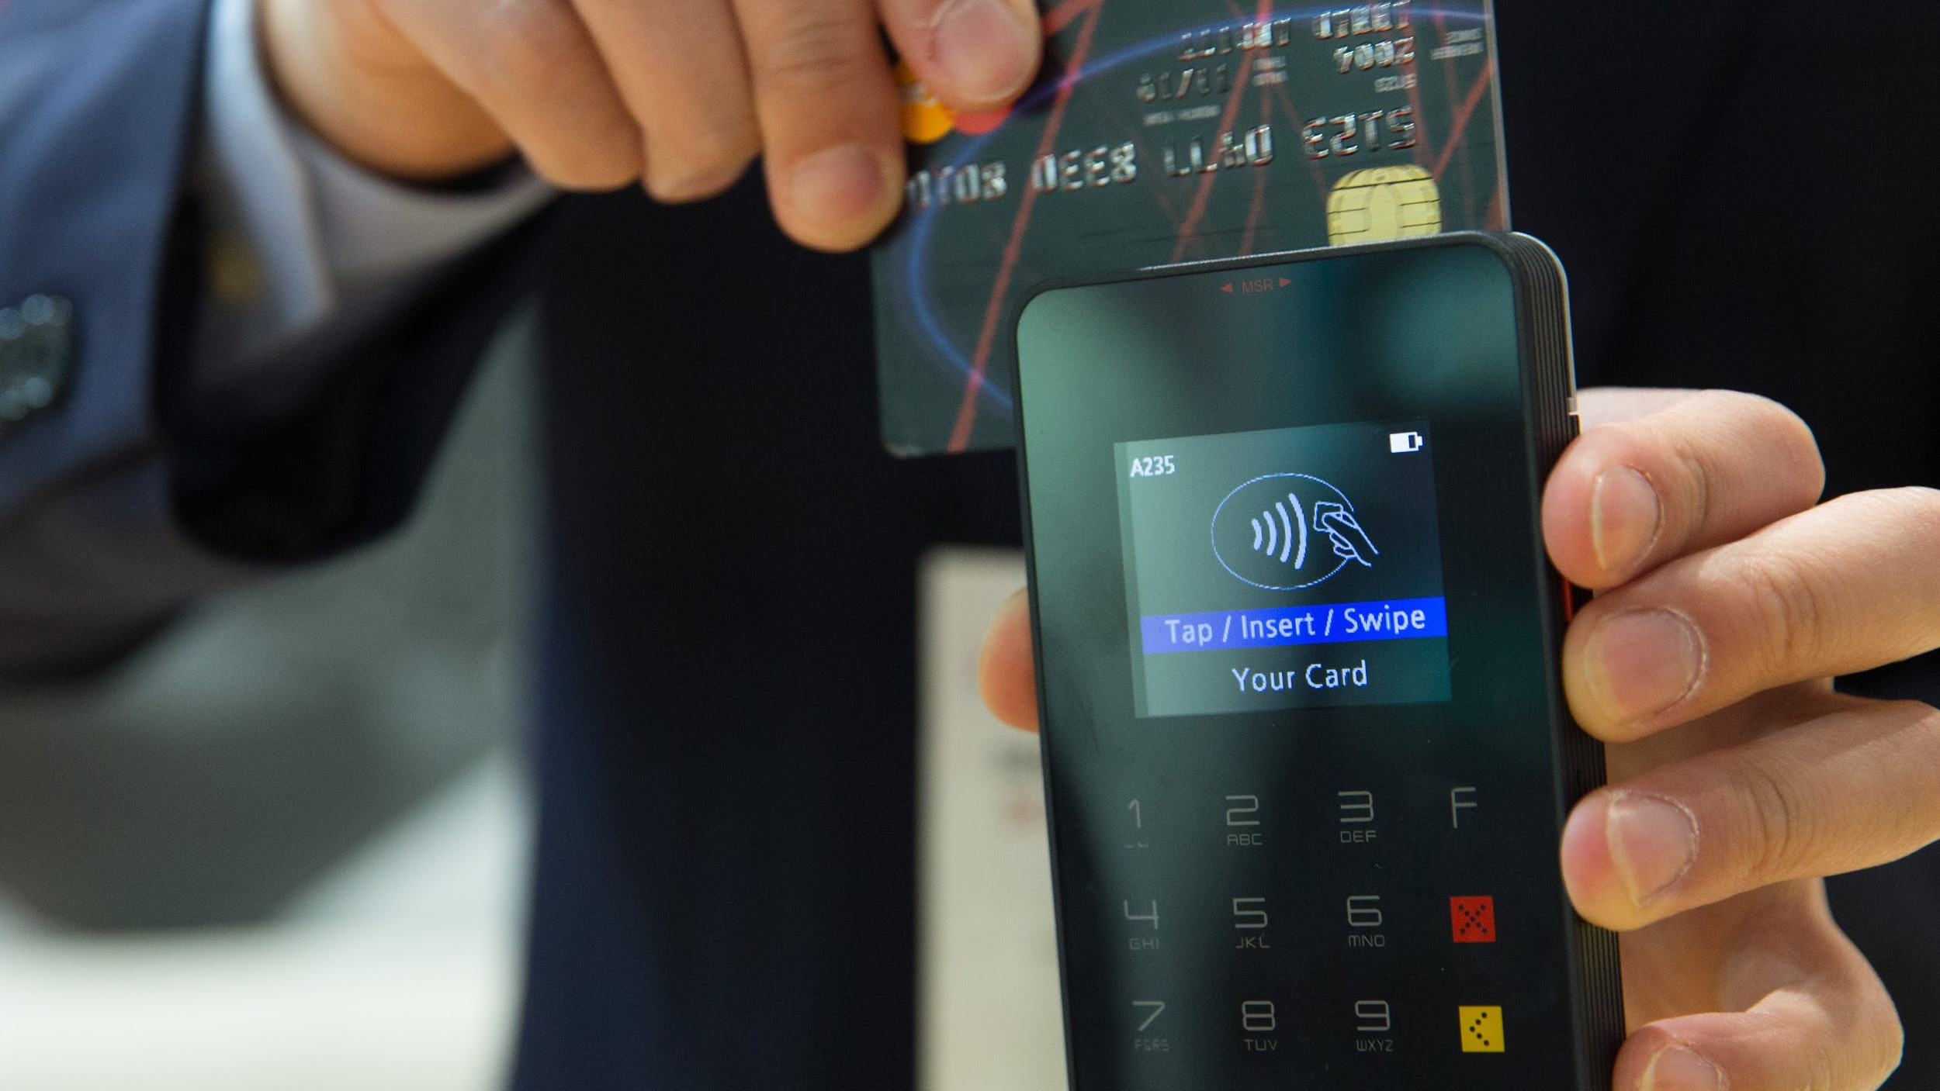
$2.52 Billion
Tourists Spending on Retail

Slide 15
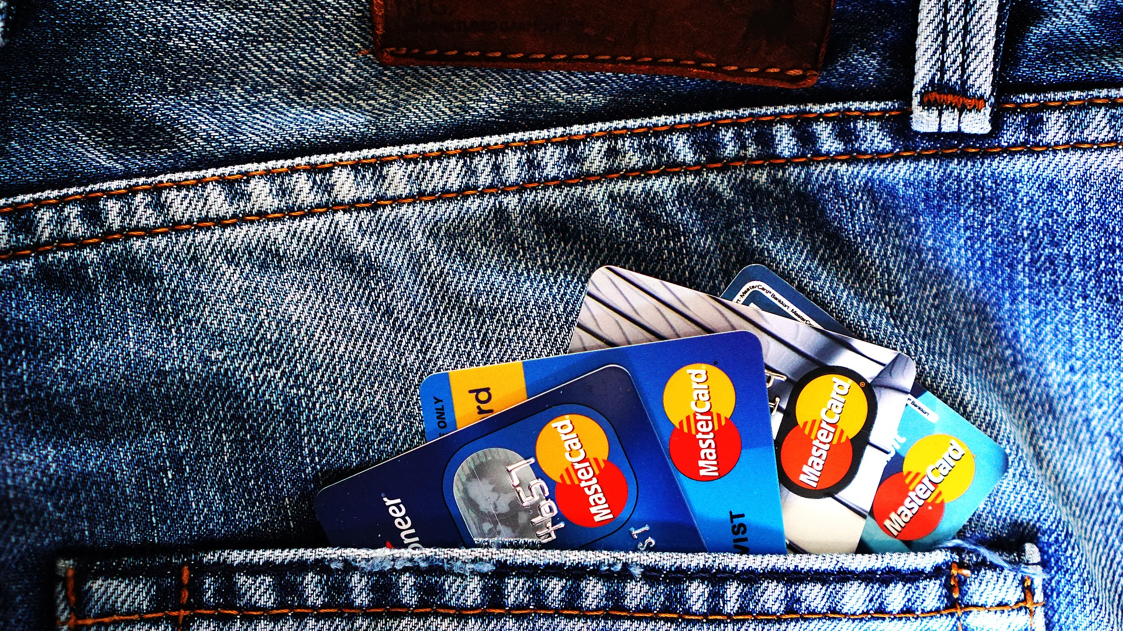
1+ Billion
Credit Card Transaction

Slide 16

14+
Million Nights Booked
In 24 Hours
#Ref: World Travel and Tourism Council

Slide 17


Slide 18

Do you find any Business IDEAS/ OPPORTUNITIES on Travel & Tourism Industry???

Slide 19

Meet
OFO
billion-dollar Chinese Bike-Sharing STARTUP

Slide 20


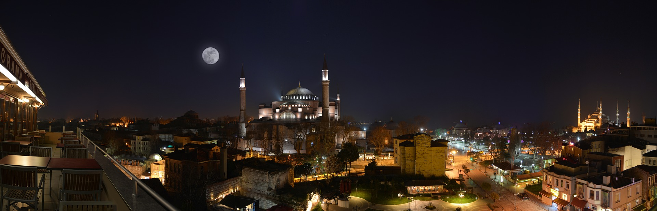

Tourism Divide
by
UNWTO(World Tourism Organization)
Natural based tourism
Cultural Based Tourism
Special Interest Tourism

Slide 21
Natural based Tourism
Ecotourism
Marine Ecotourism
Geo-Tourism
Agro-tourism
Astrological Tourism

Slide 22
Cultural Based Tourism
Cultural and Traditional Tourism
Historical Tourism
Rural Tourism

Slide 23
Special Interest Tourism
Health Tourism
Meditation Tourism
Ethnic Tourism
Sports Tourism
Adventure Travel
Home/Farm Stay
Long Stay
Incentive Travel
MICE (Meeting, Incentive, Conference, Exhibition)
Mixed tourism

Slide 24
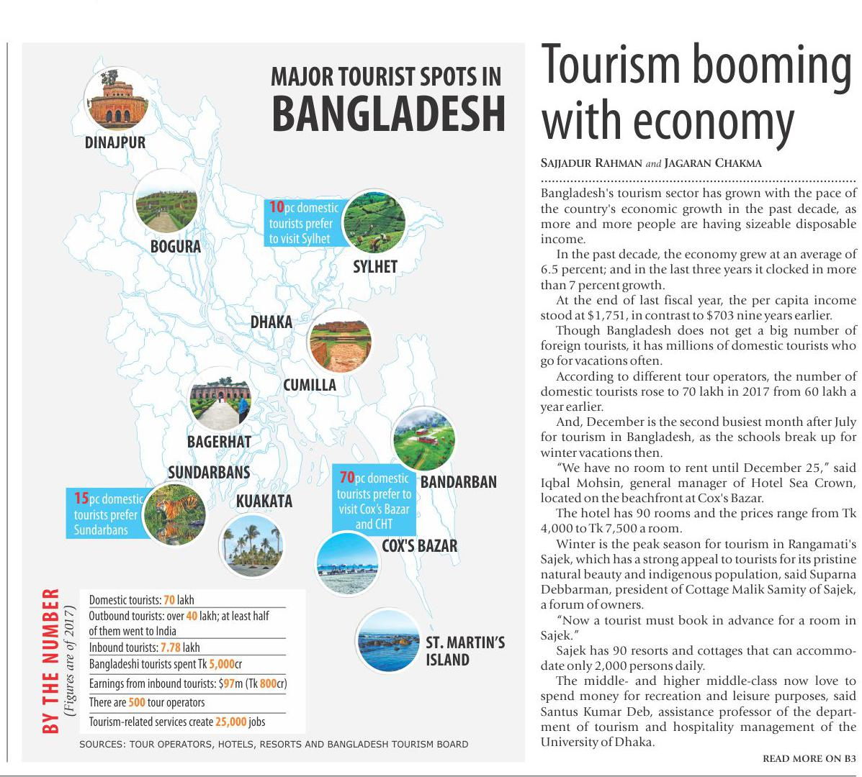
Source: The Daily Star

Slide 25

Innovations in
Hospitality and Tourism Industry

Slide 26




Today's Buzzwords
DIGITIZATION
DISRUPTION
SMART
CITY

Slide 27









Emerging Technologies
Big Data
Internet of Things
Blockchain
3D Printing
Artificial Intelligence
Cloud Computing
Augmented Reality
Virtual Reality

Slide 28











Digital Disruptions
7
of these companies didn’t exist
20
years
ago
World’s Largest Taxi Company
World’s Largest Hotel Company
World’s Largest Phone Company
World’s Most
Valuable Retailer
OWNS No Taxis
OWNS No Real Estate
OWNS No Telco Infra
OWNS Inventory
World’s Most
Popular Media
World’s Fastest
Growing Bank
World’s Largest
Software Vendor
World’s Largest
Movie House
OWNS No Contents
OWNS No Money
OWNS No APPS
OWNS No Cinemas

Slide 29

The hospitality industries which benefit from tourism include
transportation services (such as airlines, cruise ships, trainsand taxicabs)
hospitality services (such as accommodations, including hotels and resorts)
Entertainment venues (such as amusement parks, restaurants, casinos, shopping malls, music venues, and theaters)

Slide 30

Online Travel Agency (OTA)
specializes in offering planning sources and booking capabilities

Slide 31








Online Travel Agency (OTA)
Includes
Booking Holdings
……………..!!!

Slide 32





















Slide 33










World's Top Cities for Tourism
Hong Kong
29,827,200 arrivals
Bangkok, Thailand
23,688,800 arrivals
London, England
20,715,900 arrivals
Singapore
18,551,200 arrivals
Macau
18,931,400 arrivals
Country
Based on the Arrival in 2018
Paris, France
16,863,500 arrivals
Dubai, United Arab Emirates
16,658,500 arrivals
New York City, USA
13,500,000 arrivals
Kuala Lumpur, Malaysia
13,434,000 arrivals
Shenzhen, China
12,437,300 arrivals
# Ref: https://edition.cnn.com/travel/article/most-visited-cities-euromonitor-2018/index.html

Slide 34


Slide 35

QUESTION AND ANSWER

Slide 36
THANK YOU!

