Slide 1


Presentation on
Integrated Marketing Communication
@ Daffodil Family

Slide 2


Slide 3
Integrated Marketing Communication
All forms of communications & messages are carefully linked together
Integrating all the promotional tools, so that they work together in harmony
Integration of all marketing activities

Slide 4
Purpose of IMC
​
IMC leads to development & maintenance of a good COMPANY-CUSTOMER RELATIONSHIP

Slide 5
Importance of IMC
Help to pull the message together to ensure that the message is not disjointed and confusing.
Pay attention to every marketing message and every marketing piece that is distributed to ensure consistency, regardless of the channel.
Creative consistency & cost savings

Slide 6
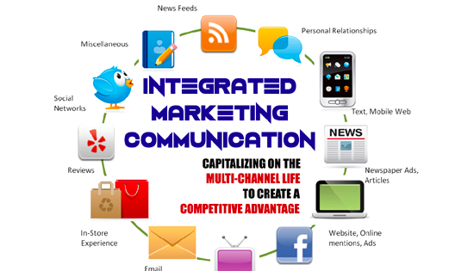

Slide 7
7 ways to create a successful integrated marketing campaign
Have a clear understanding of who your target audience is
Pick your channels
Have a consistent look
Create clear, consistent content that can easily be adapted or re-purposed to suit different media or channels
Ensure that your messaging is integrated
Make sure your marketing teams/agencies are working in sync
Don't forget to track your campaigns -- and coupons

Slide 8
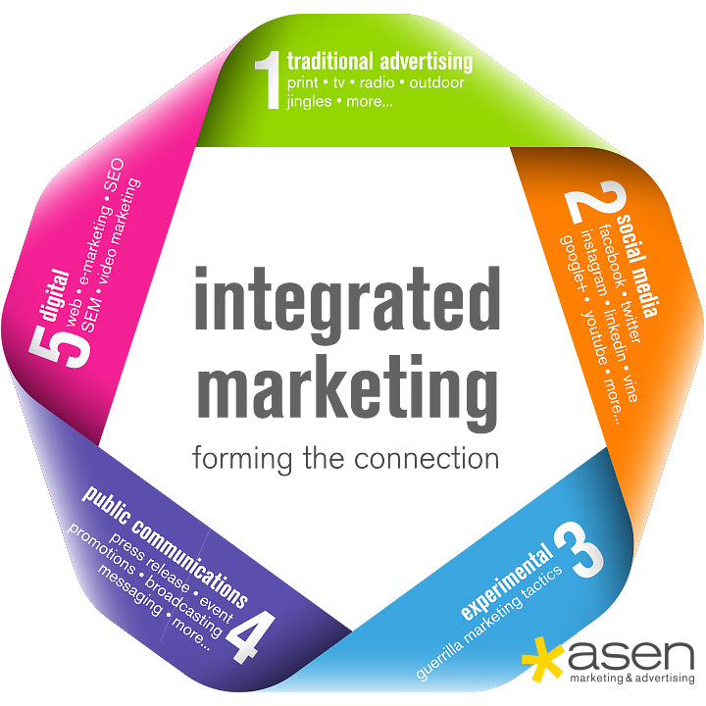

Slide 9
Integrated Marketing @ Daffodil Family

Slide 10
Let’s promote Daffodil
Instead of so many concerns

Slide 11

Call Center
16602

Slide 12


http://daffodil.family

Slide 13

https://fb.com/daffodil.com.bd

Slide 14

http://newsletter.daffodil.family

Slide 15
Lets Work Together for Integrated Marketing

Slide 16
Q & A

Slide 17
Thanks for Listening

