Slide 1


Slide 2

Industry Academia Linkage
BRIDGE the GAP

Slide 3

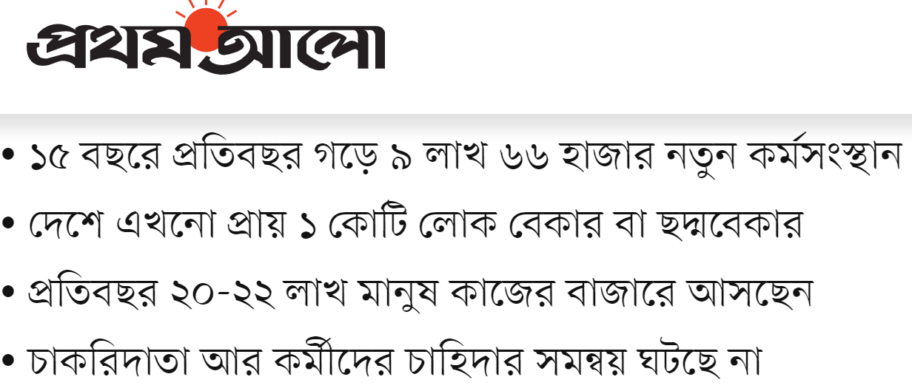



Slide 4


Slide 5


Slide 6


Slide 7

UNIVERSITIES
are busy in producing the
GRADUATE
only!
Lacking SOFT SKILLS & HARD SKILLS
#PROBLEM

Slide 8


Slide 9





Government has taken a lot of great initiatives on Employment Creation
and
Entrepreneurship DEVELOPMENT!

Slide 10
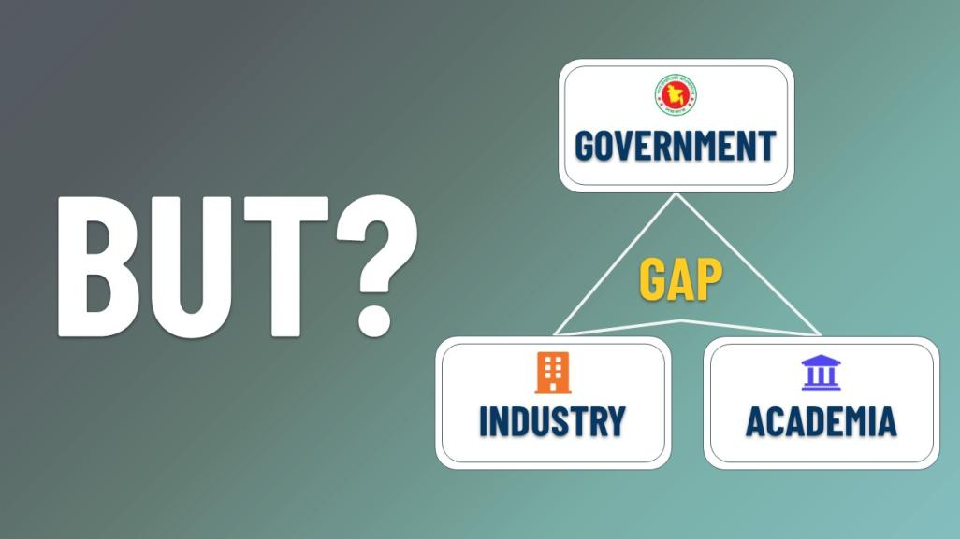

Slide 11
Strong Industry Academia Collaboration could make Government's efforts more worthy, easier, efficient & effective.

Slide 12
Government Should :
Encourage UNIVERSITIES to fulfilled industry need
Find out which universities follow the OUTCOME BASED LEARNING
Access the institutes by analysing their values to their PEOPLE, SOCIETY, COUNTRY and uplift country in the GLOBAL ARENA.

Slide 13


Slide 14


Slide 15


Slide 16

GLOBAL BEST PRACTICES

Slide 17
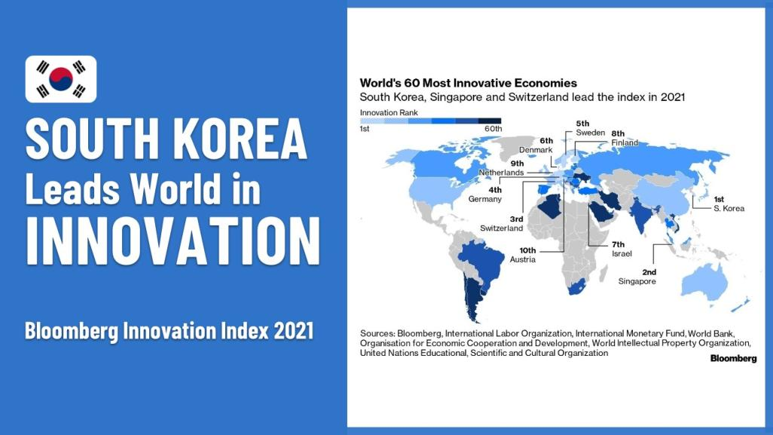

Slide 18


Slide 19
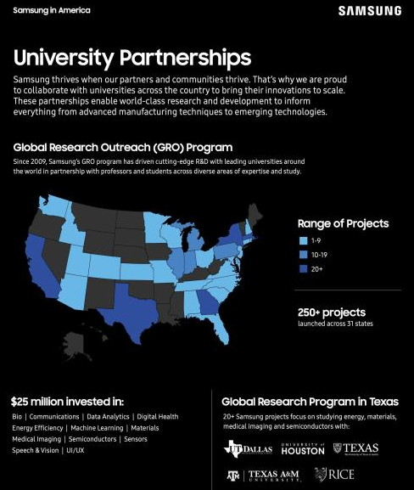


SAMSUNG STRATEGY AND INNOVATION CENTER (SSIC) UNIVERSITY RELATIONS TEAM
builds relationships with key
UNIVERSITY RESEARCH CENTERS
for keeping abreast of cutting-edge ACADEMIC RESEARCH, COLLABORATE WITH OUTSTANDING PROFESSORS, AND RECRUIT BRILLIANT ENGINEERS AND SCIENTISTS
to become the NEXT MEMBERS of their team.

Slide 20
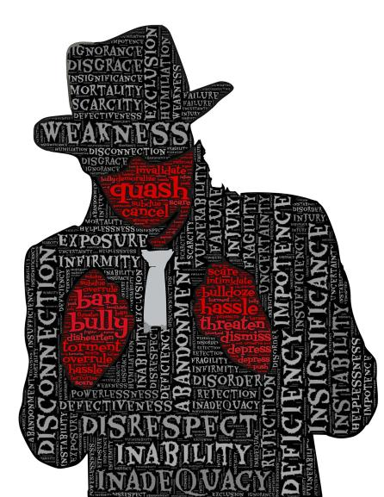
Many ENTREPRENEURS and GREAT INNOVATIONS FAILED❌because of having
RIGHT WORKFORCE!

Slide 21
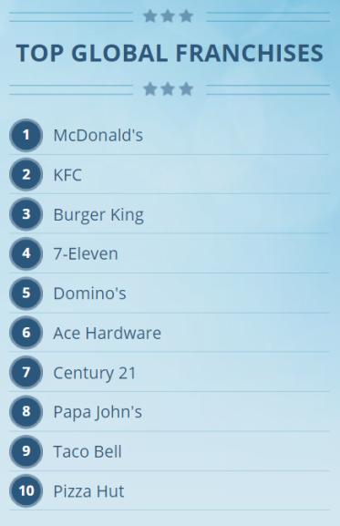

Among top 100 GLOBAL FRANCHISES,
93
are from
UNITED STATES OF AMERICA
Source: https://www.franchisedirect.com/top100globalfranchises

Slide 22
WHY?

Slide 23
WHY?
Because they FOCUS on CREATING A SYSTEM
by which they can
OPERATE, RUN and CONTROL
from
ANYWHERE IN THE WORLD

Slide 24

WEALTHY PEOPLE in USA donate money to UNIVERSITIES instead of donating to existing charities.

Slide 25
WHAT ABOUT US? How may we create such a culture for the bettermentment of OUR EDUCATION SYSTEM and FUTURE GENERATION?

Slide 26

We have the lack of INDUSTRY DATA and VISUAL ANALYTICS by which we might find the problems need to be solved for different SECTORS!

Slide 27

RECOMMENDATIONS

Slide 28

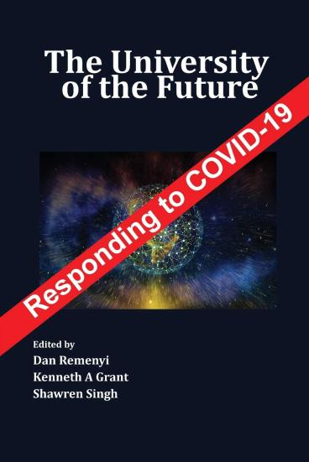

Every
UNIVERSITIES
have some UNIQUENESSES, some BEST PRACTICES…

Slide 29

Ministry
of
Education
University
Grants Commission
A BOOK can be PUBLISHED comprising the best practices of different PRIVATE & PUBLIC UNIVERSITIES in BANGLADESH
on a yearly basis...

Slide 30
Ministry
of
Education
University
Grants Commission
All the UNIVERSITIES can LEARN FROM EACH OTHERS, COLLABORATE WITH EACH OTHERS and IMPLEMENT for the betterment of the
NEXT GENERATION

Slide 31

Ministry
of
Education
University
Grants Commission
Ministry of Education and UGC should recognise the BEST PRACTICES of the UNIVERSITIES which will create a competitive culture and it will support our Education System’s Exposure.
RECOGNITION

Slide 32

AGAIN…
INDUSTRIES
can share their BEST PRACTICES
with the
ACADEMICIANS
as
CASE STUDY

Slide 33

Many INDUSTRIES usually recruit
FOREIGNERS as SKILLED MANPOWER to run the Operations- which should be documented properly and their EFFICIENCY and CONTRIBUTIONS should be reflected in a proper way...

Slide 34
Many INDUSTRIES usually recruit
FOREIGNERS as SKILLED MANPOWER to run the Operations- which should be documented properly and their EFFICIENCY and CONTRIBUTIONS should be reflected in a proper way...
These should be shared with the ACADEMIA so that in future they can produce the BEST CANDIDATES and our INDUSTRIES demand will be fulfilled.

Slide 35

DCCI can be in support of BRIDGING all these GAPS

Slide 36
CHAMBERS can invite INDUSTRIES to figure out:
  What PROBLEMS they are facing?
  What sort of SOLUTIONS they need?
  What sort of WORKFORCES they need?
  What new COURSES can be adopted?

Slide 37
CHAMBERS can consult with UNIVERSITIES on:
  The INDUSTRY needs.
  Sector specific TRENDING ISSUES.
  Skilled WORKFORCES development.
  What new COURSES can be adopted?

Slide 38
DCCI can also
CREATE more STANDING COMMITTEES
based on the NEED...

Slide 39
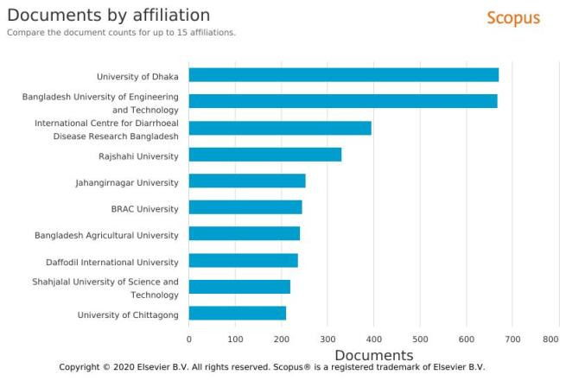
CHAMBERS should involved with ACADEMIA’s in RESEARCH
to make them COMMERCIALLY VIABLE

Slide 40
Ministry
of
Industries
Dhaka Chamber of Commerce & Industry
Ministry
of
Commerce
Dhaka Chamber of Commerce & Industry
in collaboration with Ministry of Industries and Ministry of Commerce should recognise the BEST PRACTICES of the INDUSTRIES which work closely with academia to produce the best HUMAN RESOURCES for the COUNTRY
RECOGNITION

Slide 41




INDUSTRY ACADEMIA LINKAGE
ACADEMIA
INDUSTRY
COLLABORATE to UNDERSTAND
CHAMBERS
COMMUNICATE to IMPLEMENT
MOEDU
UGC

Slide 42
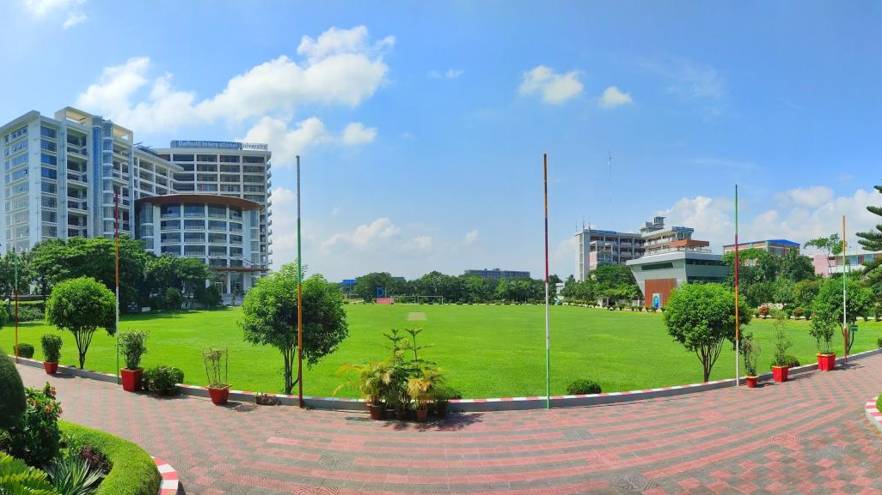
Response from
DAFFODIL INTERNATIONAL UNIVERSITY
to support
INDUSTRY-ACADEMIA RELATIONSHIPS
in
BANGLADESH

Slide 43

First of its kind in whole Bangladesh***

Slide 44


Slide 45


Spurs
the Innovation
Daffodil Business Incubator (DBI)

Slide 46


Bangladesh Venture Capital Limited (BVCL)

Slide 47
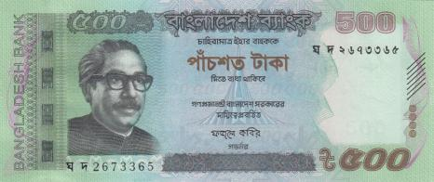
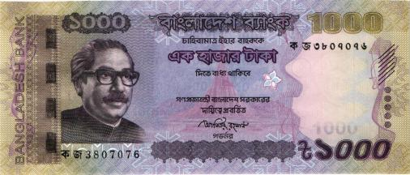
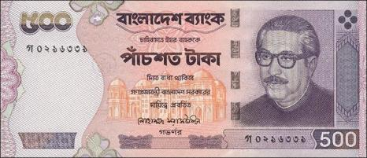

ENTREPRENEURSHIP DEVELOPMENT FUND
It is allocated as a loan for the business development/ initiation purposes, or, business support services and grooming services. It is also considered as the R&D for students’ projects.

Slide 48
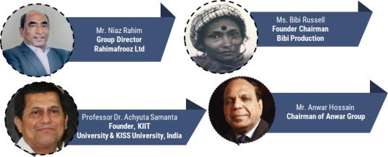
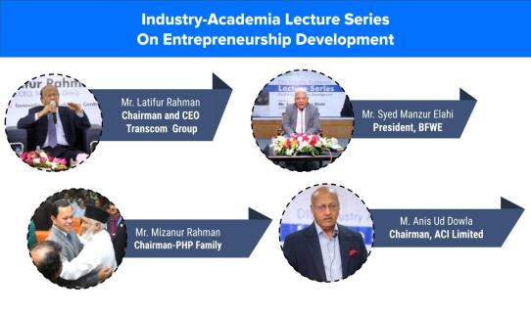
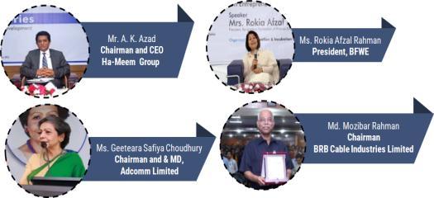
Industry-Academia Lecture Series on Entrepreneurship Development
Founder
KIIT University & Kalinga Institute of Social Sciences (KISS)
Chairman and Managing Director

Slide 49
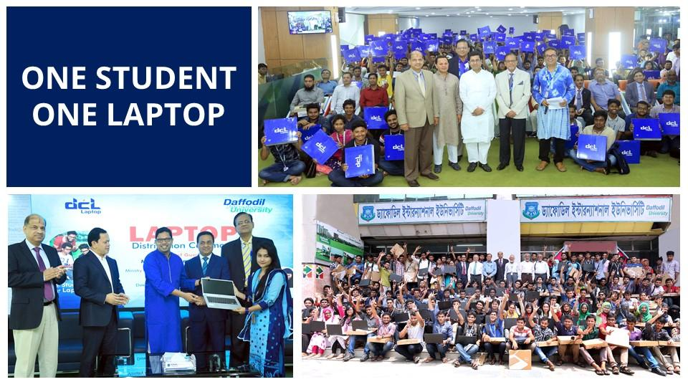

Slide 50



1-Card solution provides unified permissions, credentials, payments, and security across campus.

Slide 51
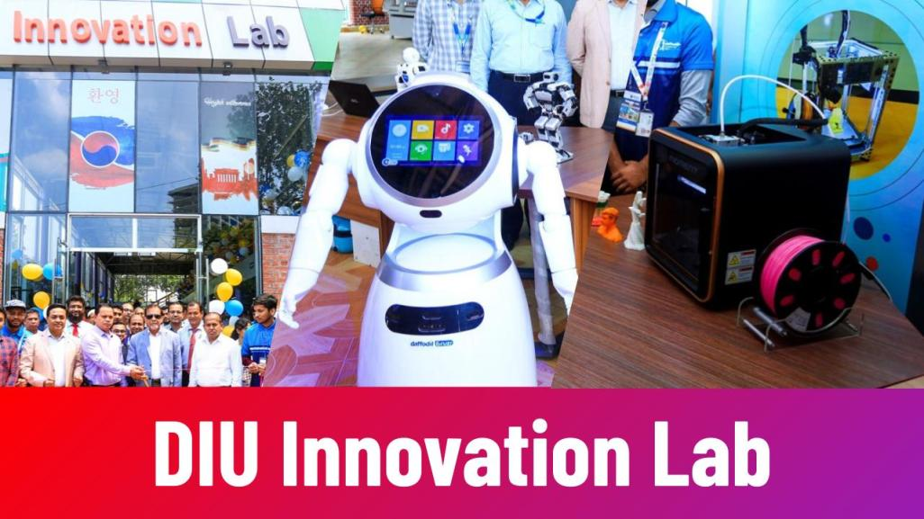

Slide 52

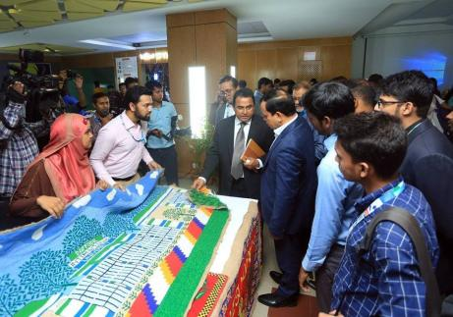
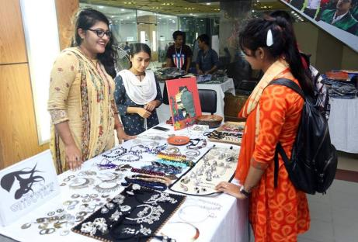
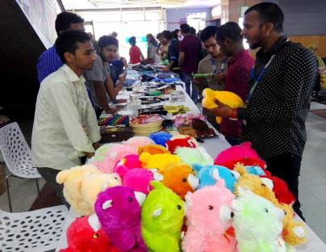
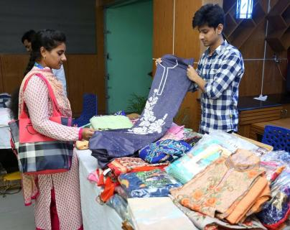

Slide 53
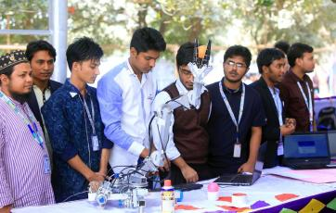
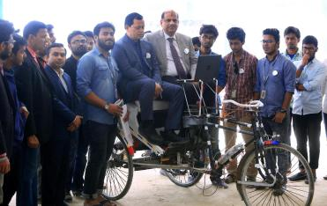
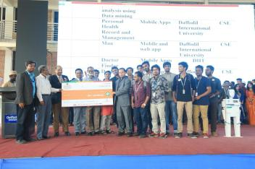
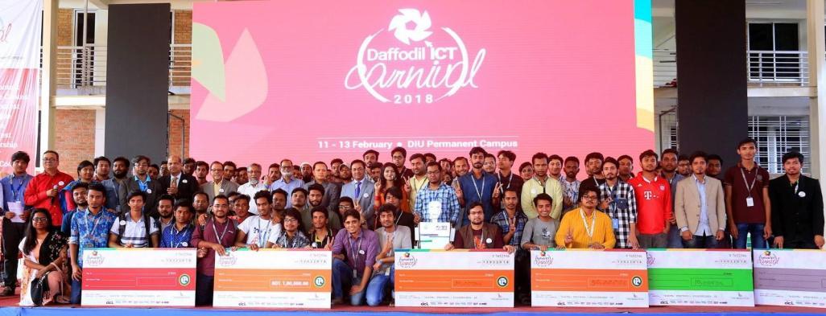

Daffodil ICT Carnival

Slide 54
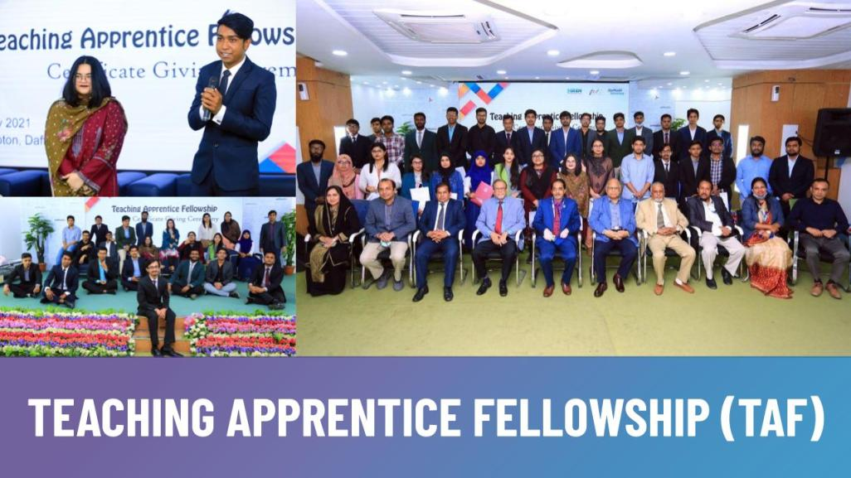

Slide 55
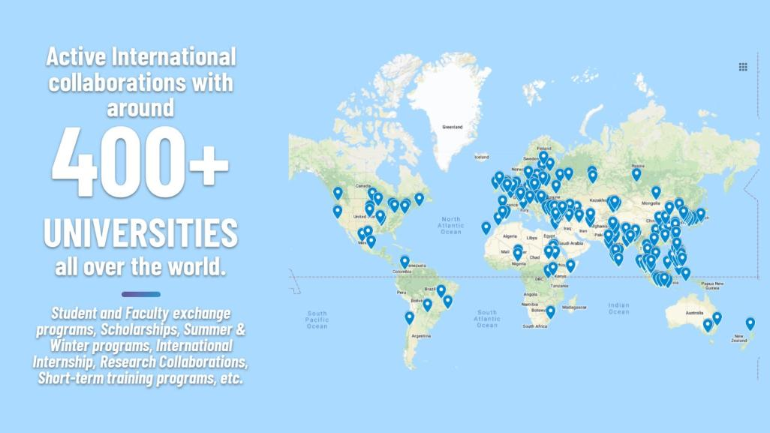

Slide 56


Slide 57







SKILL DEVELOPMENTS
CCR
CELL for
CORPORATE RELATIONSHIP

Slide 58
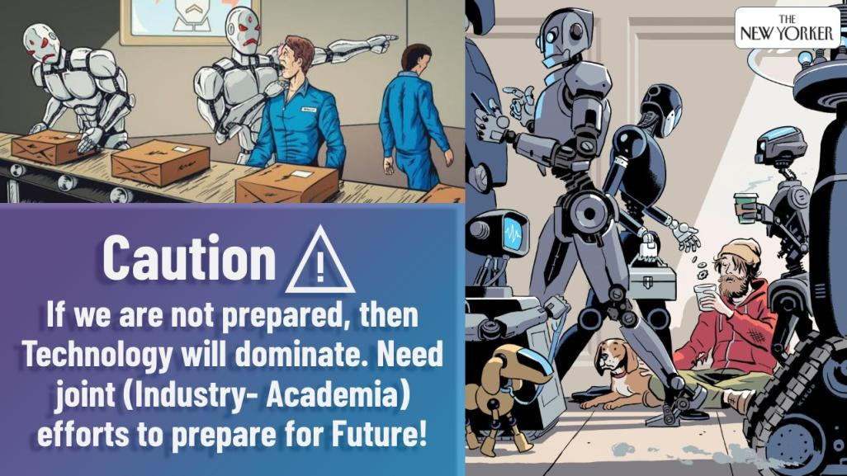

Slide 59
Thank You!!!

