Slide 1
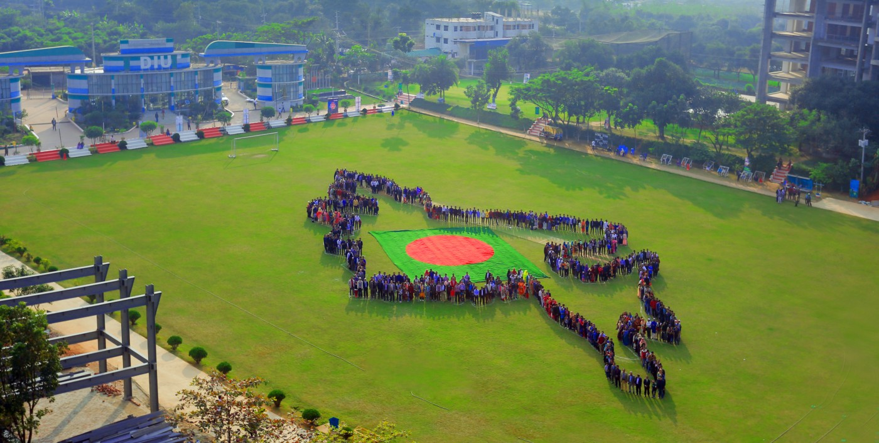

DAFFODIL FAMILY DAY &
CHANGE TOGETHER
2020
Md. Sabur Khan
Chairman
Daffodil Family

Slide 2

We Believe in Family Values

Slide 3
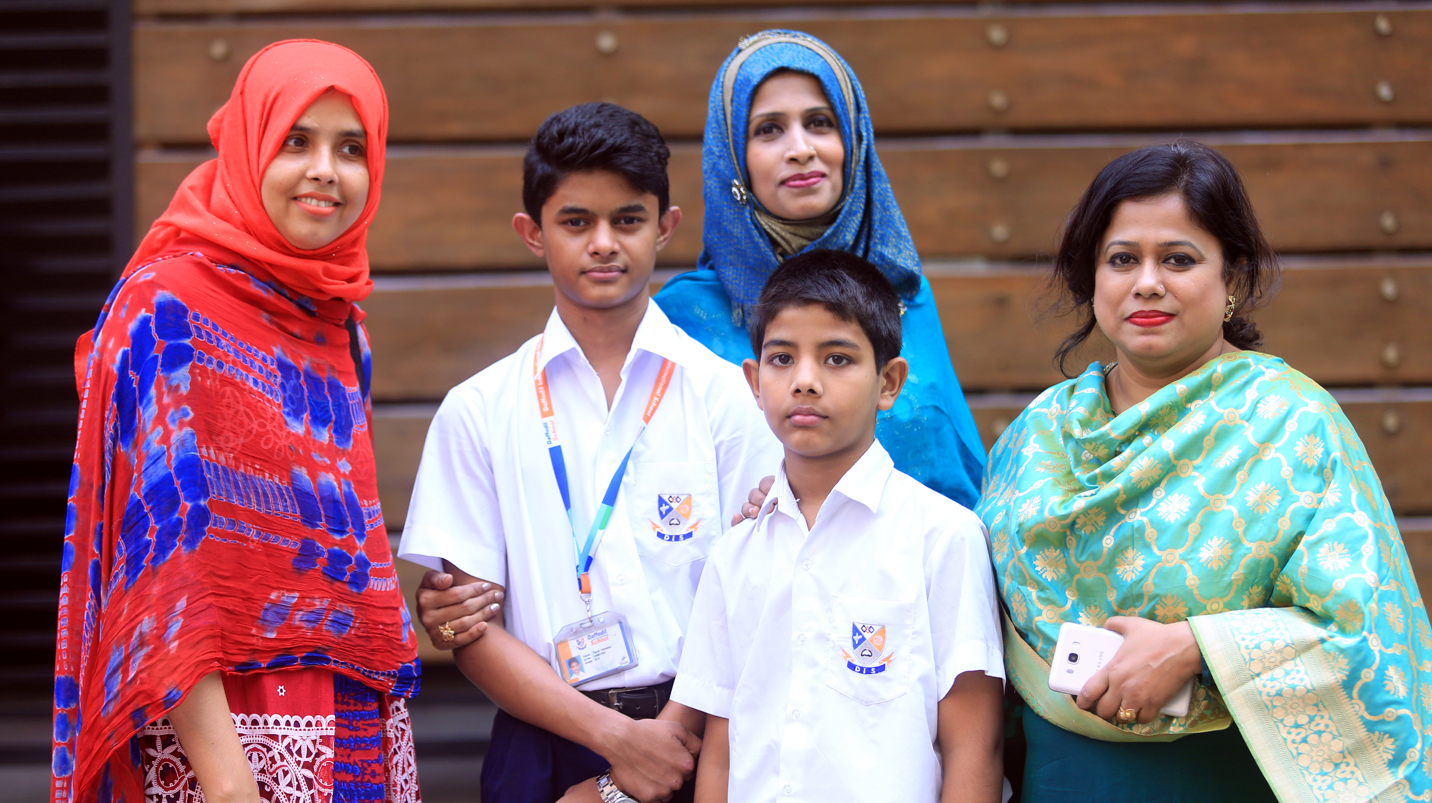
We Value Our
Students & Guardians

Slide 4


Slide 5

Teacher – Student Relationship
Image Source : https://www.quietrev.com/theres-more-to-class-participation/

Slide 6

Ensure Policies with Effectiveness
Image Source: https://www.ucl.ac.uk/public-policy/

Slide 7

Add Value:
To the Students
To the Guardians
Image Source: https://jbarrows.com/blog/five-ways-sales-can-add-value/

Slide 8

Source: https://www.globalcareercounsellor.com/blog/how-can-a-teacher-help-in-student-career-guidance/
Use of
Technology
Image Source: https://www.withum.com/resources/an-eye-opening-look-inside-a-healthcare-cyberattack-incident/

Slide 9

Technology Based Education
Image Source: https://elearningindustry.com/online-learning-advantages-online-learning-offers-plenty-incentives

Slide 10

Source: https://www.globalcareercounsellor.com/blog/how-can-a-teacher-help-in-student-career-guidance/
Market Based Curriculum
Image Source: https://piqconline.com/course/outcome-based-education-academic-quality-assurance/
Source: https://www.withum.com/resources/an-eye-opening-look-inside-a-healthcare-cyberattack-incident/

Slide 11

Source: https://www.globalcareercounsellor.com/blog/how-can-a-teacher-help-in-student-career-guidance/
Student Engagement in Job Market
Student Engagement in
Job Market
Source: https://www.withum.com/resources/an-eye-opening-look-inside-a-healthcare-cyberattack-incident/
Image Source: https://piqconline.com/course/outcome-based-education-academic-quality-assurance/

Slide 12

Source: https://www.globalcareercounsellor.com/blog/how-can-a-teacher-help-in-student-career-guidance/
Student Engagement in Job Market
Source: https://www.withum.com/resources/an-eye-opening-look-inside-a-healthcare-cyberattack-incident/
Image Source: https://www.jobberman.com/blog/career-counselling/

Slide 13
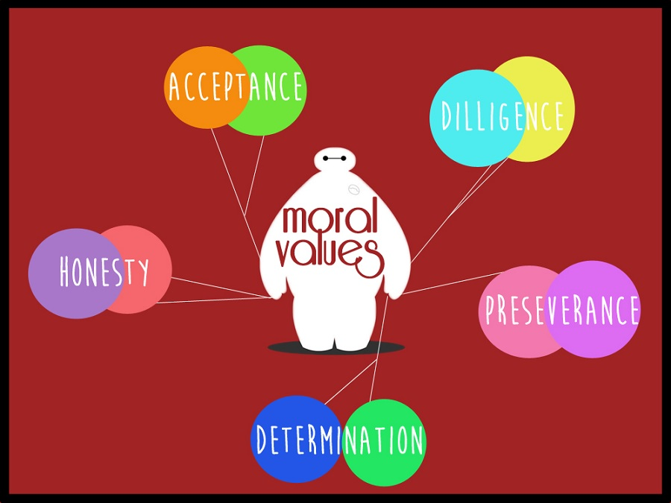
Image Source: https://www.globalcareercounsellor.com/blog/how-can-a-teacher-help-in-student-career-guidance/

Slide 14

Add Value:
To the Students
To the Guardians
Teachers Need To Develop Themselves
Image Source: https://inspirationforgood.com/product/online-mentoring-coaching/

Slide 15
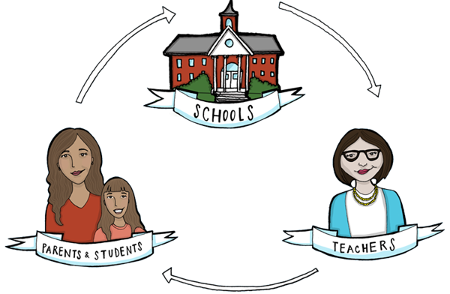
Stay Connected to Keep Sound Relationship

Slide 16

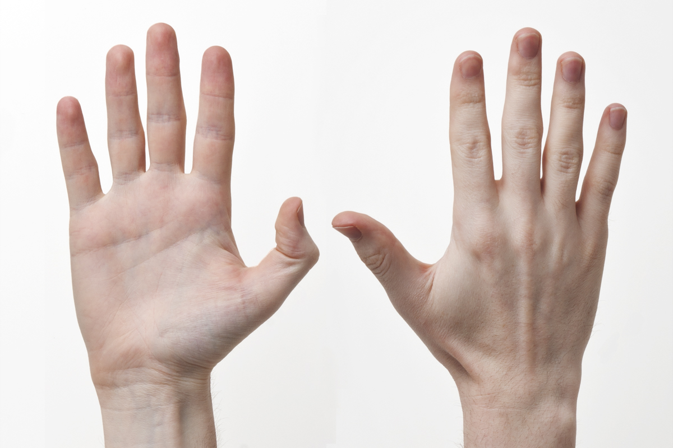
Every Human Has an Unique Identity

Slide 17

Greet
Each Other
Image Source: https://guernseydonkey.com/why-do-we-shake-hands-as-a-greeting/

Slide 18

Target 100% Good Result of Students:
Academic & Board Result
Image Source: https://alecanmarketing.com/blog/what-business-owners-can-do-negative-yelp/

Slide 19

কর্মস্থলে ফাঁকি দেয়া ভিষণ গুনাহের কাজ
Target 100% Good Result of Students:
Academic & Board Result
Your Success & Satisfaction Depend on Your Work & Honesty in Your Workplace
Image Source: https://beingbriannon.wordpress.com/2019/08/11/flexibility-in-the-workplace-the-future-of-work/

Slide 20

Target 100% Good Result of Students:
Academic & Board Result
Everyone has their Specific Field to Contribute

Slide 21

Contribute & Be a Part of Our Achievements
Image Source: https://blog.structuredweb.com/2016/10/17/structuredweb-appoints-new-vp-of-services-and/

Slide 22


Who Will Take The
Take the Responsibility to Implement the Ideas…
Image Source: https://www.brightermonday.co.tz/blog/happiness-workplace/
Image Source: https://www1.guff.com/a-new-study-reveals-why-you-should-stop-trying-to-be-happy-at-work/

Slide 23

Who Will Take The
Take the Responsibility to Implement the Ideas…
Image Source: http://job-envie.com/nl/faq-2/

Slide 24

Thank You

