Slide 1

ENTREPRENEURIAL JOURNEY
-
Constraints & Opportunities

Slide 2

Can you RELATE yourself with the MAN in the
VIDEO?

Slide 3
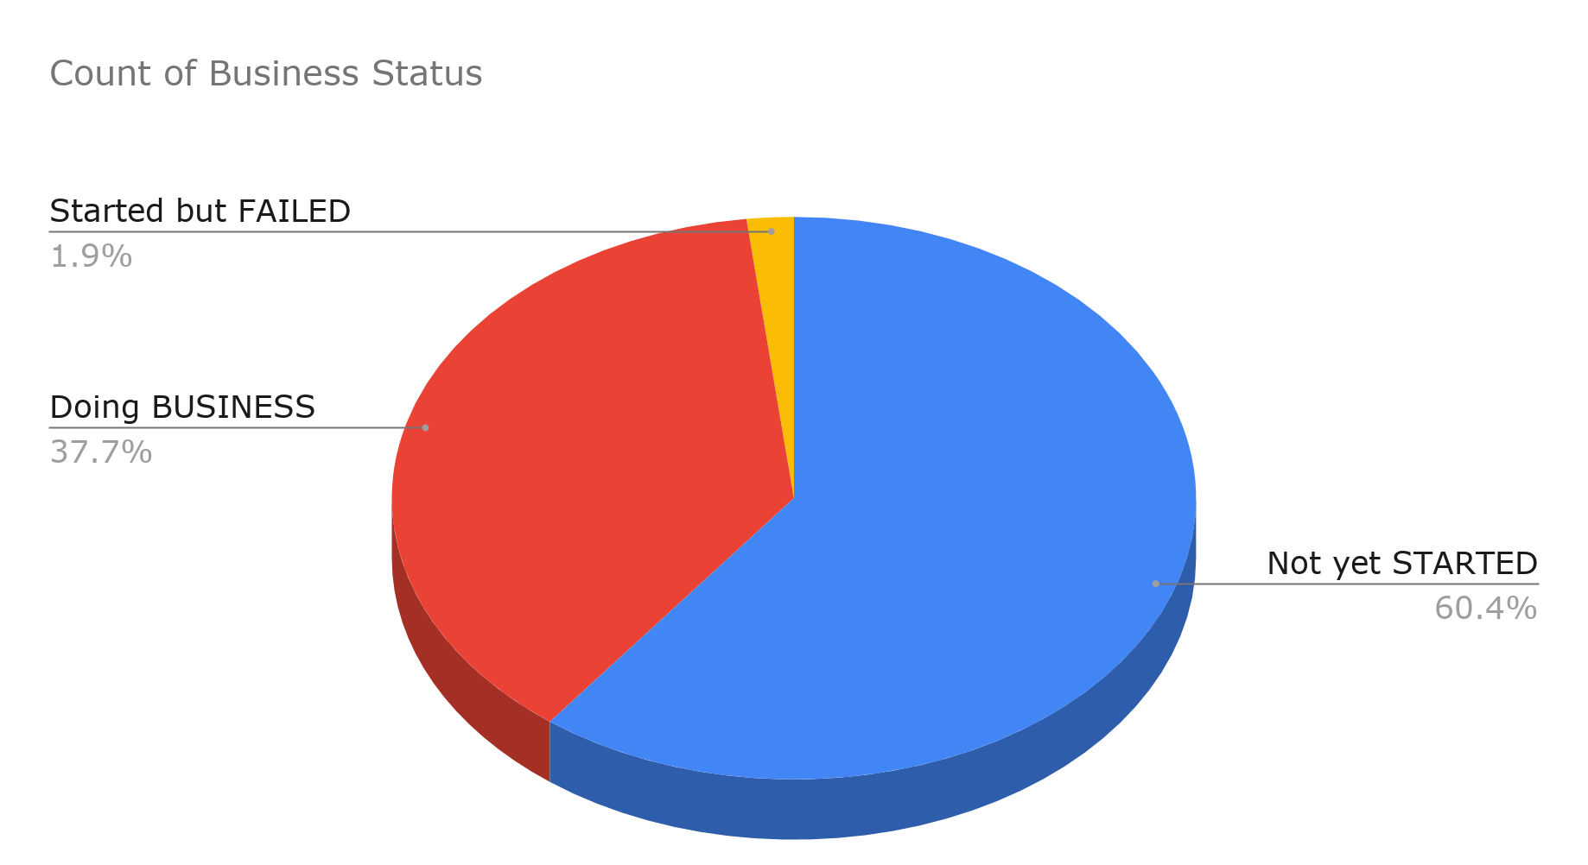
Total students and Business Status (Running Students)

Slide 4

Let me ANSWER your QUERIES...

Slide 5

How can I start and sustain the business with LITTLE INVESTMENT?

Slide 6

Which was the problem you have face?
Where could you get the idea from to startup Daffodil Computers Ltd
???

Slide 7

Overcoming Obstacles in the initial Stages
for the
STARTUPS

Slide 8

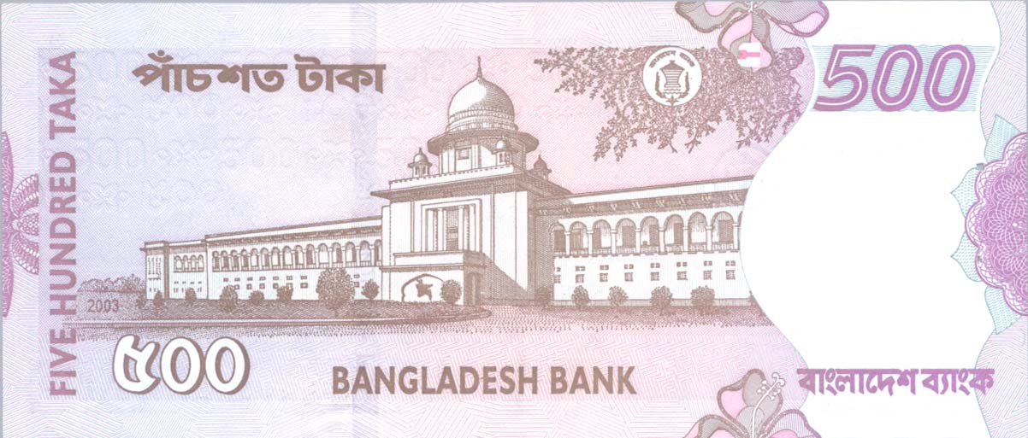
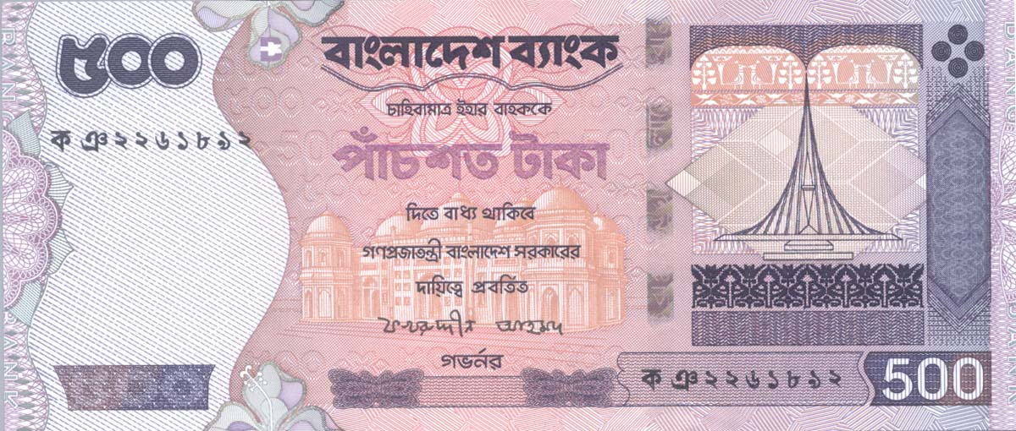
Overcoming Financial Crisis and Challenges in the Early Stage

Slide 9

What should we
DO NOT DO
as a startup?

Slide 10

What
PERSONALITY TRAITS
do
BUSINESSMAN need to be successful?

Slide 11
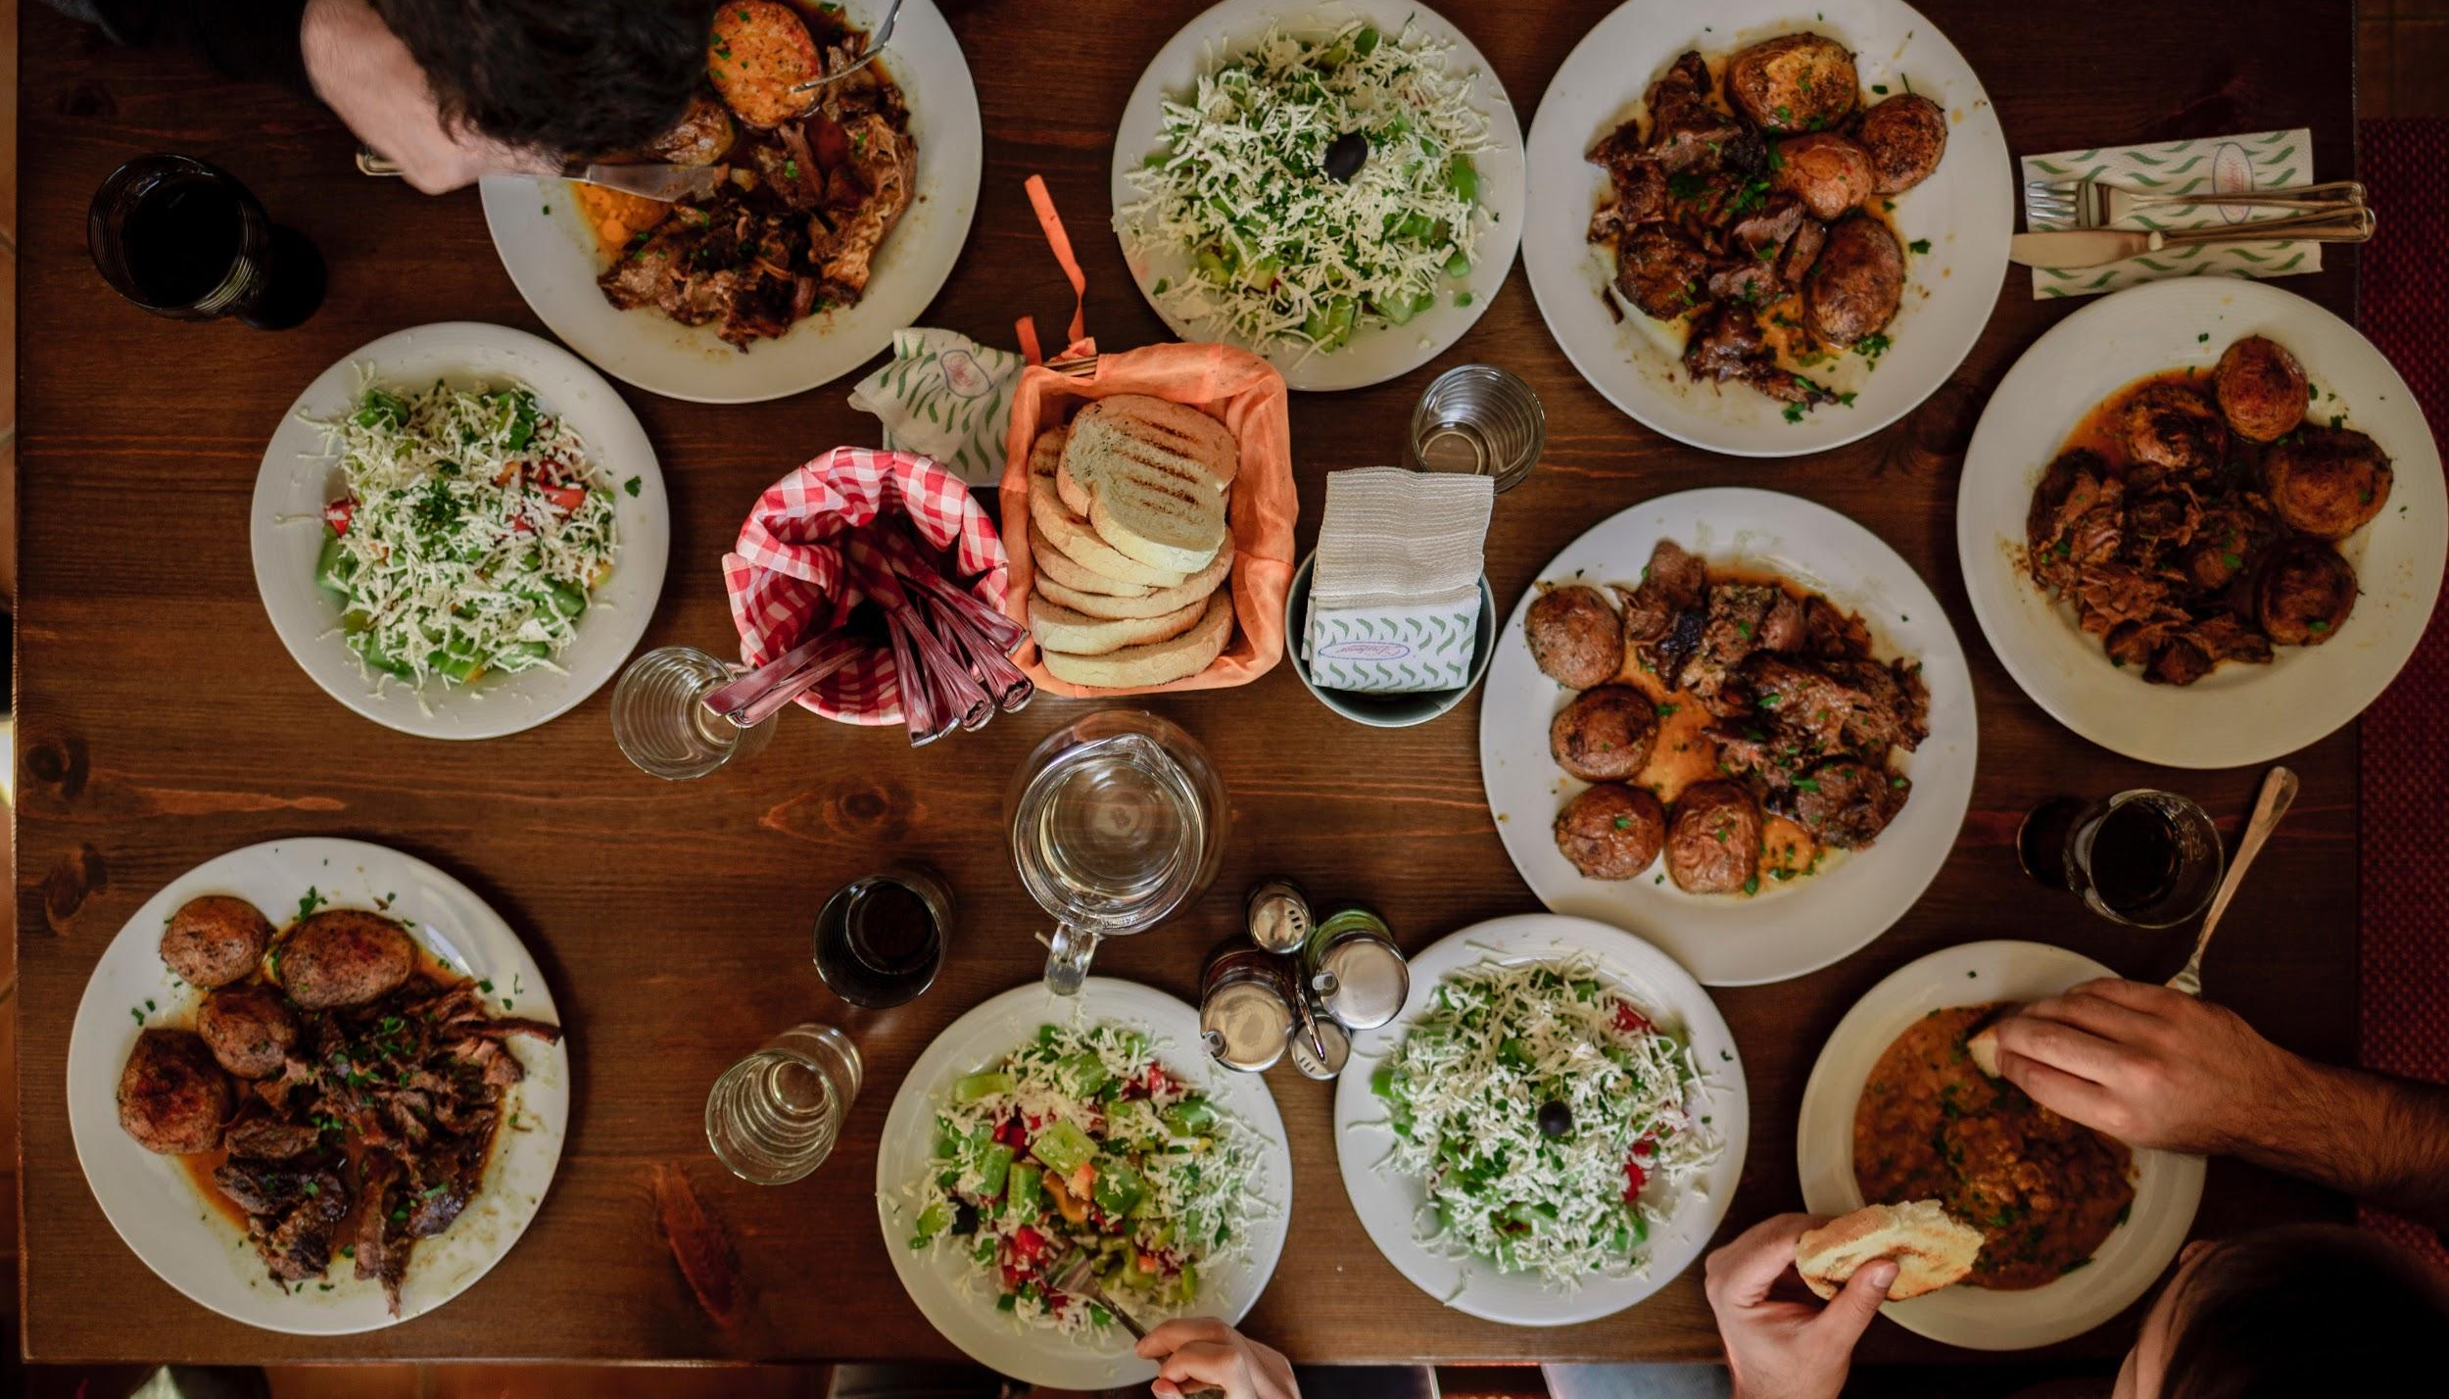
In RESTAURANT BUSINESS, there are lots of COMPETITION.
What could be the strategy to Differentiate my BUSINESS than the Competitor?

Slide 12

How to deal with co-founders that aren't serious in venture? [If the equity stakes are equally distributed through verbal commitment]

Slide 13

MARKETING
strategies
for
NEW STARTUPS

Slide 14
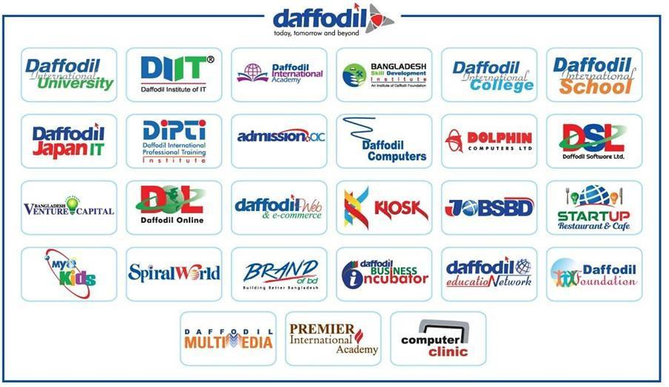
CONTRIBUTORS

Slide 15





Bangladesh Venture Capital Limited
Proper UTILIZATION
of our RESOURCES
Daffodil Business Incubator
Entrepreneurship Development Fund
Innovation Lab
Startup Market

Slide 16
THANK YOU!

