Slide 1
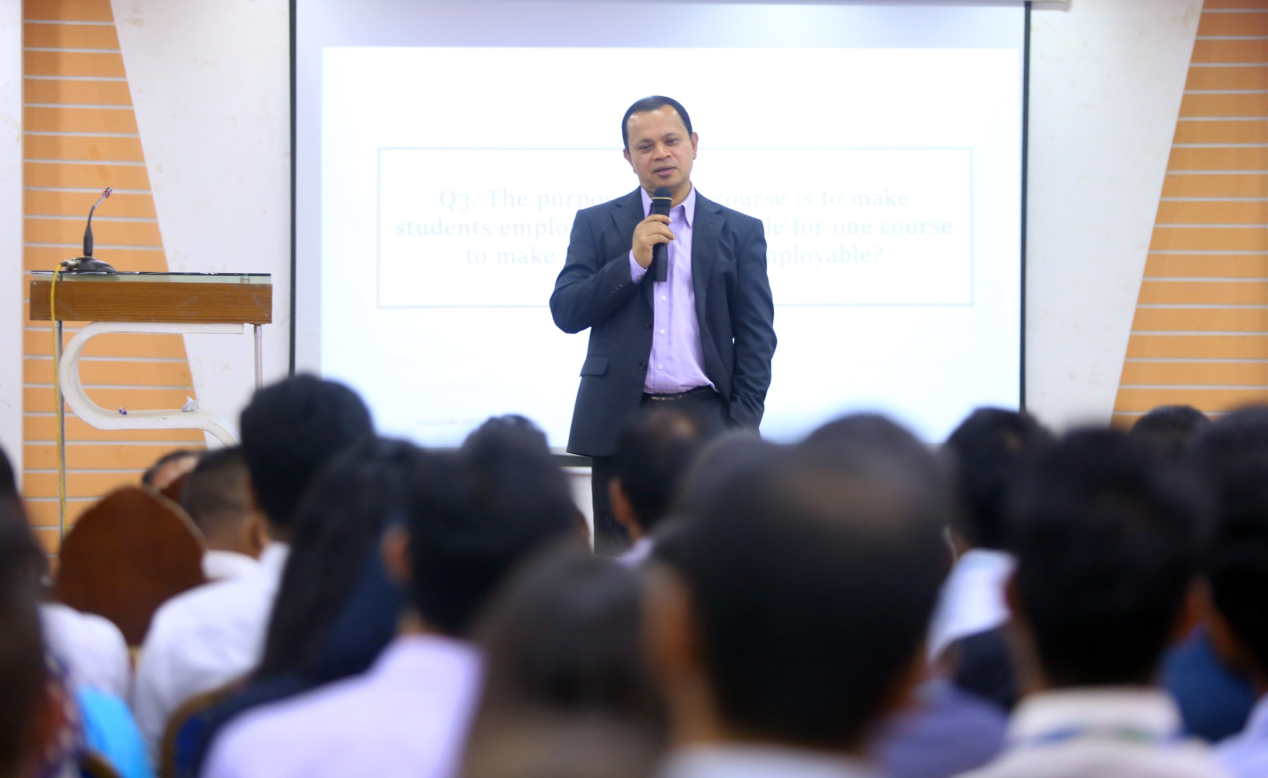

A Session on Employability 360º
-Md Sabur Khan
Chairman BoT, Daffodil International University

Slide 2

Start working now, don’t wait for the perfect job to come to you.

Slide 3
Find a work and see if it matches your capabilities. Show them your skills, don’t just ask for a job.

Slide 4
Do a SWOT analysis of yourself then create a plan of action to promote your skills and overcome your shortcomings.

Slide 5
Start working whatever or wherever you can. Don’t limit yourself in your comfort zone. You will not get any money or respect unless you prove your worthiness.
So, dream big but start small.

Slide 6
Never complain about anything or blame others. Don’t live in the past and stop negative self-talking.

Slide 7
Take criticisms positively otherwise it will demoralize you. Absorb the criticism and take them as a challenge.

Slide 8
Select your desired companies and find ways to communicate with their key people.

Slide 9
If anyone says NO, please remember NO means next opportunity. Every rejection brings an opportunity. Keep communicating.

Slide 10
Be involved in different associations and clubs such as – HR Association, Rotary Club, etc. Be extrovert, help people, serve voluntarily, be proactive, love people; opportunities will knock you ultimately.

Slide 11
Question & Answer

