Slide 1

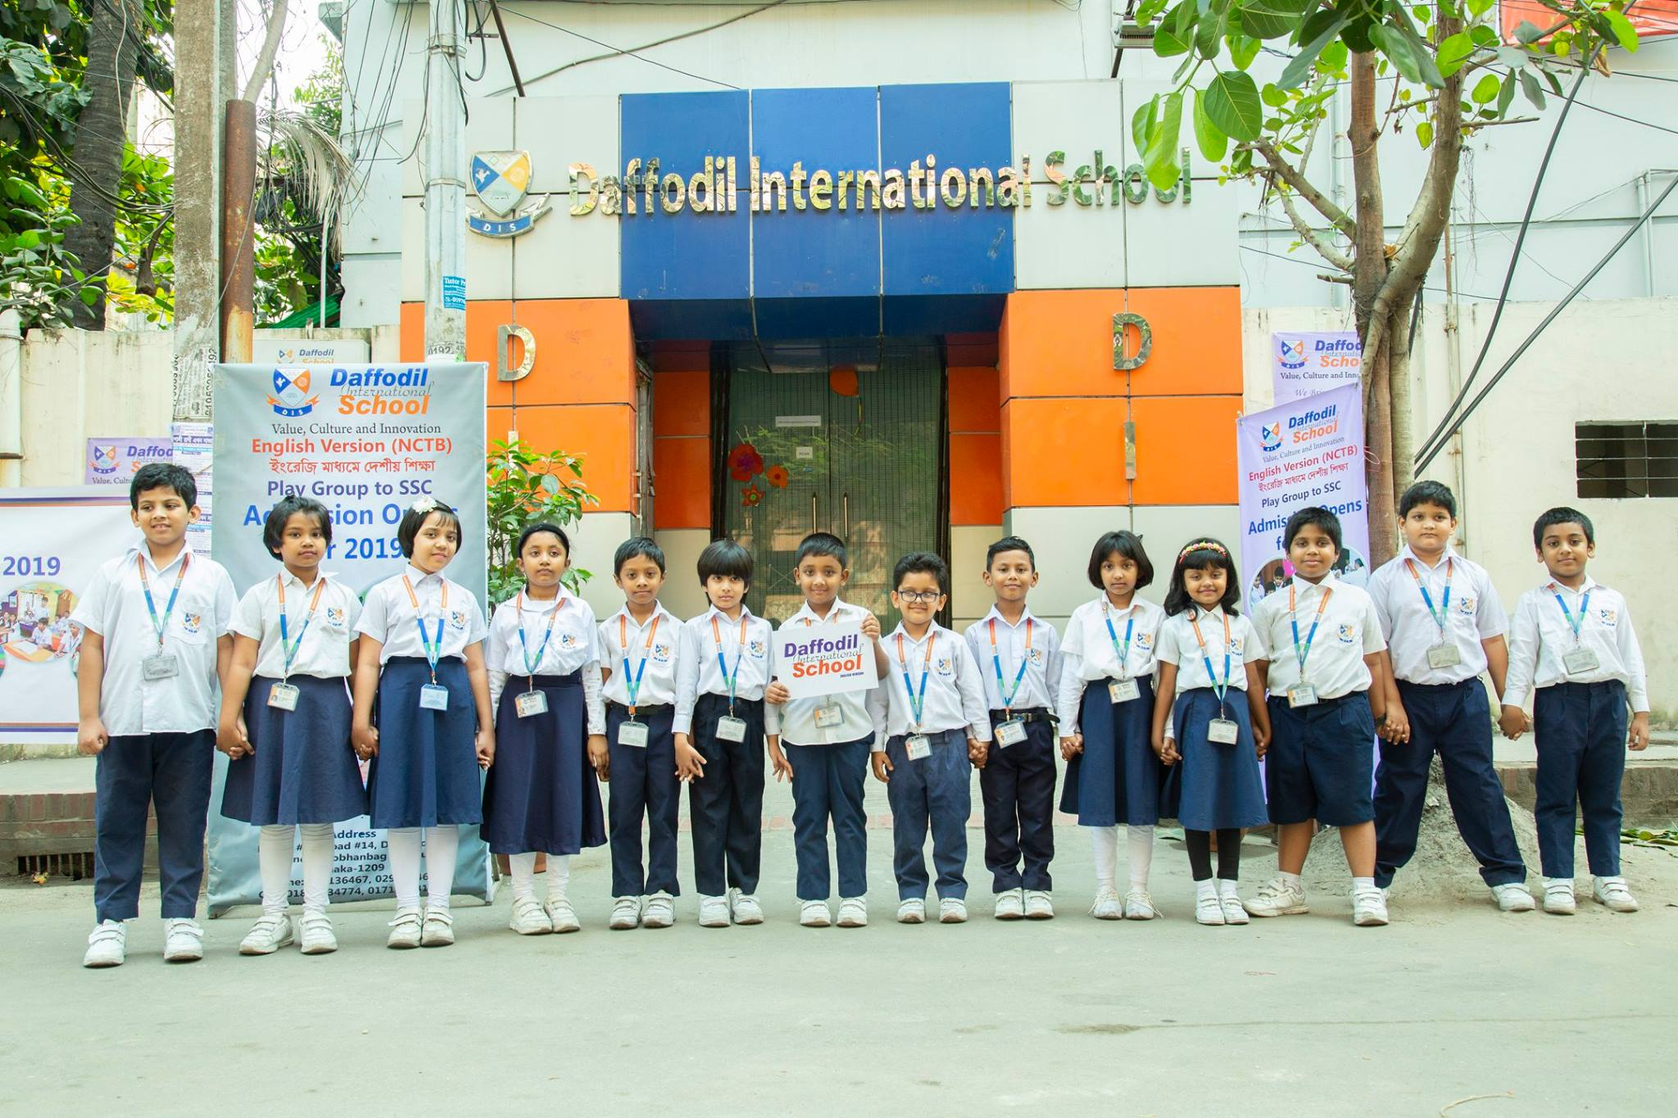


DIS & DIC
Teachers Training For Quality Enhancement
Conducted by
Md. Sabur Khan
Chairman, BoT
Daffodil International University

Slide 2


Slide 3
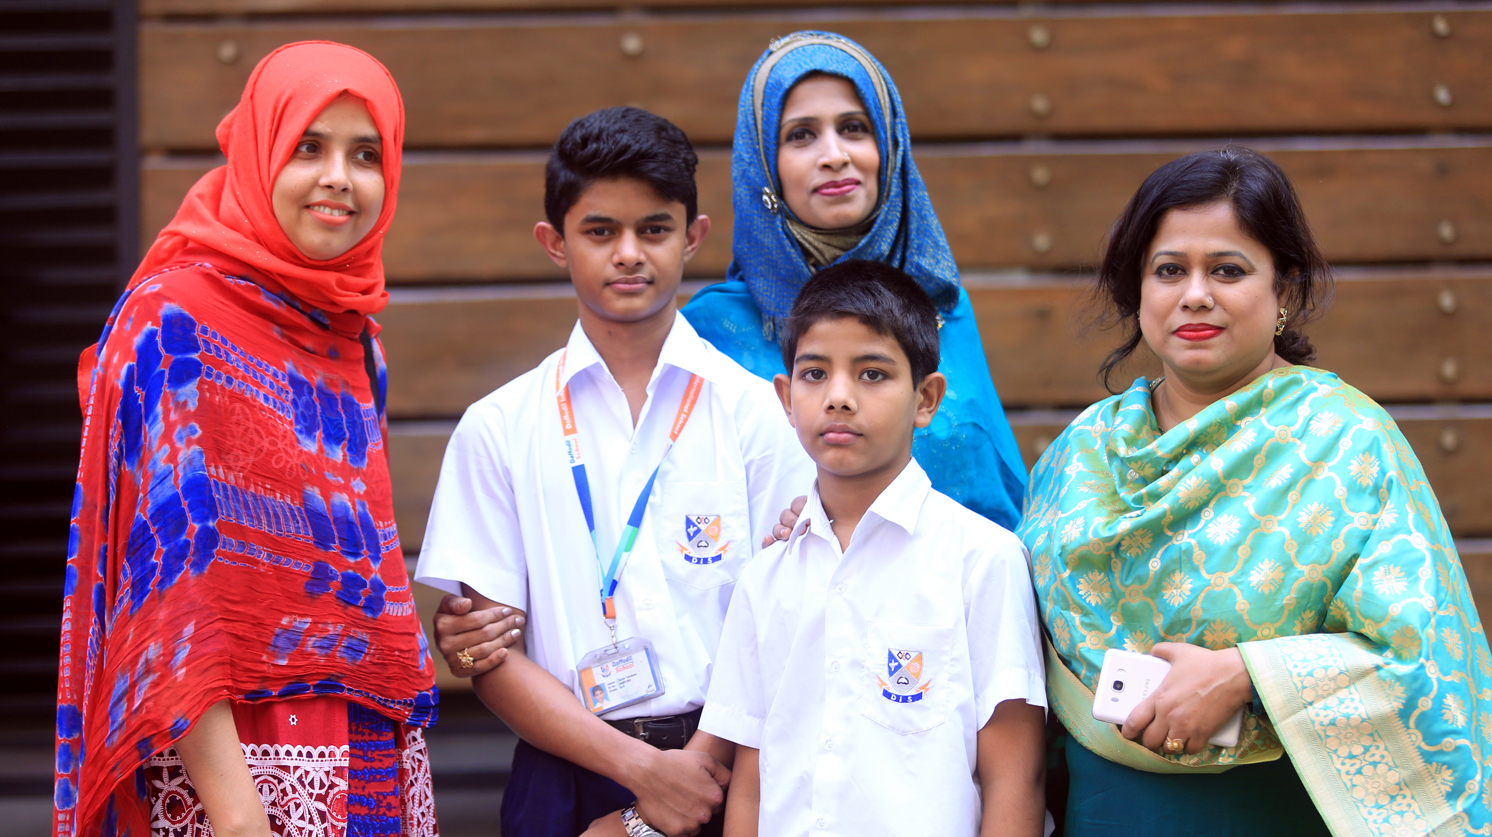
Guardians Are The Heart of a
School & College

Slide 4

Build a Good Relationship with Guardians
Source: https://learningfirst.org/blog/teacher-shows-how-communication-parents-more-grade

Slide 5

Survey on Parents’ Opinion
Parent’s Satisfaction
Parent’s Demand
Parent’s Suggestion

Slide 6
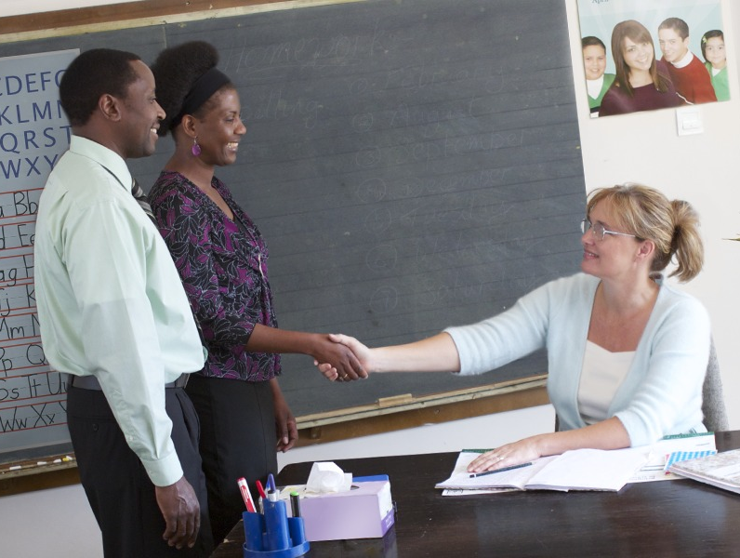
Meeting on the Survey
Teachers will find out the Positive Minded Guardians
Collect the Best Experience of their Previous School/College
Discuss about the Future Development
Value their Opinion
Source: https://www.jw.org/zu/izincwadi/omagazini/g201210/lokho-abazali-abangakwenza/

Slide 7

Ensure Policies with Effectiveness
Source: https://www.ucl.ac.uk/public-policy/

Slide 8

Provide Guidelines to…
Existing & New Students

Slide 9

Add Value:
To the Students
To the Guardians
Source: https://jbarrows.com/blog/five-ways-sales-can-add-value/

Slide 10

Teacher – Student Relationship
Source: https://www.quietrev.com/theres-more-to-class-participation/

Slide 11

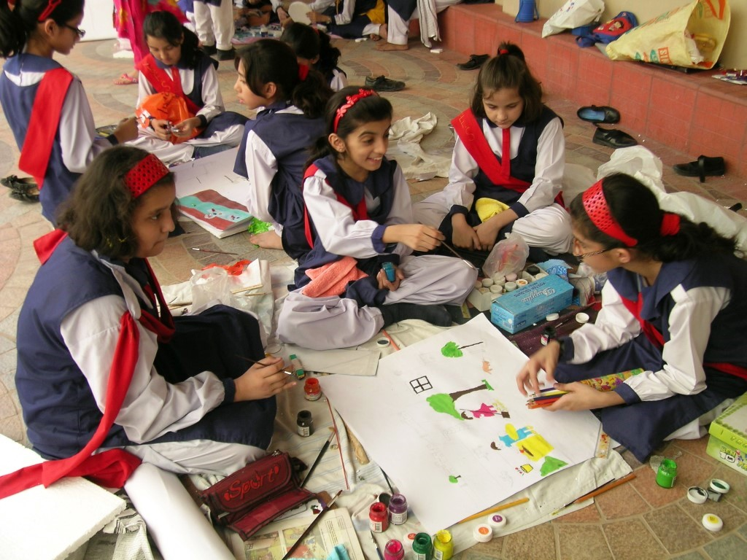

Responsibilities
of a
Teacher
Helping in the Classroom
Engage in Extra-curricular Activities
Taking Care of Weak & Talented Student

Slide 12

Source: https://www.globalcareercounsellor.com/blog/how-can-a-teacher-help-in-student-career-guidance/
Nurturing Every Student By Their Capability & Inner Potentiality

Slide 13
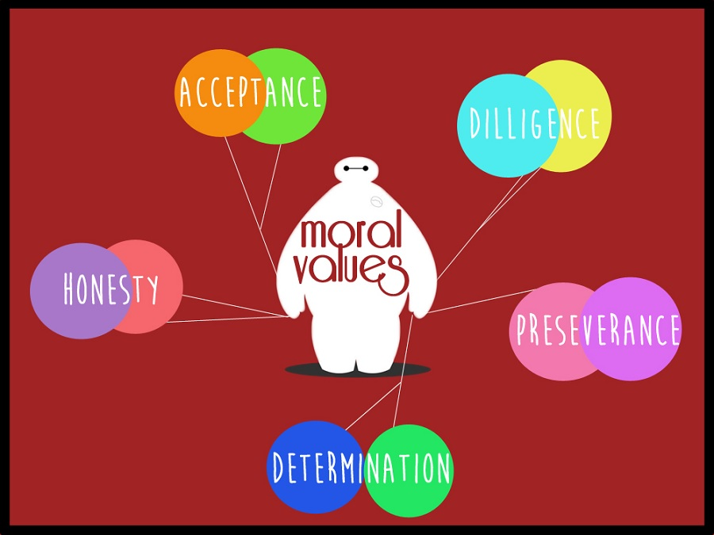
Source: https://www.globalcareercounsellor.com/blog/how-can-a-teacher-help-in-student-career-guidance/

Slide 14

Find Out The Best Learner
Source: https://www.prodigygame.com/blog/classroom-management-strategies/
Let The Student
To Take Class
For Increasing Their Confidence

Slide 15

Database of Every Student
Medical Report
Psychological Report
Physical Weakness
Daily Class Report
Exam Report
Extra-Curricular Report
Creativity
Attitude
etc.
Source: https://www.insightsintoimpact.com/its-just-a-database/database-graphic-hi-res/

Slide 16

Source: https://www.assante.com/assante-life/wealth-planning/how-long-do-you-need-plan-foror-how-long-will-you-live
Inform The Guardian, Their Child’s Report

Slide 17
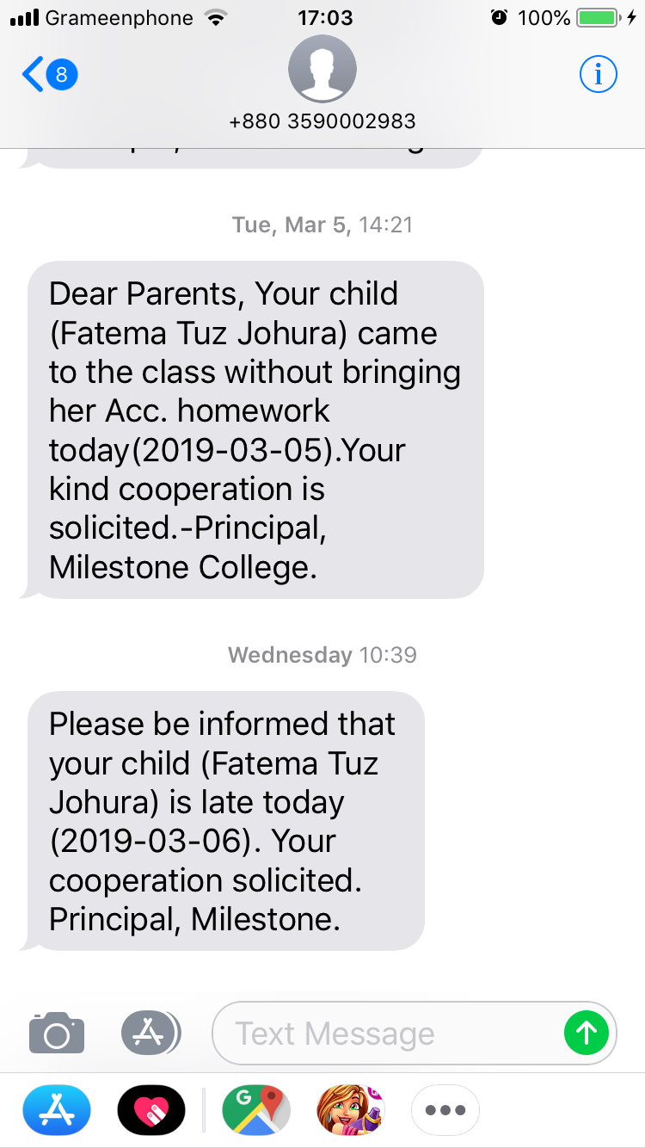
Follow Other School’s Reference
Other Schools’ Approach for
Making Students Active in Class

Slide 18

Satisfaction of Guardians
Target 100% Good Result of Students:
Academic & Board Result
Source: https://alecanmarketing.com/blog/what-business-owners-can-do-negative-yelp/

Slide 19
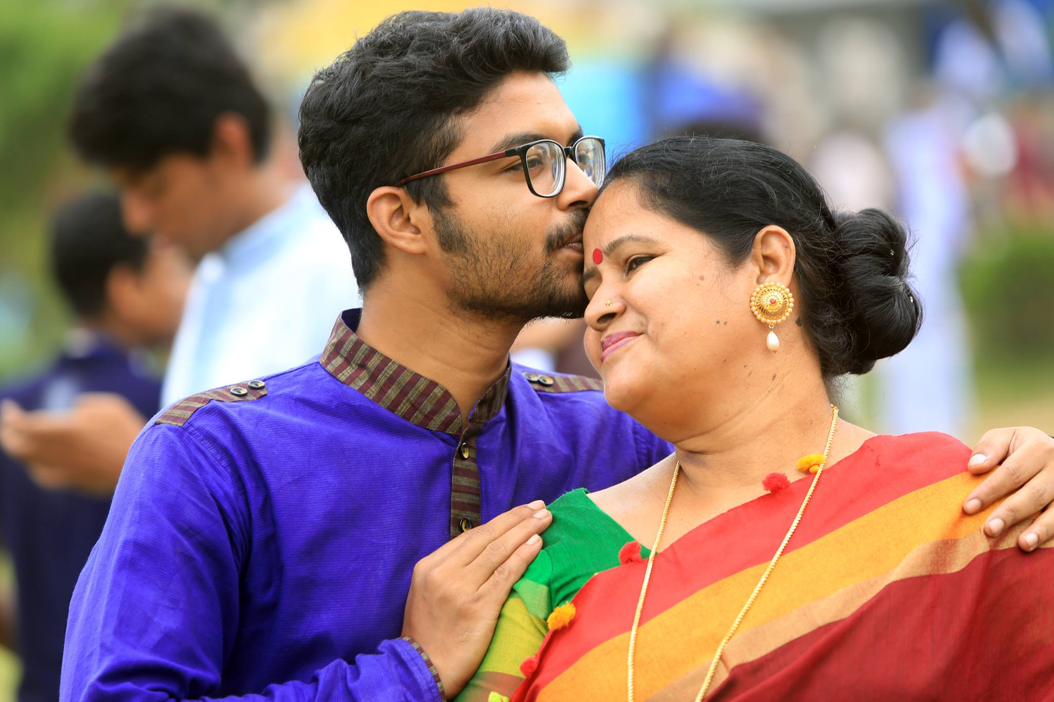

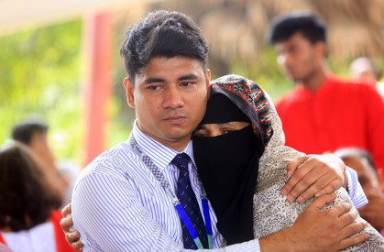
Introduce
Art of Living to
Every Student

Slide 20

Greet
Each Other
Source: https://guernseydonkey.com/why-do-we-shake-hands-as-a-greeting/

Slide 21

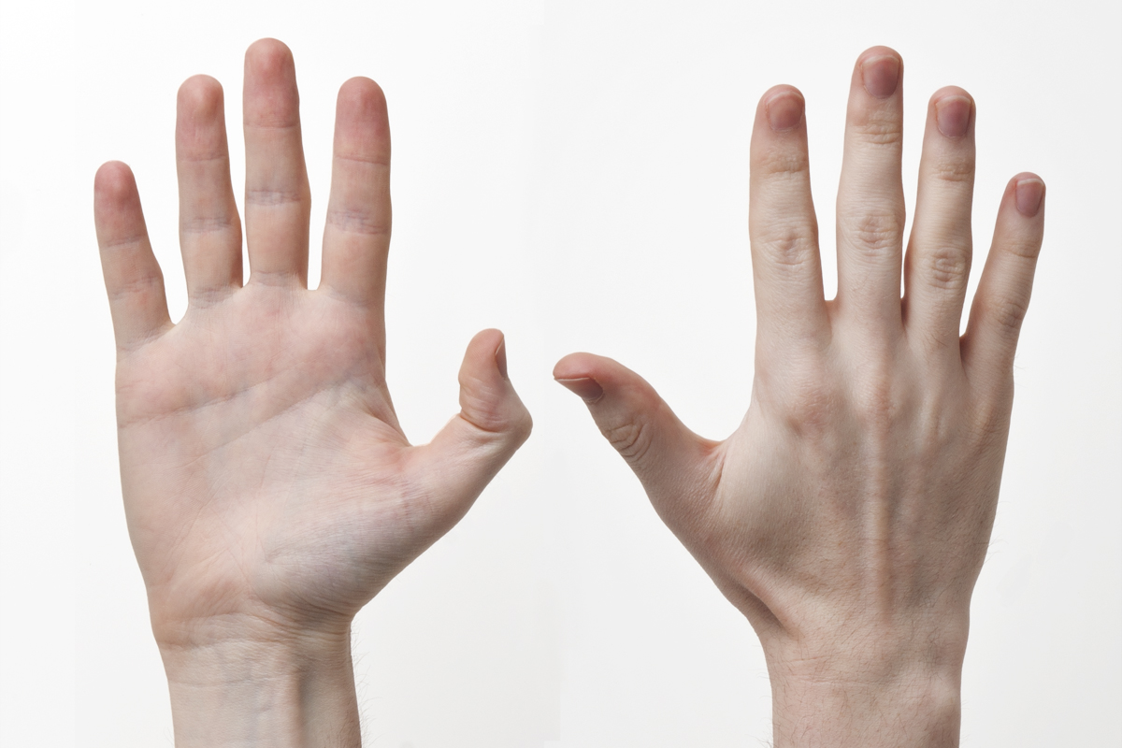
Every Human Has an Unique Identity

Slide 22
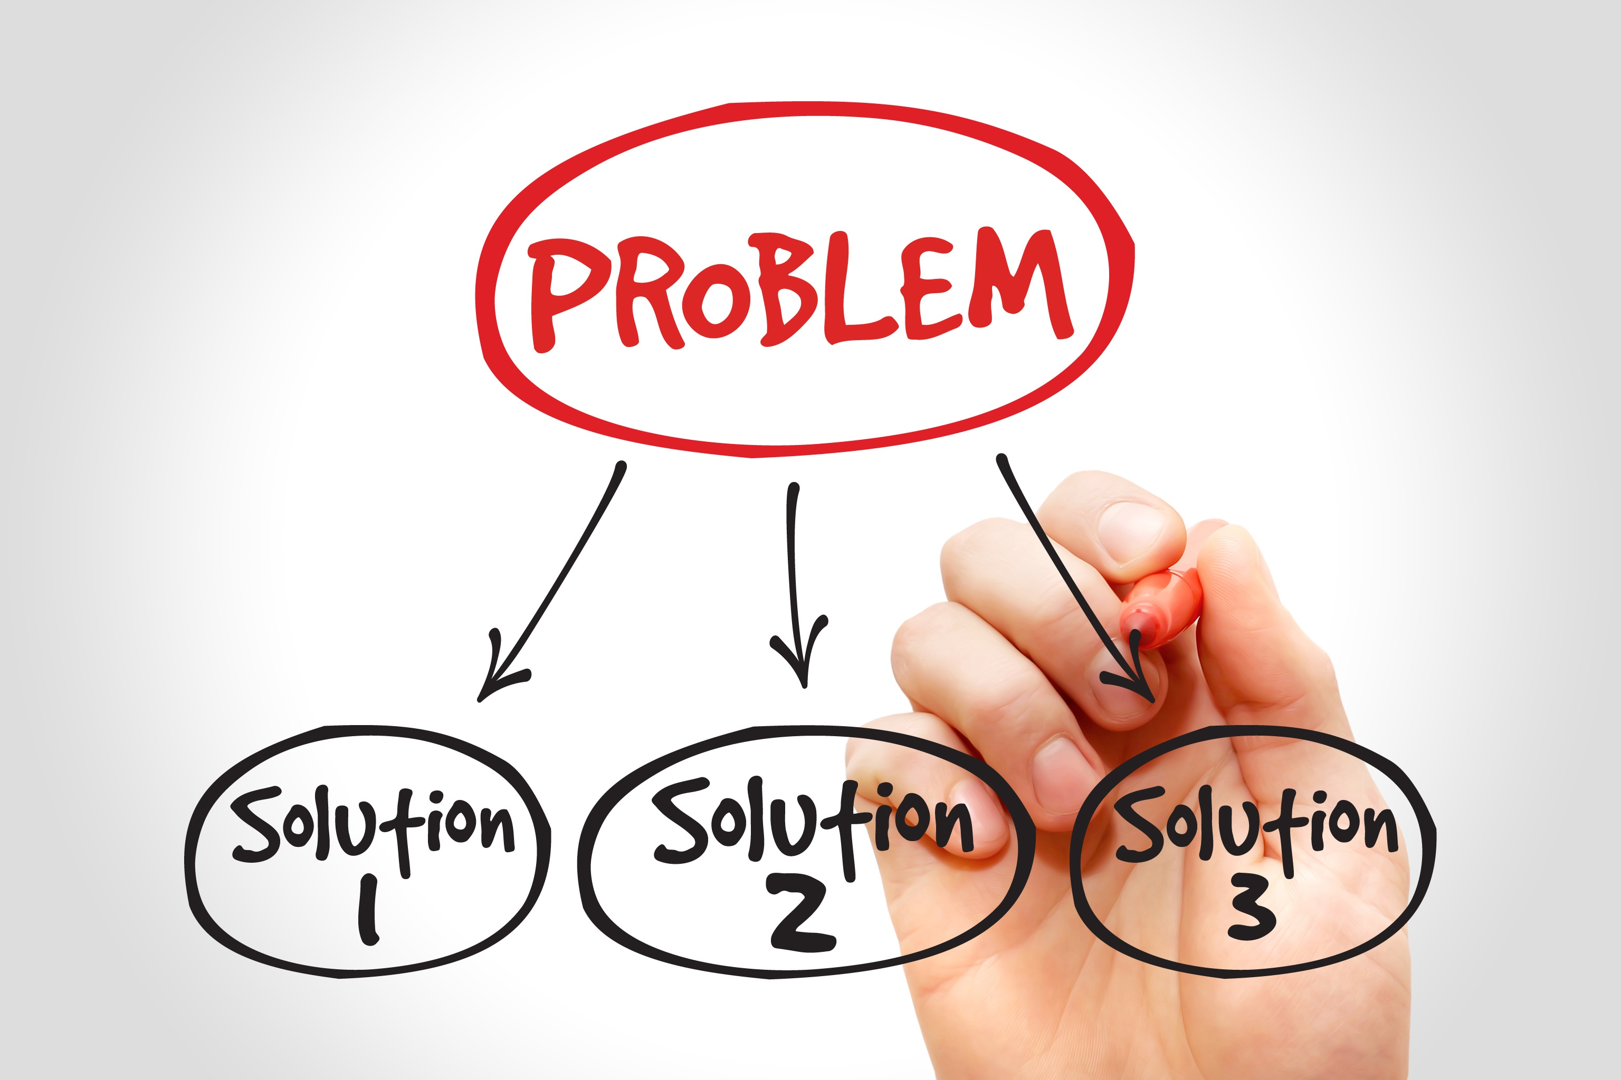
We Need Solutions:
Instant Solution
Permanent Solution
Source: http://buildmindpower.com/solve-problems-easier/

Slide 23

Hand Notes
Specific Job Descriptions
E-mail
Follow-up
Daily Report
Appreciation
Source: http://www.incoreinsightlytics.com/government-of-india-approves-national-health-policy-2017/

Slide 24

Target 100% Good Result of Students:
Academic & Board Result
Source: https://alecanmarketing.com/blog/what-business-owners-can-do-negative-yelp/

Slide 25

Teacher’s Feedback from the Survey:
Teaching Evaluation
Guideline from Supervisors
Student Counselling Cell
Academic/Monitoring Committee
Practical Based Class
Subject Based Training
Moral Value Increasing
Motivational Session
Accountability

Slide 26

Who Will Take The
Who Will Take The Responsibility to Implement the Ideas…

Slide 27
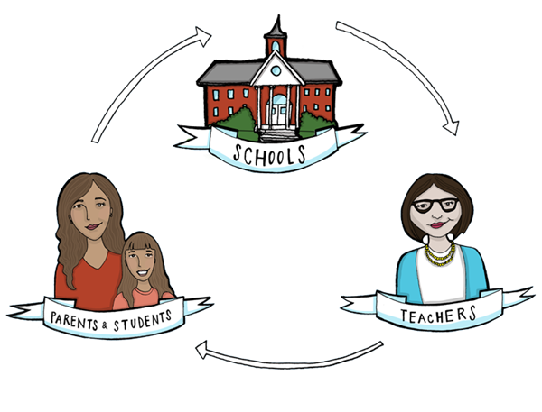
Stay Connected to Keep Sound Relationship

Slide 28

Be Committed to Become the 2nd Parent

Slide 29

Thank You

