Slide 1



C
Career Plan : Life & Beyond
Lesson 15

Slide 2
People Often Invest More Time Planning Their Vacation Than Planning Their Career.
Think About It

Slide 3



UNDERSTANDING CAREER
TIME
LIFE
MONEY

Slide 4
UNDERSTANDING CAREER
PAST
PRESENT
FUTURE
BEYOND ?

Slide 5
UNDERSTANDING CAREER
Out of the Box
AFTER
DEATH
PAST
PRESENT
FUTURE

Slide 6
UNDERSTANDING CAREER
Out of the Box
FAMILY
WORK
CHARITY

Slide 7

UNDERSTANDING CAREER
Out of the Box
FAMILY
WORK
CHARITY
JOB

Slide 8

Dream BIG
Out of the Box
Notes:
On May 25, 1961, President John F. Kennedy announced a goal: America would put a person safely on the Moon before the end of the decade. Many thought this was impossible. To people’s amazement, Kennedy’s ambitious goal was achieved on July 20, 1969, when Neil Armstrong stepped onto the Moon's surface. In this context, JFK’s initial goal setting guided and motivated Neil Armstrong’s giant step for mankind. Goals are not only in the domain of leaders, though. They are part of our everyday lives.

Slide 9
GOAL SETTING
The Power of Goal
So, Why Do 3% of Harvard MBAs Make Ten Times as Much as the Other 97% Combined ?

Slide 10
So, Why Do 3% of Harvard MBAs Make Ten Times as Much as the Other 97% Combined ?
The answer is a simple question: “Have you set clear, written goals for your future and made plans to accomplish them?” In 1979, interviewers asked new graduates from the Harvard’s MBA Program and found that :
84% had no specific goals at all
13% had goals but they were not committed to paper
3% had clear, written goals and plans to accomplish them
In 1989, the interviewers again interviewed the graduates of that class. You can guess the results:
The 13% of the class who had goals were earning, on average, twice as much as the 84 percent who had no goals at all.
Even more staggering – the three percent who had clear, written goals were earning, on average, ten times as much as the other 97 percent put together.
Source: From the book What they don’t teach you at Harvard Business School by Mark McCormack

Slide 11
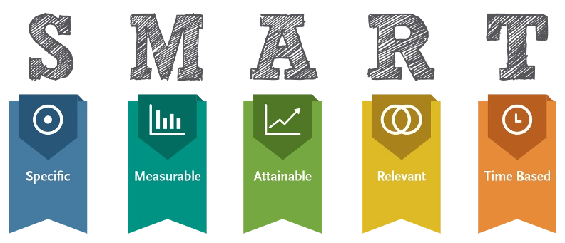

Goal Setting
TEST
Goal must be Smart
5W1H

Slide 12
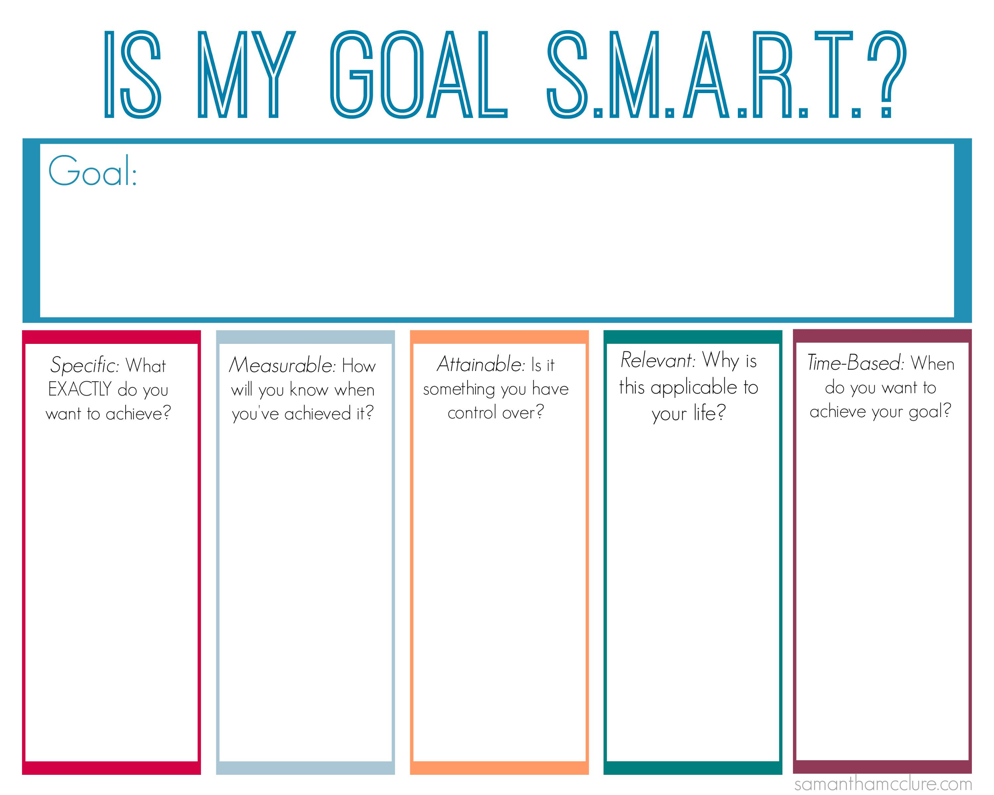
Goal Setting
Goal must be Smart

Slide 13

RISK REGISTER
A Risk Register is a master document which is created during the early stages of your career plan.
It is a tool that plays an important part in your Risk Management Plan, helping you to track issues and address problems as they arise.

Slide 14
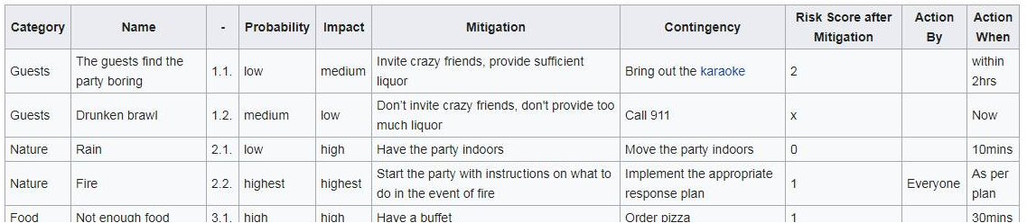
RISK REGISTER
Example of a RISK REGISTER to plan a party

Slide 15
Career Planning Process
Your Strengths
(e.g., creativity,
leadership, writing)
Your Interests
(e.g., people, math, science)
Your Needs
(e.g., income, growth,
personal fulfillment)
Identify Career
Possibilities
Occupational Outlook Summaries
Networking, Internships, Job Shadowing, Volunteering
CareerOneStop Job Summaries & Videos
Evaluate/Select a
Career

Slide 16
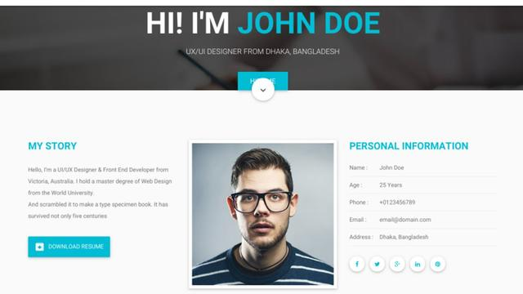
www.ami.com
Future of CV

Slide 17
“Emotional intelligence (EQ) is your ability to recognize and understand emotions in yourself and others, and your ability to use this awareness to manage your behavior and relationships.”
Drs. Travis Bradberry
and Jean Greaves
Emotional intelligence 2.0
Role of Emotional Intelligence (EQ)

Slide 18
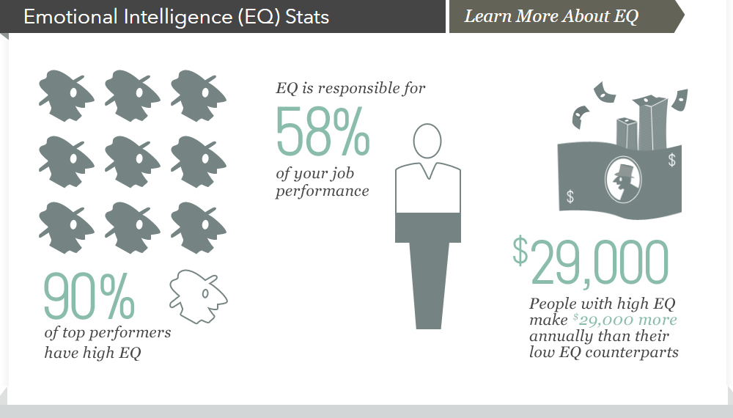

Slide 19
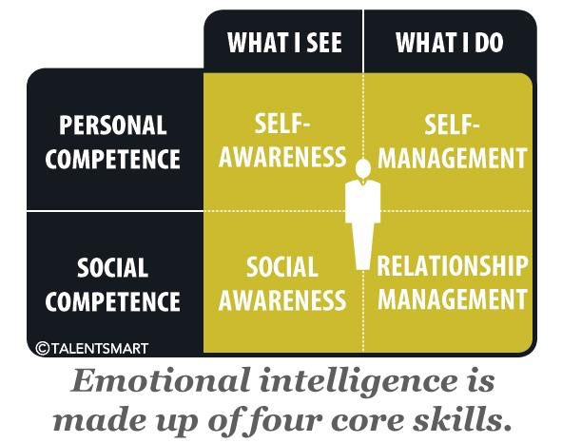

Slide 20
Check What Employers Want from You

Slide 21

Commonwealth Youth Sport for Development and Peace Working Group (CYSDP)
What we are looking for
Commonwealth nationals
Between the ages of 18 and 29
Passionate and active in Sport for Development and Peace in a voluntary, educational or professional capacity
Current skills include: communications/ social media, knowledge of governance, strategic development/ leadership skills, public speaking/ presentation experience, knowledge and experience of innovative, small NGO or social enterprise development.
Current geographic gaps include Caribbean , Pacific and Asia

Slide 22

About this job
Job description
Project Manager
Identify opportunities for new project and enhancement of existing projects in line with CSR vision and values.

Slide 23
Desired Skills and Experience
Graduate/BBA from any reputed university with good academic background.
Good communication and analytical skill
Good knowledge on Project Management and Cost-Benefit Analysis.
Good Team Player.
Strong public relation and negotiation skill

Slide 24

Senior Specialist - Financial Audit - Internal Audit
Desired Skills and Experience
Educational Qualifications:
Bachelor Degree in Accounting/Finance/Business along with professional accounting qualifications (CA/CPA) with auditing background are must.
Special Skills:
Should be able to run audit project independently (single handed)
Proven ability to work in a team and ability to handle multiple assignments at individual capacity.
Strong interpersonal and communication skills including the ability to interact with clients, upper management and Board members.
Display good interviewing and superior writing skills.
Attention to detail and higher level skills in MS excel.
Good organizational skills needed to manage a high volume of assigned cases.
Honest and ethical with high levels of integrity and confidentiality.

Slide 25

Position Qualifications
Core Competences:
Leadership skills
Financial understanding
Negotiation & argumentation skills
Problem solving
Presentation & communication skills
Entrepreneurial & Commercial Thinking
Persuading & Influencing
Leading & Supervising
Relating & Networking
Planning & Organizing
Minimum Qualifications & Experience Requirements:
Bachelor Degree in Engineering.
Candidates having MBA will get preference.

Slide 26


