Slide 1

Evaluation Compliance
Md. Sabur Khan, Chairman, BoT, DIU
71 Milonayoton, Daffodil Tower
June 30, 2018

Slide 2
Most Important KPIs
1
Revenue
Revenue and outcome are the two most important KPIs. If your efforts do not contribute to these two areas, then your contribution will have no value.
2
Outcome

Slide 3

Self and Team Development
Continue to develop yourself along with your peers, teams and subordinates. If you get a training, circulate the learning.

Slide 4

Job Delegation
Delegate your job properly. While delegating, make sure to define the roles and specify the requirements to whom you are delegating the job. Otherwise, it will be very hard to reach the expected outcome.

Slide 5
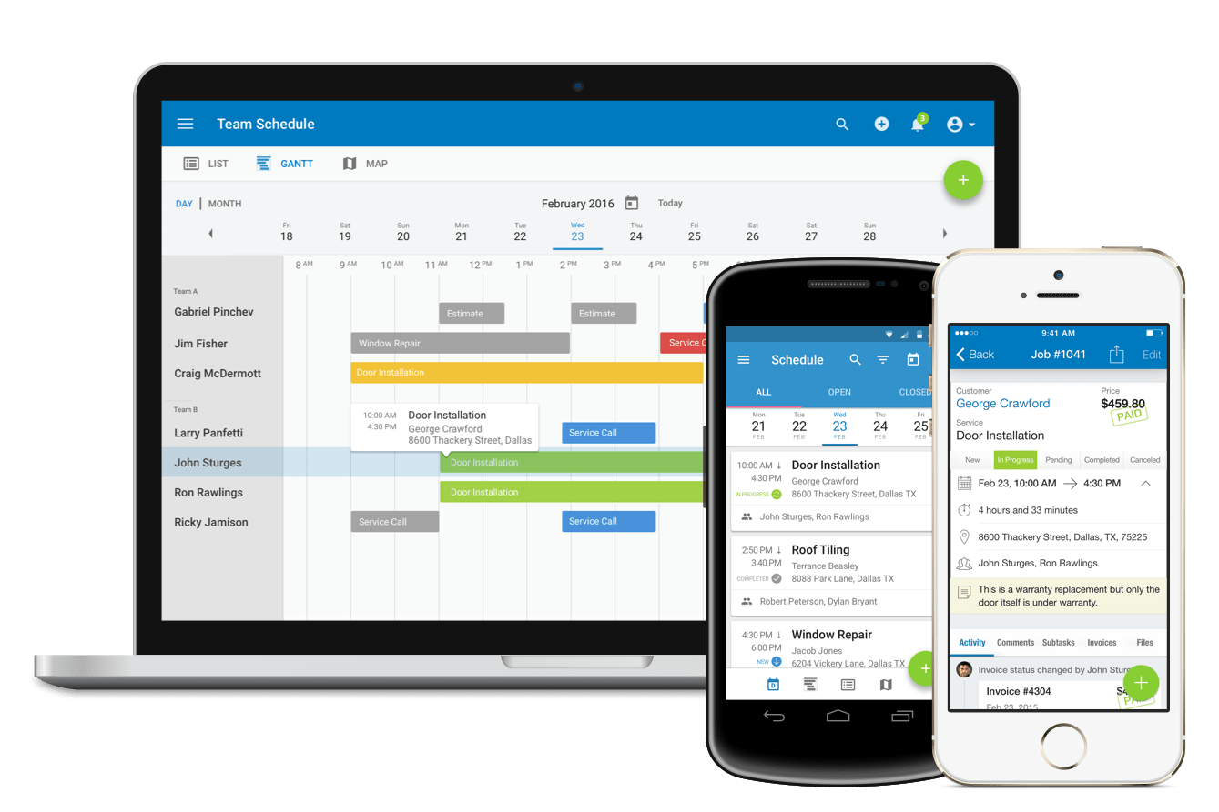
Job Tracking
Only delegating the job will not work unless you track the job. Track the job systematically until it is implemented. Use available utilities and applications to track jobs and document the process and updates. It will help you preparing necessary reports to make your work visible.

Slide 6

Specific Contribution
While reporting, mention your contribution specifically. Giving just title or vague description will only confuse the management and harm your career. Specify what role you played and what was the impact or outcome.

Slide 7




Maintain Document
Maintain work related documents. It will greatly help you with work delegation, tracking the job and reporting. Maintain files, cloud backup, label your important emails and use tools like excel and Google Sites to systematically accumulate all the documents in one place.

Slide 8
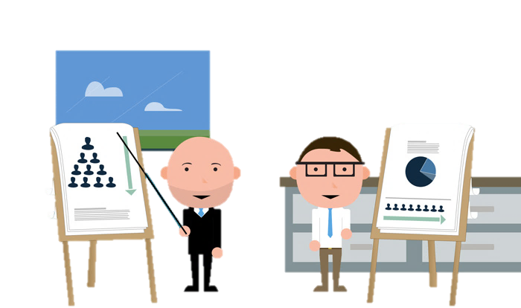
Supervise Systematically
Being a supervisor is not an easy job. Supervisors need to be systematic themselves before they can develop systematic subordinates. Also, do not be bias in evaluating your subordinates. It will only deprive them from learning and growing. Specifically guide them on where to improve and how to improve.

Slide 9

Ensure Implementation
It is important to keep track of all the jobs and tasks that were assigned to you and ensure that they are implemented. It is through implementation your performance will be evaluated.

Slide 10
Be Responsive and Responsible
Video Guidelines
DIU is sending emails, video guidelines and WhatsApp messages to delegate jobs but it is observed that in some cases there are still no response which indicates lack of responsibility. DIU would again like to make alert and invite to be responsive and responsible on assigned duties and tasks.
02
Emails
01
Instruction Types
WhatsApp Messages
03

Slide 11

Release the Unfit
Emotional attachment helps with teamwork and getting things done more easily but do not let emotion get in the way when someone keeps proving that he/she is unfit. If anyone shows no improvement over time and fails to perform repeatedly, he/she should be released from the institution.

Slide 12





Quick Facts
Airbnb, Alibaba, Uber, Pathao are some of the companies which outsourcing people, job and tasks. WhatsApp was created by 11 people and they are controlling millions of people without money. Where as BTTB having thousands of people are not much functional. We need people who can develop continuously and add value.

Slide 13

World’s top 10 companies are now virtually run.
Work from Anywhere & Anytime

Slide 14

We Need Flat System
Contribution, job and tasks should be tracked so that evaluation is based on contribution and not position or person. Contribution should determine the value one can avail from the institution along with the position a person deserves.

Slide 15


Focus: Capability & Intelligence
Your and our focus should be capability and intelligence. Otherwise, you won’t be able to add value to the institution and the institution won’t be able to add value to your career. Everyone need to prove themselves by showing and developing systems to add value to their positions and to contribute to revenue/outcome.

Slide 16

Regular Jobs are Integral Part
Ongoing and day to day tasks are integral part of everyone’s job because organization employ you full time for all sorts of day to day job and any sudden challenges while you are carrying your responsibility.

Slide 17
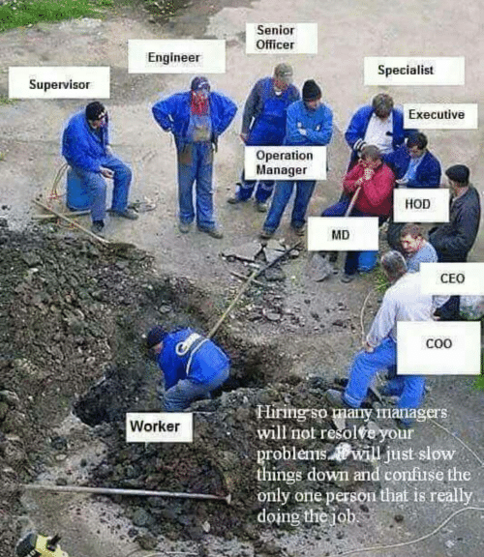
Having
Worker Mentality

Slide 18
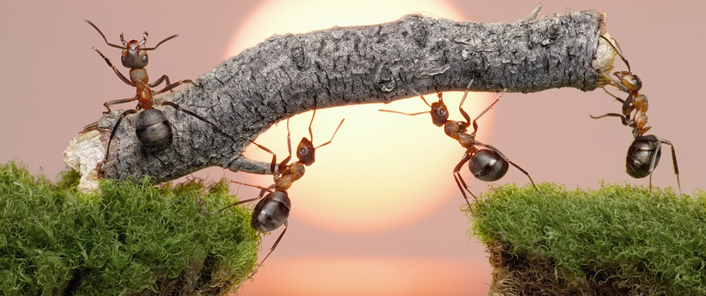
Encourage Teamwork

Slide 19
?
?
?
Any Question?

Slide 20
Many Thanks!

