Slide 1

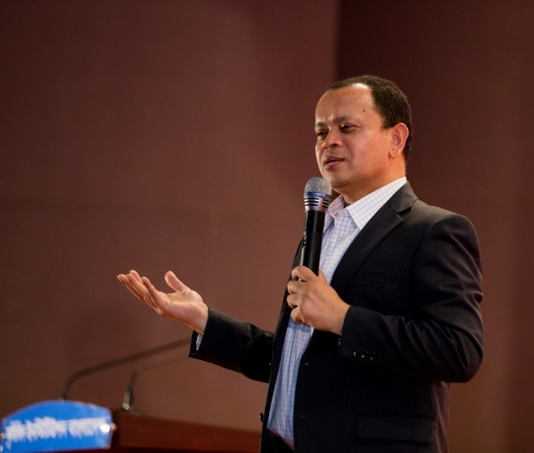

Academic collaboration between Bangladesh and Finland: How both countries can be mutually benefited?
Bangladesh Finland Business Association
Annual Business Summit
Espoo, Finland
22 August, 2019 @ 17:00-20:00 EET
Presented by:
Dr. Md. Sabur Khan
Chairman
Daffodil International University

Slide 2
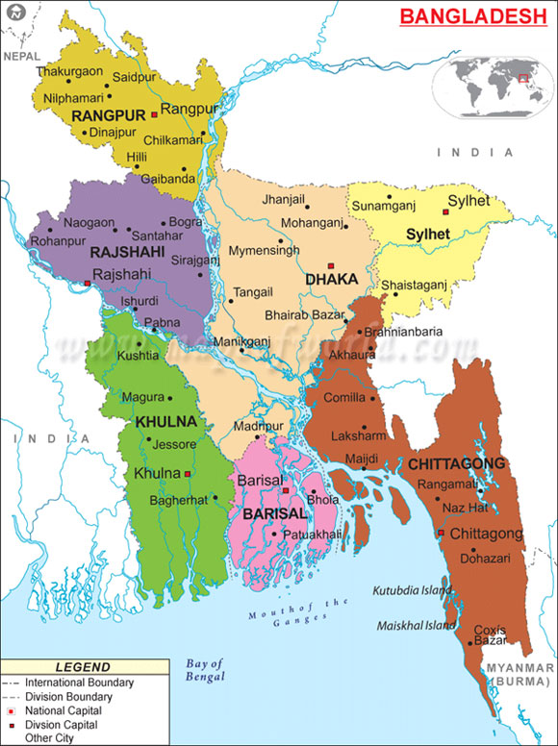
Bangladesh
Bangladesh belongs to the largest river delta as well as one of the most fertile regions of the world with a total area of 1,47,570 sq.km. and a coastline of 710 (check) km. It has a population of 160.8 million (as on July 2016), making it one of the densely populated countries of the world. Bangladesh in largely ethnically homogeneous. Over 98 percent of the people speak in Bangla. English is widely spoken as well. The country is covered with network of rivers and canals forming a maze of interconnecting channels and rich waterways.
Notes:
Lesson descriptions should be brief.

Slide 3
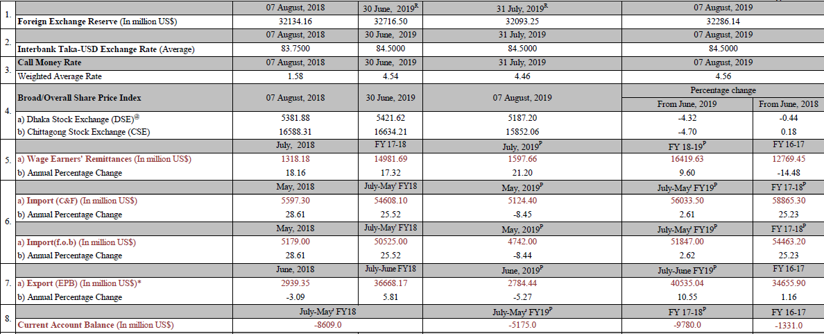
Selected Economic Indicators - Bangladesh
Source: https://www.bb.org.bd/pub/weekly/selectedindi//20190808secindi.pdf

Slide 4
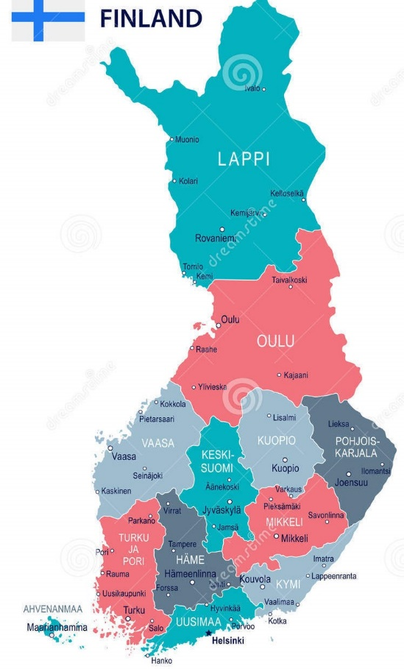
Finland
Finland covers an area of 338,145 km², making it almost the size of Germany, or slightly smaller than the US state of Montana. The country's landscape offers a lot of National Parks, covered mostly with coniferous taiga forests (78%), bogs and fens, it has rarely cultivated land. About 10% of its area is occupied by lakes, rivers and ponds. Halti Mountain at 1,324 m is Finland’s highest point.
A population of 5.5 million people (in 2017) making Finland one of the most sparsely populated countries in Europe, about half of the population live in the southern coastal region. Capital and largest city is Helsinki, spoken languages are Finnish (89%), Swedish (5.3%), and Sami, a language spoken by the Laplanders (Sami), the indigenous people inhabiting the Arctic area of Sápmi.

Slide 5
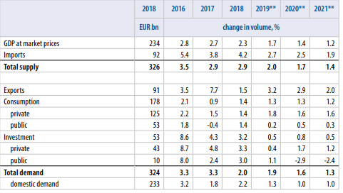
Selected Economic Indicators - Finland
Source: https://vm.fi/en/frontpage

Slide 6
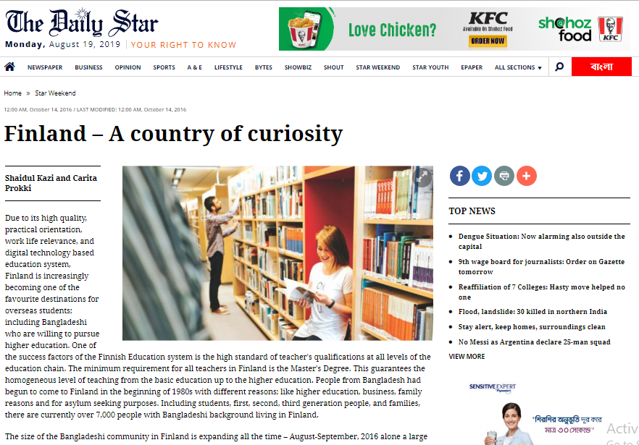

Slide 7
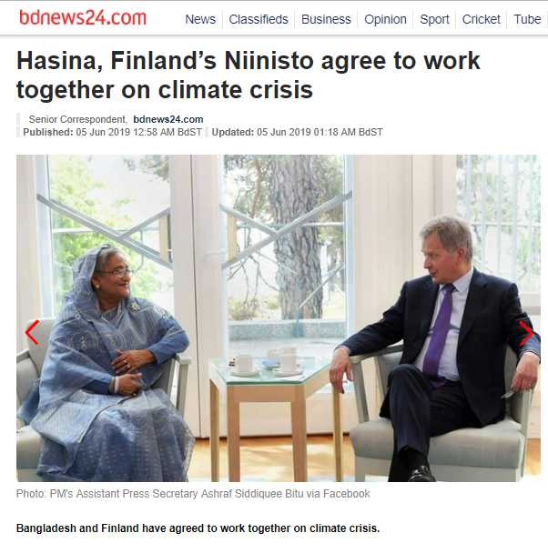
Bangladesh-Finland Relationship
Prime Minister H.E. Sheikh Hasina during this year, on a four-day visit in Finland which has strengthened the relationships between Bangladesh and Finland more.

Slide 8
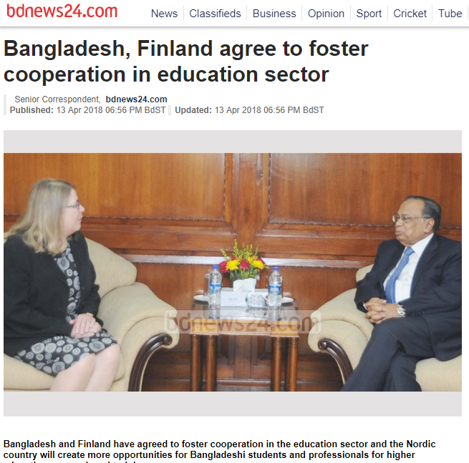
Bangladesh Finland Bilateral Tie
During a bilateral consultation in Dhaka in 2018, Bangladesh and Finland have agreed to foster cooperation in the education sector and the Nordic country will create more opportunities for Bangladeshi students and professionals for higher education, research and training.
Dhaka and Helsinki agreed to work on building partnership in implementing the SDGs, Agenda 2030 and mitigating the adverse effect of climate change.
They committed to forge cooperation in bilateral trade and investment to enhance bilateral trade up to its potential, and agreed to hold the first-ever Bangladesh-Finland business and investment forum in Dhaka later this year.

Slide 9
Bangladesh Finland Business Association
It has been outstanding that Bangladesh Finland Business Association, a non-profit organization founded by a group of Bangladeshi and Finnish businessmen, academics and professionals in Finland, has been working for the interests of businesses between these two nations and to promote trade, investment opportunities and co-operation between the Finland and Bangladesh.

Slide 10
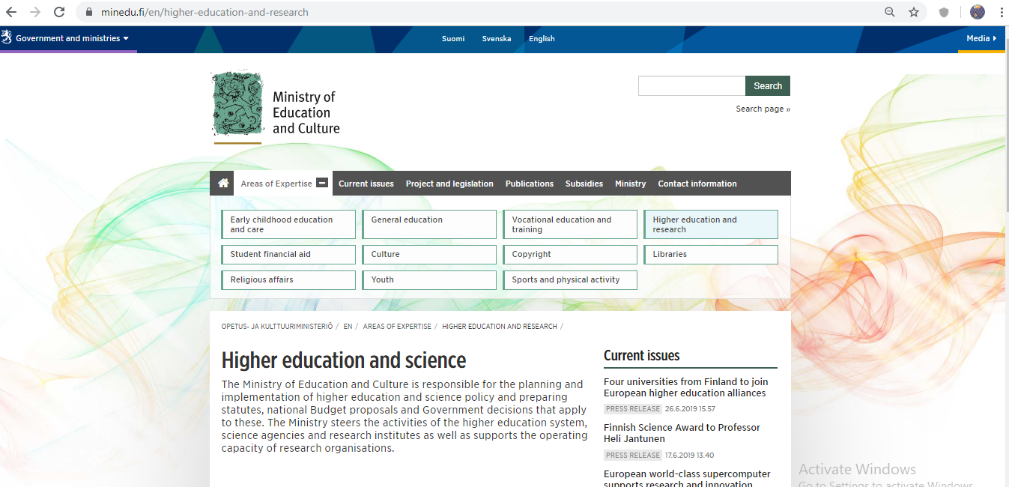
Ministry of Education and Culture, Finland

Slide 11
Policy and development in higher education and science
Higher education policy
The Finnish higher education system consists of universities and universities of applied sciences. Higher education institutions are autonomous actors that are responsible for the content of their education and research as well as the development of their own activities.

Slide 12
Finland's higher education policy
The objective of Finland's higher education policy is to develop higher education institutions as an internationally competitive entity where each institution also flexibly responds to regional needs.
The activities of universities and universities of applied sciences promote Finnish competitiveness, well-being, education and learning as well as sustainable development.
The objective is to establish a higher education system that is of a higher standard and more international as well as more influential and effective than at present.
The higher education system consists of universities and universities of applied sciences of high standards, each profiled in their core areas. Profiled higher education institutions create clearer and deeper cooperation and division of responsibilities among themselves and with research institutes in the areas of education, research, support services, structures and infrastructures.
The higher education institutions exercise foresight and help regenerate society, culture and working life and make sure the required highly educate workforce is available.
Being international and attractive learning and research environments, the higher education institutions work to develop their activities.

Slide 13
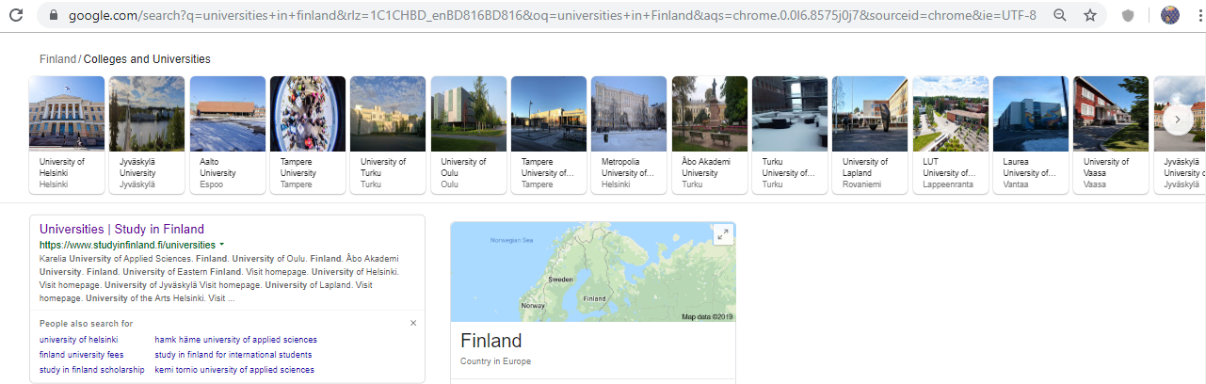
UNIVERSITIES in finland

Slide 14
UNIVERSITIES in finland
Finland has two types of higher education institutions: universities and universities of applied sciences (UAS). English-taught degree programmes are offered on bachelor's, master's and doctoral levels.
Universities of applied sciences offer professionally oriented higher education and have strong ties with working life and regional development.
Universities focus on scientific research and the education they provide is based on it. Doctoral programmes are offered by universities.

Slide 15
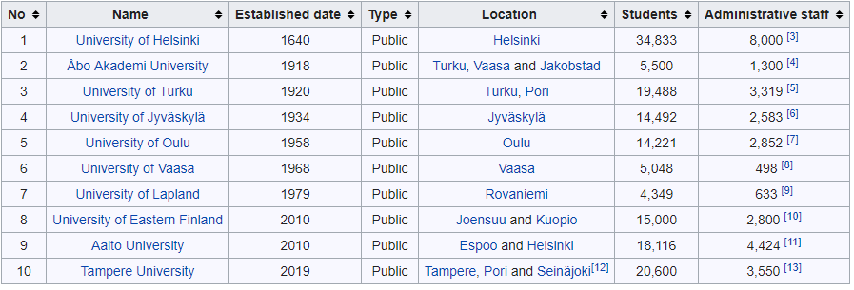
Multidisciplinary Universities
Source: https://en.wikipedia.org/wiki/List_of_universities_in_Finland

Slide 16
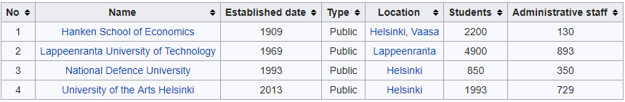
Specialized universities
Source: https://en.wikipedia.org/wiki/List_of_universities_in_Finland

Slide 17
Bangladesh-Finland Possible Academic Cooperation
University to university collaboration through academic, faculty and student exchange programme, research and extension
Offering scholarship Masters and Ph.D
Setting up innovation hub
Cooperation maybe extended in facilitating the blended learning process with the involvement of dtakeholders of two countries.
A committee, naming, ‘Higher Education Cooperation between Bangladesh and Finland’ may be formed to look after the overall development.

Slide 18











Bangladesh Finland Academic Cooperation through EdTech Startups
There are 51 EdTech startups in Finland. Following are some of them

Slide 19

According to UNESCO, “Higher education includes all types of studies, training, or training for research at the post-secondary level, provided by universities or other educational establishments that are approved as institutions of higher education by the competent state authorities”.
In the global knowledge economy, higher education has a crucial role in nurturing human capital. It promotes economic growth, leads social transformation, and finds solutions to national development challenges.

Slide 20
History of higher education in this region
Higher education in the modern concept began in this region with the establishment of the University of Calcutta in 1857.
The establishment of the University of Dhaka in 1921 had a profound impact on the development of education in Bangladesh (East Bengal).
Dhaka remained the only university in the region for the rest of the British period.
Five more public universities were however established during the Pakistan period, between 1953 and 1970.
Since the liberation of the country, there has been a remarkable growth in both the number of universities and in the number of university students.
A new development in university education in Bangladesh has been the establishment of private universities since 1992.
National Education Policy 2010

Slide 21
Higher Education in Bangladesh
Higher Education in Bangladesh
General Education
Vocational Education
Distance Education
Agricultural Education
Medical Education
Madrasa Education
Science, Technology & Engineering Education
In Bangladesh, higher education consists of a 3 year pass-course or a 4 year honors course for the bachelor’s degree, followed by a two year Master’s course for pass graduates and a one-year Master’s course for honors graduates.

Slide 22
Current Statistics
At present there are 45 public universities
103 private universities
3 international universities
Universities in Bangladesh are autonomous bodies administered by statutory bodies such as Syndicate, Senate, Academic Council, etc. in accordance with provisions laid down in their respective Acts.
The number of universities both public and private has increased significantly
Enrollment rate of students has increased positively
Teachers in the universities have better academic qualifications now than before.
More publications are being made by academicians now than before

Slide 23
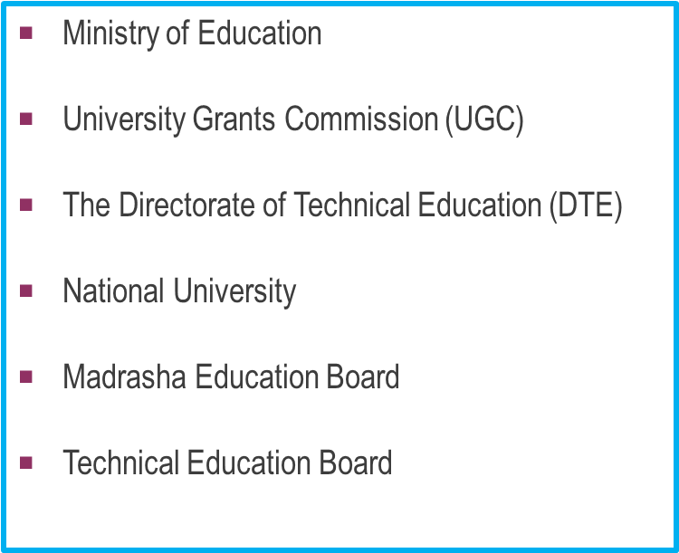
Management of Higher Education in Bangladesh

Slide 24
Acts, Policies and Commissions for Higher Education in Bangladesh
Education Policy 2010
UGC Act 1973 (amended in 1978)
Private University Act 2010
Master plan for ICT in Education 2012-2021
Mohammad Moniruzzaman Mia Commission-2003
Dr. M.A. Bari Commission-2002
Shamsul Haque Education Committee- 1997
Mofiz Uddin Education Commission-1988
Qudrat-e-Khuda Education Commission-1972

Slide 25

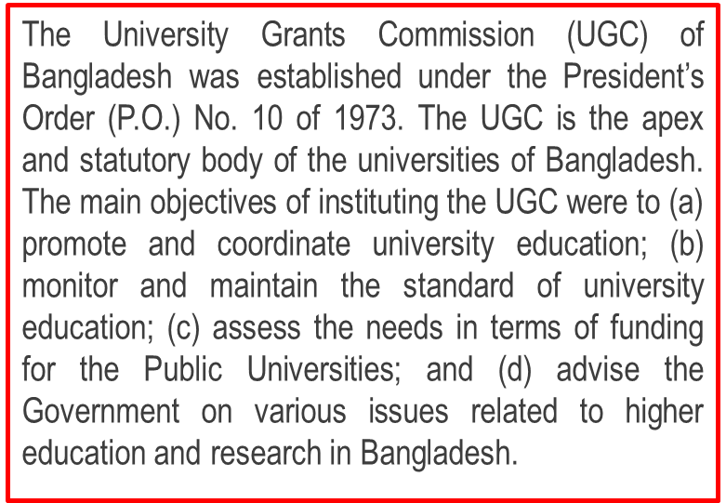
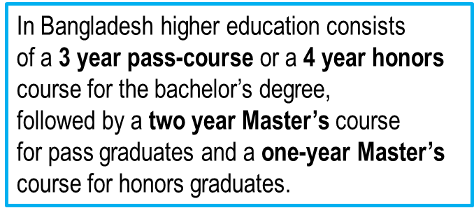
University Grants Commission of Bangladesh

Slide 26
UGC (Contd….)
At present there are 43 public universities
103 private universities
3 international universities
Universities in Bangladesh are autonomous bodies administered by statutory bodies such as Syndicate, Senate, Academic Council, etc. in accordance with provisions laid down in their respective Acts.
The number of universities both public and private has increased significantly
Enrollment rate of students has increased positively
Teachers in the universities have better academic qualifications now than before.
More publications are being made by academicians now than before

Slide 27
Challenges of Higher Education in Bangladesh
Seat limitation compared to number of students who pass HSC
Assurance of quality education, rather than scoring just quantity
Establishing the principles of good governance
Traditionalism without having any significant relevance to the national needs
Lack of industry- academia alliance
Inadequate Financing Facility
Inadequate laboratory and library facilities
Absence of co-curricular and extra-curricular activities
Drop out students
Brain drain

Slide 28
Supports needed
Large numbers of post-secondary technical institutions need to be established to produce sufficient numbers of professionals.
The curriculum of higher education should be regularly updated so that it can incorporate the contributions of modern knowledge and research and make its standard acceptable to the outside world.
There is an immediate need for combining the academic component of the courses with applied component suited to the work experience situation, i.e. industry-academia alliance.
The teaching community must enrich themselves with the new developments to improve their competencies and quality and to cope with reformed curriculum.
The role of the Government Ministry, UGC and Donor agencies should be defined in a positive and synchronized way.

Slide 29
Supports needed (contd)
Standard teacher- student ratio needs to be maintained.
There is need to ensure availability of necessary infrastructural facilities like well designed campus buildings, class rooms well-equipped with computer terminals and power point facilities, completely digitized libraries, computer centers, laboratories for relevant disciplines, auditoriums, cafeteria, recreation centers for students and faculties, playground, etc. that create academic atmosphere.
Research and publications should be made compulsory for all teachers.
All teachers should have a computer terminal and a designated computer equipped with latest internet facility and software necessary to do advanced research.
Institutionalized best management practices and an over arching good governance system must be in place.

Slide 30
Private Universities in Bangladesh
In the 1990s the government realized the need for setting up private universities as it was clear that the public universities in Bangladesh would not be able to meet the increasing demand for higher education. The government recognized and appreciated the initiatives taken, in the early nineties by a group of educationists to establish private universities. After due examination of their proposals, the government felt the necessity of enacting the legal framework under which private universities could work. As a result the National Parliament passed the Private University Act-1992. It was a milestone in the history of higher education in Bangladesh.

Slide 31
Rational of introducing Private Universities
Private universities could be guided by the market related phenomena in providing higher education.
Higher education in the private sector can reduce the financial burden on the government
The condition of private sector answerability can help maintain academic schedules and avoid session jams
Private universities can also offer a better student-teacher ratio compared to public institutions. As a result, attendance, participation and evaluation of students can be more easily ensured and monitored.

Slide 32
Promoting Research and Innovation in Universities in Bangladesh
The HEQEP offered 345 competitive academic innovation grants, out of which 132 grants that supported exclusively research projects have been awarded to 27 public and 9 private universities.
Grants for research projects-financed activities to improve research capabilities in the supported universities, including the upgradation of laboratories and purchase of equipment needed to carry out the work.

Slide 33
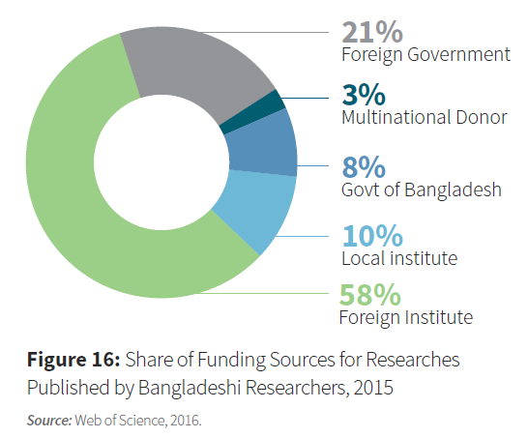
Resource allocation for research

Slide 34


HEQEP project
WORLD BANK
Higher Education Quality Enhancement Project (HEQEP)
To meet the globalization challenges raising higher education quality to the world standard is essential. Bangladesh Govt. has taken initiatives to develop the quality of tertiary education. Govt. plans to prepare university graduates in such way that they can successfully compete in the context of international knowledge society.
Accordingly, the Ministry of Education, with the assistance of the World Bank, has undertaken a Higher Education Quality Enhancement Project (HEQEP). The project aims at improving the quality of teaching-learning and research capabilities of the tertiary education institutions through encouraging both innovation and accountability and by enhancing the technical and institutional capacity of the higher education sector.
The University Grants Commission of Bangladesh is the implementing agency of the project. A HEQEP Unit has been established in UGC for implementation, management, monitoring and evaluation of the activities.

Slide 35
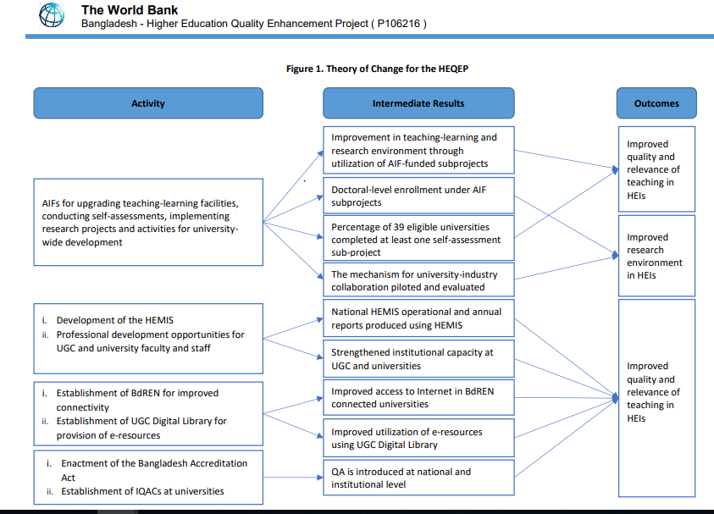

Slide 36
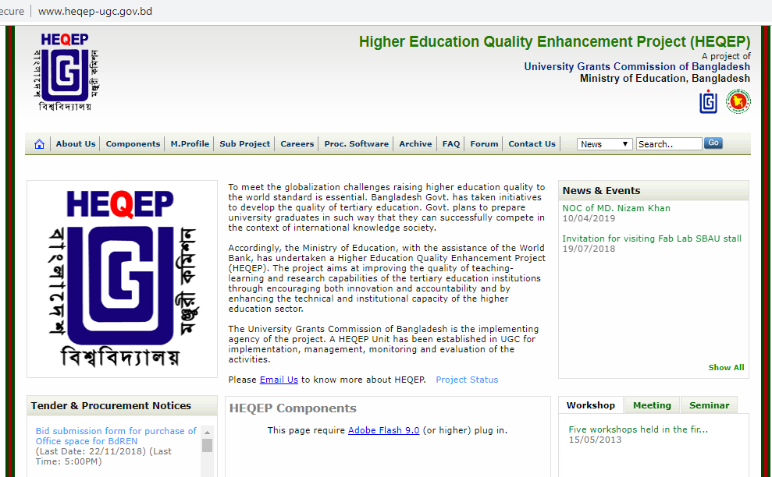
HEQEP

Slide 37
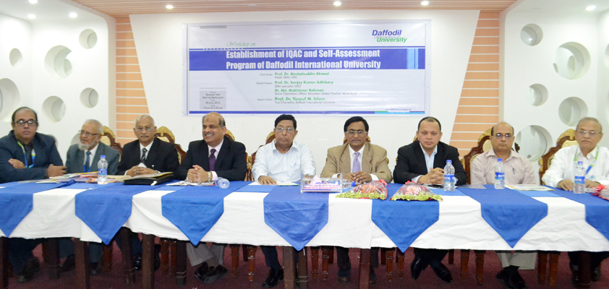
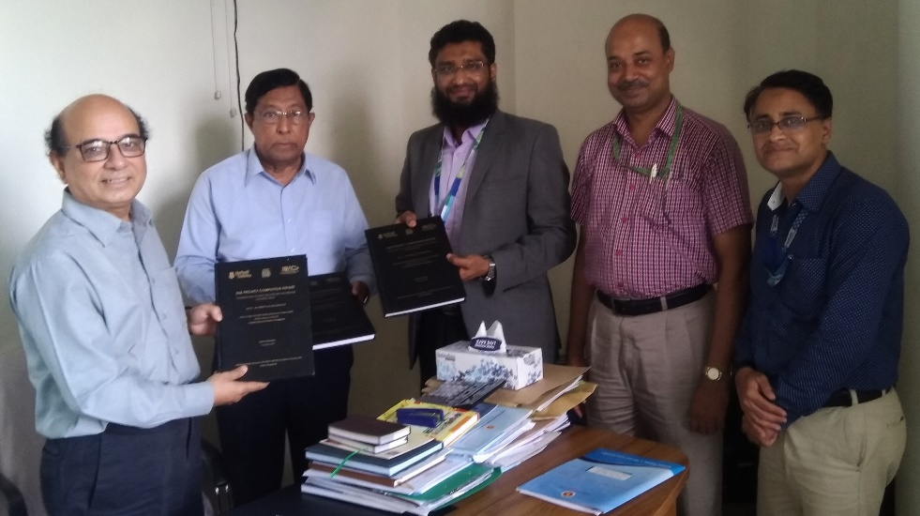
IQAC of DIU submits the Sub-Project Completion Report (PCR) of HEQEP
Institutional Quality Assurance Cell (IQAC) of Daffodil International Universityhas submitted the Sub-Project Completion Report (PCR), today on 14 August, 2018 to Professor Dr. Sanjoy Kumar Adhikary, Head, Quality Assurance Unit (QAU), University Grants Commission of Bangladesh. It is worthwhile to mention that DIU has successfully completed the sub-project, ‘Establishment of IQAC at Daffodil International University (DIU)’ within the completion deadline, 30 June, 2018.

Slide 38
Academic Innovation Fund (AIF)
The Higher Education Quality Enhancement Project (HEQEP) consists of four components. The most important component is Academic Innovation Fund (AIF), a fund designated to be awarded to participating public and private universities as non-refundable grant to promote innovative proposals for quality enhancement. The general objectives of AIF are to establish enabling conditions to improve the quality and relevance of teaching, learning and research and to introduce an efficient instrument for the allocation of public funds with emphasis on innovation and accountability. Its broad objectives are to produce advanced human capital in the form of highly skilled university graduates who would move the country towards higher productivity, economic growth and sustainable development. The total cost of the AIF component amounts to Tk 372.06 crore.
Under Window 1, 75% of the available fund would allocated among Science and Technology based sub-projects, 15% to Humanities, Social Sciences, Business Studies and Law field and 10% to Self-assessment purpose.
Under Window 2, Science and Technologies will get 85% and Humanities, Social Sciences. Business Studies and Law will get 15%.
Under Window 3, University-wide Innovation sub-projects will get 100% of the fund. No fractions are here in this window.

Slide 39
DIU and its Internationalization (contd)
As a young university, Daffodil International University (DIU) took lot of initiatives in higher education domains which excelled at international arenas, too and the university has successfully accomplished numerous tasks related to internationalization. With its endeavor to produce quality graduates and for establishing educational eco-system, DIU ranked at highest international ranking platforms like Times Higher Education Impact Rankings 2019, QS Asia University Rankings 2019 and GreenMetric University Rankings 2019.
The University has entered into more than 300 Memorandum of Understandings (MoUs). The University has also identified the most effective agreements, namely those with Dongseo University in Korea, SIAS International University, China, Universiti Sains Malaysia, University of Surabya, Indonesia, Universiti Sains Islam Malaysia, Mykolas Romeris University, Lithuania Universiti Malaysia Perlis, Open Universiti Malaysia, KIIT University in India, Fatih University, Karabük University in Turkey
There are more than 400 international students at DIU, representing about 1.7% of the total student population. They come from a range of countries but mainly from Afghanistan, Nepal, Nigeria and Somalia, Turkey. Tuition and other fees vary from programme to programme, however, for all programmes, international students pay fees which are 25% higher than the fees paid by local students.

Slide 40
DIU and its Internationalization (contd)
In 2016, Internationalization Strategies Advisory Service (ISAS) reviewed Daffodil International University (DIU) to refine its internationalization policies and processes, support its future-orientated internationalization efforts, and assist it in achieving its stated aim of strengthening internationalization at the University. The report focused 10 areas for the review and those areas are: Institutional internationalization policy and strategy of DIU and its link with strategies of its Faculties, Partnerships strategy and implementation – University and Faculty levels, Governance structure for internationalization, Financial & human resources and academic & administrative staff development, Internationalization of research, International student recruitment strategy, Language policy, including programmes delivered in English, Internationalization of the Curriculum and Pedagogy, Services and advice for incoming international students (exchange and degree-seeking) and Campus Internationalization for all, Study abroad and exchange – promotion, administration and advice for outgoing students. As per the recommendations, DIU took required initiatives for the improvement.

Slide 41
DIU and its Internationalization (contd)
Sending students to study abroad is part of an international education curriculum. Although not possible for all students, those who can take the opportunity to study abroad add valuable experience to their academic careers. During 2018-2019, under inbound exchange programme 603 students were attended and 174 students went abroad under outbound programme. It may be mentioned that 151 faculty members were the part of outbound programme and more than 100 faculty members have visited DIU in this tenure. A good number of teachers went abroad under PhD exchange program. DIU students and faculty members went at outbound exchange programmes and participated under different prestigious platforms like Mevlana scholarship, Erasmus+, Global Leadership Programme, International Voluntary Exchange Programme, European Association for International Education (EAIE) Conference etc. During 2018-19, renowned international faculty members like Dr. Neil Perez Balba, Lyceum of the Philippines University, Philippine, Ms. Hu Yan, Hunan, University of Humanities, China, Professor Ir. H. Rachmat Mudiyono, Universitas Islam Sultan Agung (UNISSULA), Indonesia have conducted academic programs at DIU under faculty exchange programs. As part of international academic collaboration, DIU also joined hands with Western Sydney University in a sanitation project. It may be mentioned here that faculty members of DIU went foreign universities for doing their Ph.D are of world renowned institutions like University of Illinois , Chicago, University of Maryland, USA; University of Sydney, Australia University of Bonn, Germany.

Slide 42
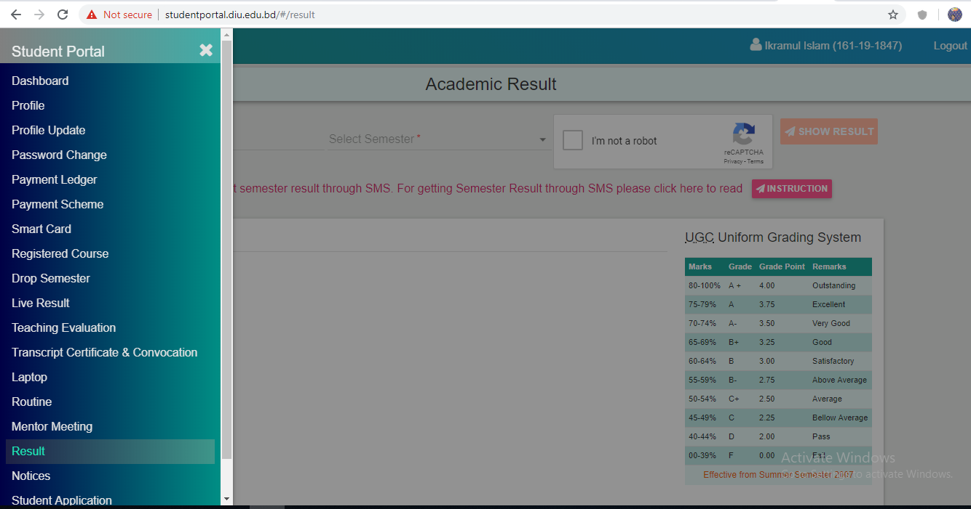
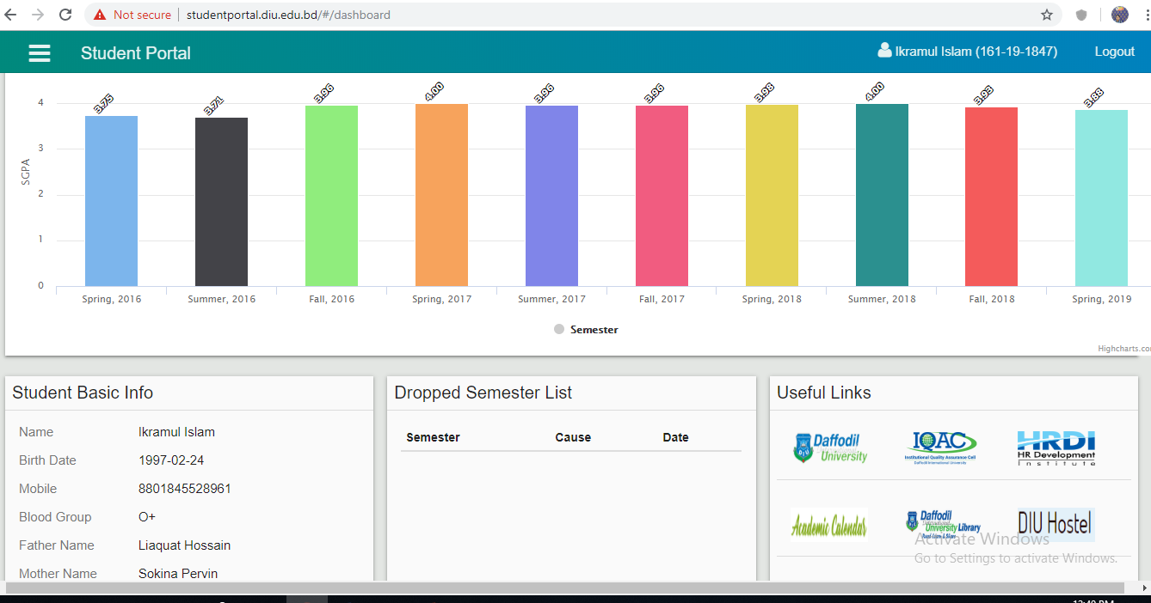
Student Portal/Dashboard
Student Portal/Dashboard
DIU has established unique ‘Student Portal, from where students can create profile, see result, payment ledger and scheme, onfrmation on trabscript/cetifictae, routine, mentor meeting etc
http://studentportal.diu.edu.bd/#/login

Slide 43
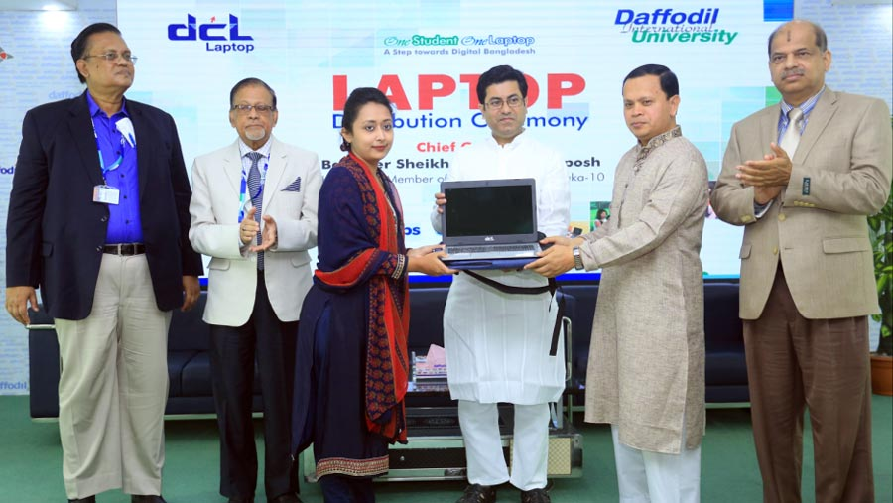
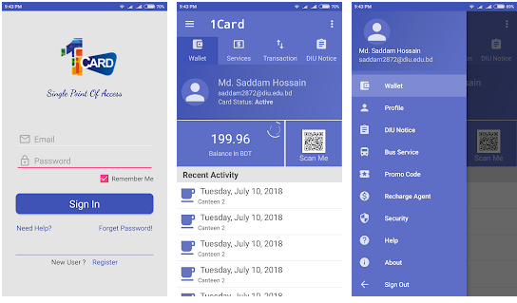
DIU Model
One Student One Laptop
To provide personal computing access to rural and under privileged students of Daffodil International University. To enable them to participate in class room, assignments, and on-line discussion activities to help consolidate learning.
http://laptop.daffodilvarsity.edu.bd/
1-Card Solution
1-Card solution provides unifies permissions, credentials, payments, and security across your entire campus. Core technology streamlines system management, integrates data between systems through our data management engine, and manages financial transactions.
https://play.google.com/store/apps/details?id=com.onecard.bd.daffodil&hl=en

Slide 44
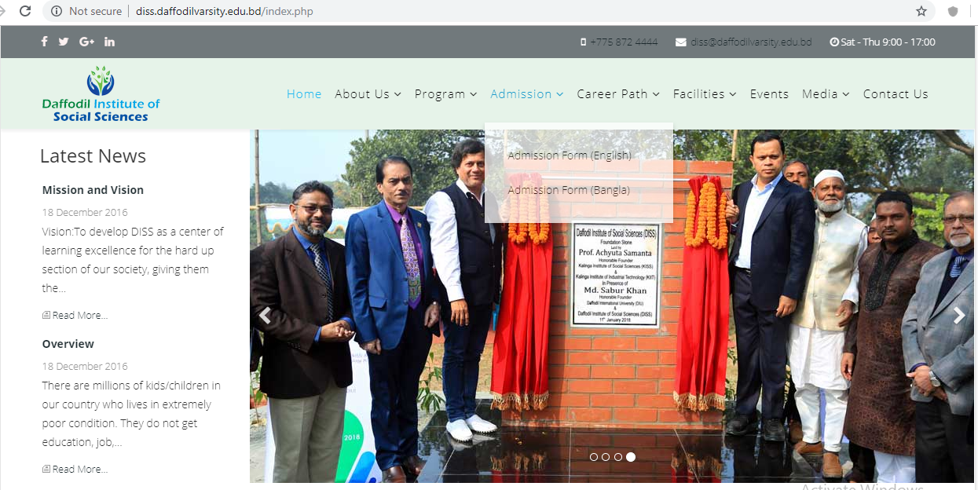
Daffodil Institute of Social Sciences
DISS is concerned with the underprivileged, orphan, abandoned children who have lot of prospects. DISS makes earnest effort to pick up, gear up and groom up for the betterment of their lives and making them as the resources for the world, not burden. Our motto is to give a real leverage in educational development and earning based vocational and creative education for the underprivileged children.
http://diss.daffodilvarsity.edu.bd/index.php
Entrepreneurship Development Fund (EDF)
Entrepreneurship Development Fund (EDF) is only intended to be used for the development of all the students of Daffodil International University. It will be allocated as a loan for the business development/ initiation purposes, or, business support services and grooming services. It will be considered as the R&D for student’s projects.

Slide 45
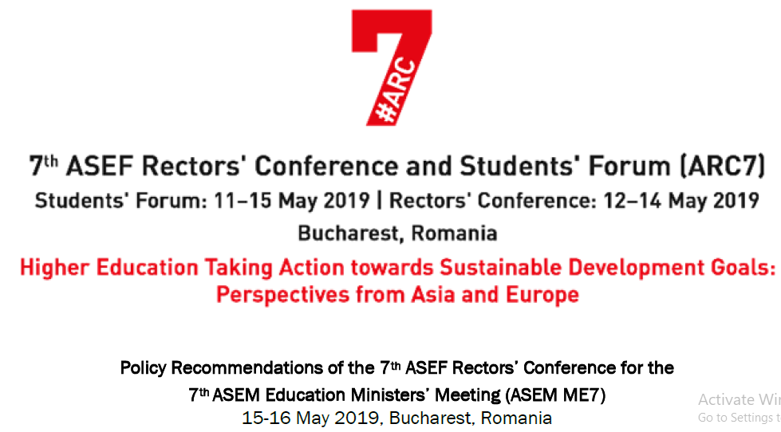
7th ASEF Rectors’ Conference and Students’ Forum (ARC7) in Romania
DIU management has participated at 7th ASEF Rectors’ Conference and Students’ Forum (ARC7) in Romania on Higher Education Taking Action towards Sustainable Development Goals: Perspective from Asia and Europe

Slide 46
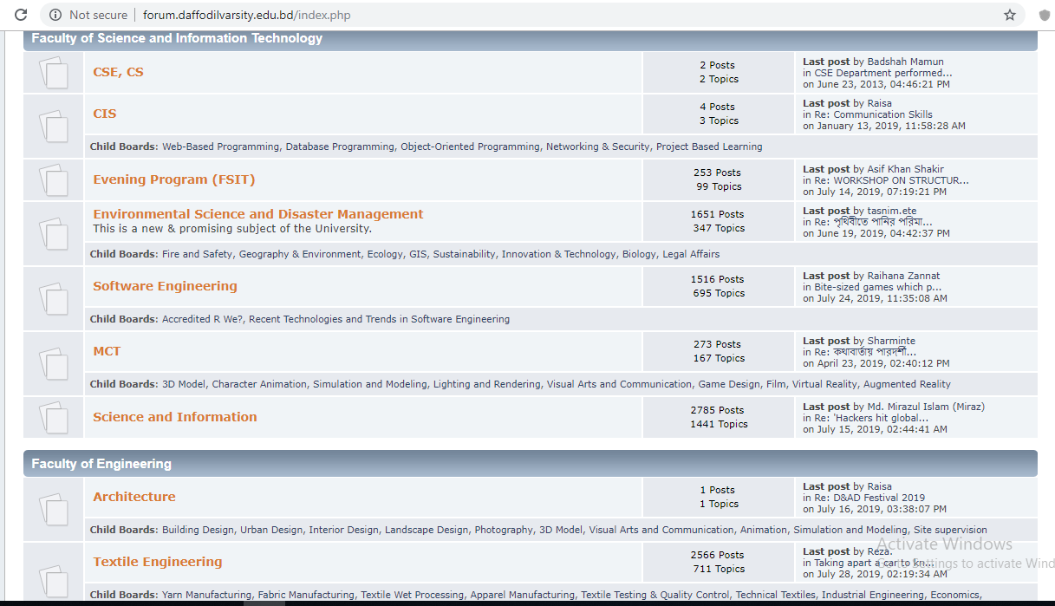
DIU Forum
DIU Forum
Daffodil International University Forum contains information about Open Text material, which is only intended for the significant learning purposes of the university students, faculty, other members, and the knowledge seekers of the entire world and is hoped that the offerings will aide in the distribution of reliable information and data relating to the many areas of knowledge

Slide 47
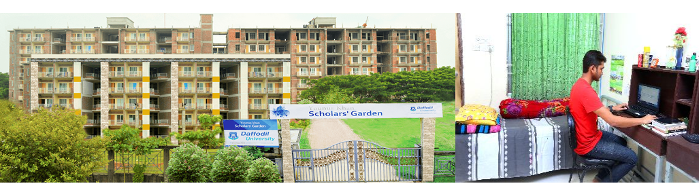
DIU Hostel Facilities
DIU has arranged spacious, secure and convenient residences for male & female students, where students reside in comfort, and in an environment conducive to study. The serene atmosphere of this accommodation is provided upon requirement.
Male Hostel of Daffodil International University
Female Hostel of Daffodil International University

Slide 48
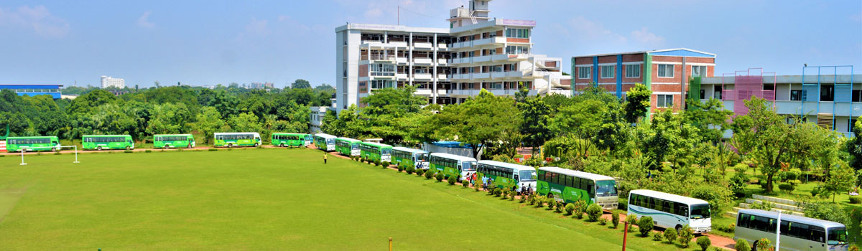
OUR integrated transport system
DIU has own unique transport system to cater the needs of student, faculty members and administrative employees.
At present, transport pool comprises with about 50 buses.

Slide 49
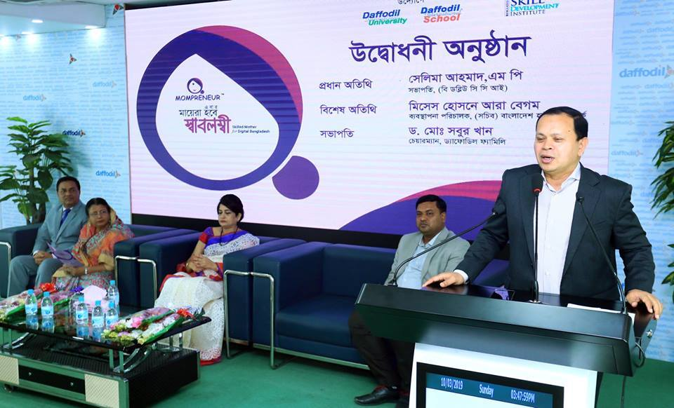
MOMPRENEUR: For the first time in the country, Mom-Preneur, a special initiative of Daffodil International University and Daffodil International School to empower the kids Mom. In 2017, Daffodil International School Initiated “Kidpreneur”

Slide 50
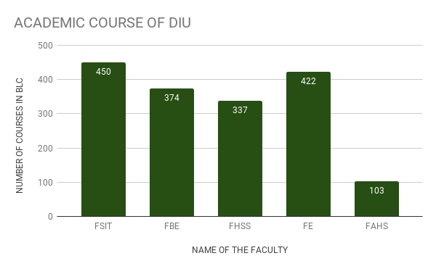
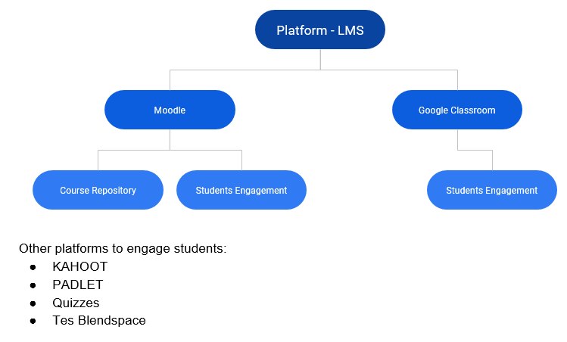
DIU Blended learning center
DIU Blended Learning Center will be an umbrella to all projects and tasks related to online education at Daffodil International University (https://elearn.daffodil.university/).

Slide 51
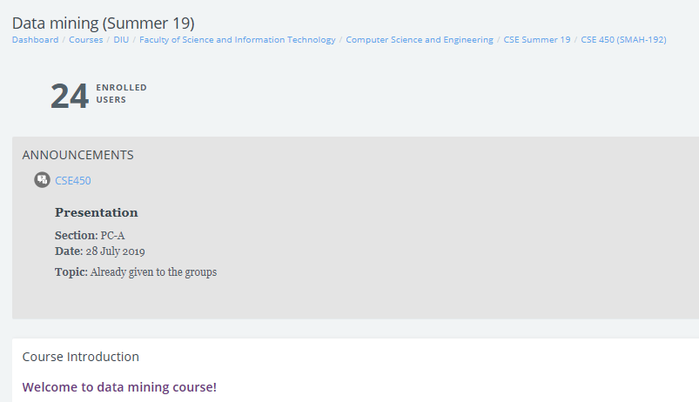
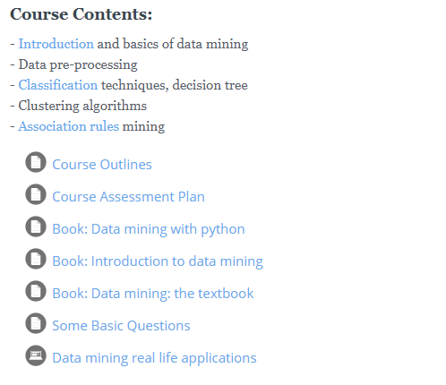
DIU Blended learning center (Contd….)

Slide 52
Scholarship (national)
Daffodil International University Scholarship
Professor Dr. M. Lutfar Rahman Scholarship
Razia Begum Scholarship
Akij Group (Trust) Scholarship
Professor Dr. Aminul Islam Memorial Scholarship
Freedom Fighters Ward
Talent Hunt Scholarship

Slide 53
Scholarship (International)
Community College Initiate Student Exchange Program 2016-17 in the U.S.
Global Korea Scholarship 2019 for Masters Degree
Mevlana Scholarship
Erusmus Scholarship
Shenyang Aerospace University Scholarship, China

Slide 54
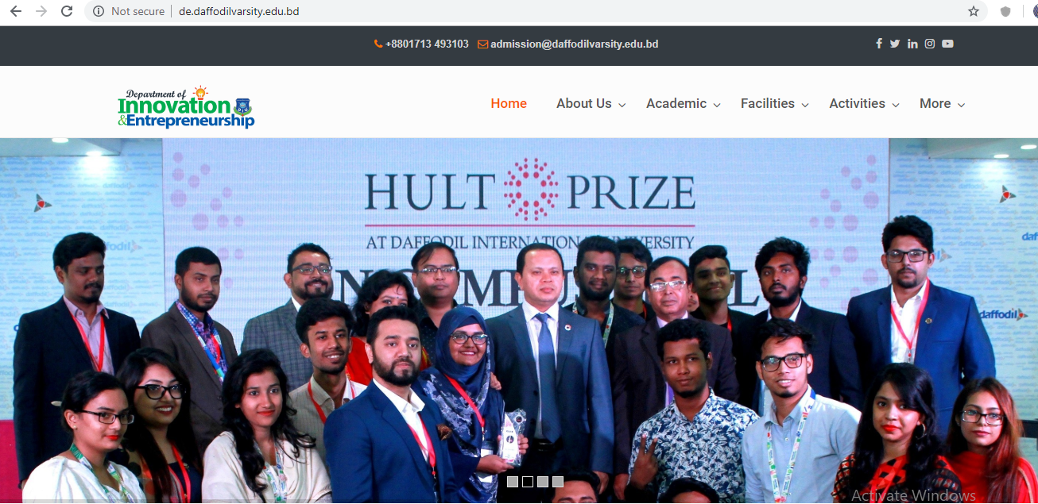
Entrepreneurial activities of DIU
Daffodil International University established the Department of Innovation and Entrepreneurship under the Faculty of Business and Entrepreneurship and introduced the pioneering four-year Bachelor of Entrepreneurship program in Bangladesh.
http://de.daffodilvarsity.edu.bd/about-us/initiatives/

Slide 55
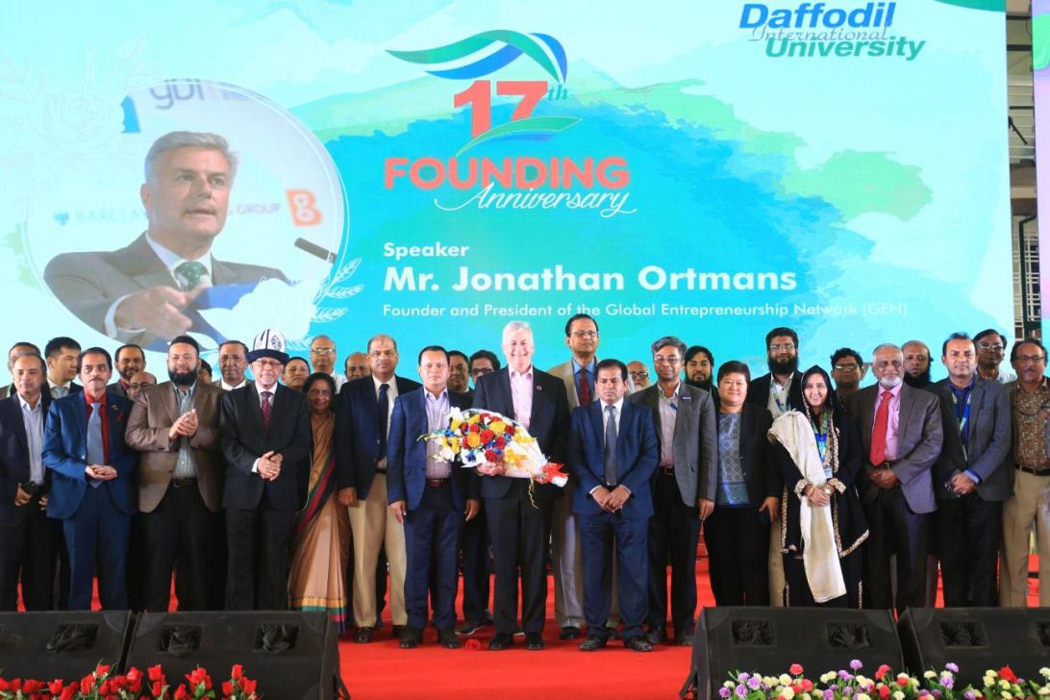
Jonathan Ortmans, President of Global Entrepreneurship Network (GEN) visited Daffodil International University
“…..I have no doubt that Daffodil International university is playing a good role for spreading entrepreneurial mindset among the young generation of the country…”
Jonathan Ortmans,
President of Global Entrepreneurship Network (GEN)

Slide 56
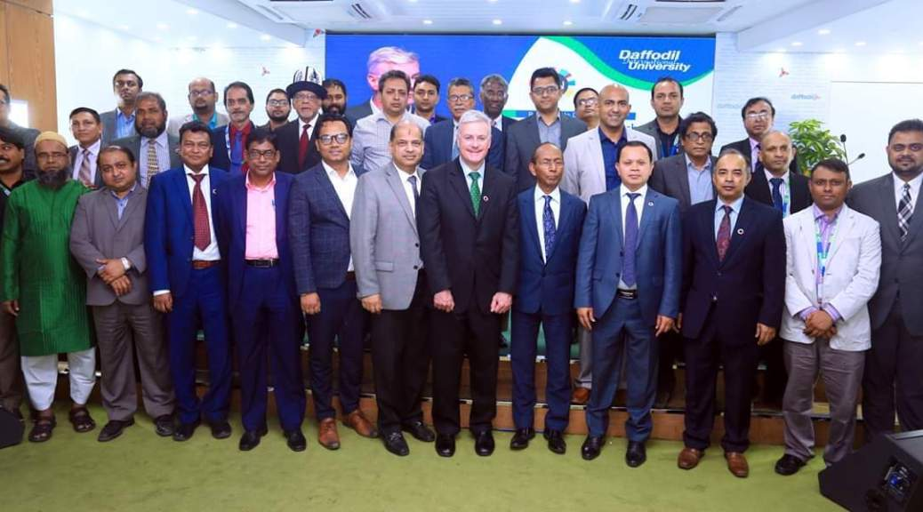
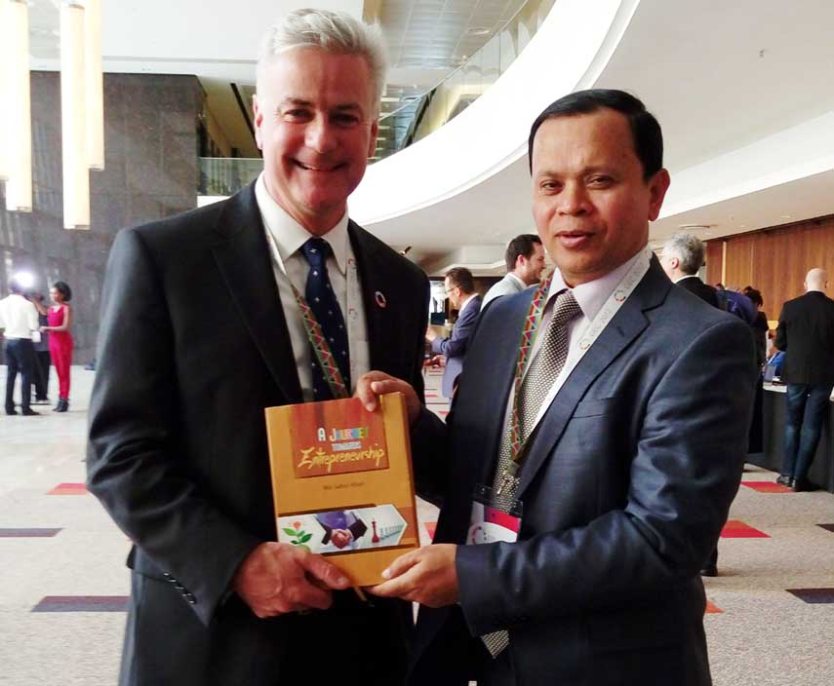
Jonathan Ortmans, President of Global Entrepreneurship Network (GEN) visited Daffodil International University

Slide 57
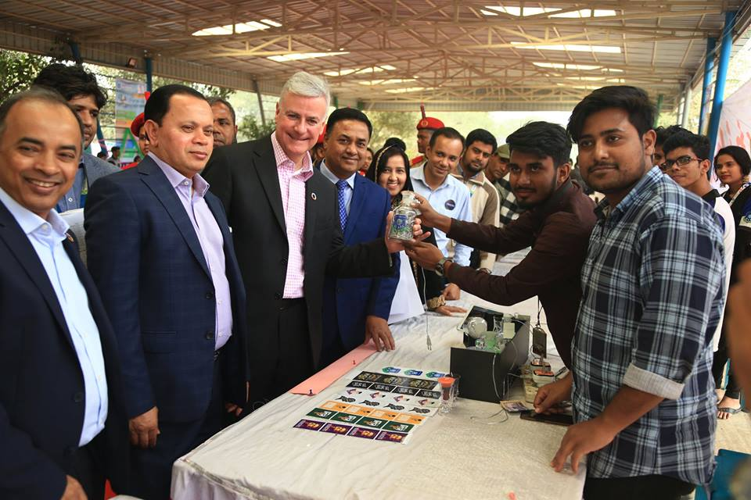
Jonathan Ortmans, President of Global Entrepreneurship Network (GEN) visited Daffodil International University

Slide 58
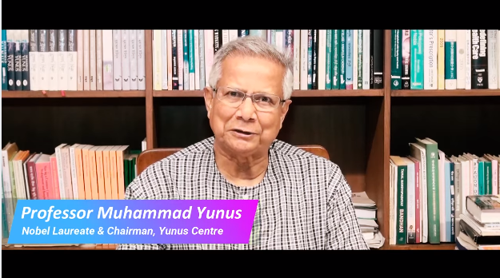
“…..I am very happy that Daffodil International University is arranging its 3rd International Social Business Summer Program (ISBSP)…..
….When you join the program at DIU, you will meet the people physically, meet them in their work, meet them in new classroom, they will be talking about their experience, what they have done. It’s a rare opportunity to meet the people who has such a dramatic change for the world ”
https://www.facebook.com/diu.international/videos/742442186151189/

Slide 59

Daffodil Business Incubator (DBI) has been thought to support this growing need. DBI works as a business support institutions. DBI speed up and systematizes the process of creating successful enterprises by providing anample and integrated range of support, including incubator space, ensuring business support services, and proving every scope for clustering and networking. DBI also offers new companies the opportunity to rub elbows with others in their world.
http://incubator.daffodilvarsity.edu.bd/

Slide 60
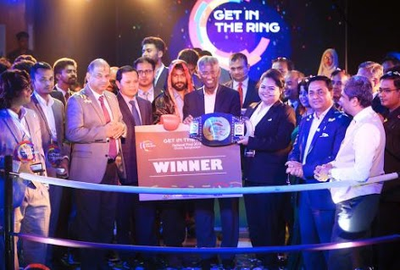

GITR (Get In The Ring- Bangladesh)
Get in the Ring Dhaka is a selection event for the Global Startup Competition of the Get in the Ring Foundation. This yearly pitch competition challenges you to show what you’ve got in an actual ring. Through 1-on-1 battles, you will compete for awards, a place in the Global Meetup and the attention of potential fans. Daffodil International University is the host of Get In The Ring- Bangladesh.
Startup Grind- DIU:
Startup Grind DIU is a university chapter of the Google for Startups- which is the largest independent startup community, actively educating, inspiring, and connecting more than 1,500,000 entrepreneurs in 600 cities. By Startup Grind-Daffodil International University we will bring the successful Bangladeshi Entrepreneurs who will share the stories behind their journey. The events are arranged in almost every month.

Slide 61
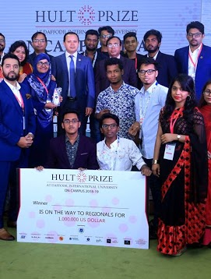
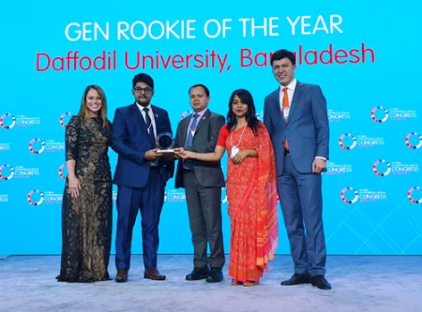
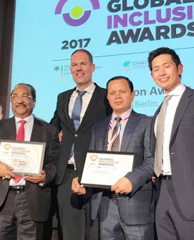
Global Money Week
Bangladesh Skill Development Institute (BSDI) and Daffodil International University (DIU) led the weeklong GMW celebration in collaboration with Bangladesh Bank.
Global Entrepreneurship Week (GEW)
DIU has won the ‘Rookie of the year’ Award for its outstanding performance in promoting GEN Entrepreneurial effort countrywide. The award has been conferred in a colorful ceremony held on April 15, 2019 in Manama, Bahrain during Global Entrepreneurship Congress and Dr Md. Sabur Khan, Chairman, Board of Trustees, DIU received this recognition for the University.
HULT Prize DIU
DIU hosts HULT Prize on a regular basis. We are ranked no. 1 this year as we have the highest number of participation. More than 586 teams have participated so far this year.

Slide 62


Department of Innovation and Entrepreneurship in association with Startup Huddle Dhaka hosts events in every month where they focuses on educate, engage, and connect entrepreneurs and future leaders of the country.
Global Entrepreneurship Congress (GEC): Every year, the Global Entrepreneurship Congress gathers together thousands of entrepreneurs, investors, researchers, policymakers and other startup champions from more than 170 countries to identify new ways of helping founders start and scale new ventures around the world. DIU delegates participated in Global Entrepreneurship Congress every year.
Global Entrepreneurship Research Network(GERN):
DIU is the program member of Global Entrepreneurship Research Network under GEN.

Slide 63
Are u the next startup
"Are You the Next Startup?" is a national level talent hunt program introduced to find out potential startups and entrepreneurs of Bangladesh. It will hunt, groom, design, organize, and manage new enterprises or business ideas till the ultimate success of each winner.
http://next-startup.net/
Startup Market: The concept of ‘Daffodil Startup Market’ is being initiated to promote entrepreneurial potentials of students and create more buzz in university life. It will be a platform for students to run small businesses and learn from those experiences. Student vendors can sell almost any wares, books, candles, foods, art works, handmade goods, jewelry, bonsai, toys, seasonal items and anything innovative that they want over a period of a whole day (from 2PM-6PM). At a rental of only BDT 120 (for 1 day), it is an extremely viable option for budding student entrepreneurs in DIU.

Slide 64
Startup Idea Fund: Before graduation establishes yourself, don’t be a job seeker rather create employment for others”, this is the motto to the development and creates entrepreneurial Ecosystem. With this motto, Daffodil International University is organizing a startup idea competition to support innovative ideas.
Entrepreneurship Development Fund (EDF) :
Entrepreneurship Development Fund (EDF) is only intended to be used for the development of all the students of Daffodil International University. It will be allocated as a loan for the business development/ initiation purposes, or, business support services and grooming services. It will be considered as the R&D for student’s projects.
Daffodil ICT Carnival: ICT itself is in the craziest ride in terms of its fast development. A huge number of our young population is the passengers who are taking different benefits considering the latest trend and whatever opportunities are coming before them. In most cases, the talents are not explored for the absence of focus, exposure, link with industries. On the other hand, Industries don’t also get right talents which they need. To bridge between these two points and to showcase the products/services, Daffodil Family is going to organizing the ICT Carnival.

Slide 65
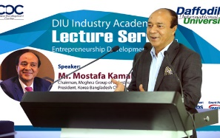
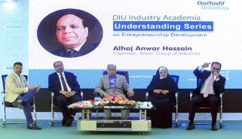

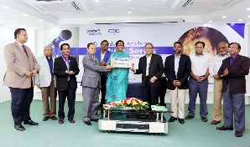
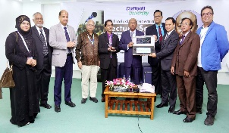
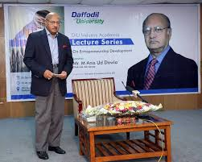
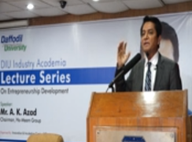






Industry-Academia Lecture Series: With the aim to inform and motivate the educated youths of the struggle and challenges faced on route to success by the well known entrepreneurs of the country, Daffodil International University Industry Academia Lecture Series on Entrepreneurship Development introduced by Innovation and Incubation Center (IIC) of Daffodil International University

Slide 66

Global Entrepreneurship Summer Camp, UniMAP, Malaysia(2016)
The GESC is the brainchild of the top management of five Asian universities, who meet in China in 2015. The universities are Mahasarakham University (Thailand), Daffodil University (Bangladesh), Wenzao Ursuline University of Languages (Taiwan), Ubudiyah University (Indonesia), and Universiti Malaysia Perlis (UniMAP) (Malaysia). The camp is designed to encompass both theory and practical components, including visitations to factories, markets, and other entrepreneurial centres. It is an excellent chance to connect with fellow participants from different corners of the continent. A mentor-mentee arrangement is part of the delivery approach of the camp. Participants will be guided to achieve specific entrepreneurial targets including planning for global entrepreneurship start-ups and performing correct business pitching processes.
International Social Business Summer Program: The International Social Business Summer Program 2018 (ISBSP) was held from 1- 10 July, 2018 in the lush green campus of Daffodil International University (DIU) with the motto “Social Business Entrepreneurs for Better World”. Young minds from 16 different countries including Switzerland, Greece, France, Germany, Brazil, Taiwan, Philippines, Indonesia, South Korea, India, Sri Lanka, China, Somalia, Nigeria, Nepal and of course, Bangladesh came together to learn how to solve world's most pressing issues by using the power of business.

Slide 67

Global Entrepreneurship Camp (GEC), 2019 at USIM, Malaysia
Global Entrepreneurship Camp 2019 is the 10 days long program on entrepreneurship jointly organized by USIM, DIU, and Perfect Triangle SDN. Key aim and objectives are: to present a platform where youth can come together to brainstorm on how to develop a global entrepreneurial mindset, to challenge youth globally, Students would equip themselves with global knowledge, participate in cross-cultural activities, build communication skills, and gain confidence to be able to become future business leaders. They also will get academic credits and recognition from several institutions, as well as an experience of Malaysian lifestyle, culture, and heritage through different set activities of study and recreational visits.. The camp will be held from the February 8th to 18th, 2019.

Slide 68

DIU-INHA Entrepreneurship Program-2019
Two week long (9-19 February 2019) ‘DIU-INHA Entrepreneurship Program-2019’.A contingent of 12 students and 2 researcher from Inha University, South Korea along with 12 students from different Departments of Daffodil International University joined this Entrepreneurship Camp at Daffodil International University Bangladesh started on 9th January 2019. This 24 students were divided into 4 groups and presented 4 Business Idea at closing ceremony. Team THUNDER won the best Business Idea award.
Social Business Creation competition, HEC- Montreal: Daffodil International University (DIU) is going to host the 4th edition of Social Business Creation competition organized by HEC Montréal in Canada and Yunus Centre in Bangladesh. DIU will also organize the regional semifinal of this competition. This competition is an innovative pedagogical platform on which students learn to create social businesses. Beside the rich learning experience, students will get chances to win several prizes of CAD 57,500 in total

Slide 69


DIU Research and publication on Entrepreneurship

Slide 70
Scopes for DIU and Finnish Universities
Strategic Agreement
Student Exchange Programme
Research Collaboration
Sharing resources (like DIU has business innovation lab, business incubation centre, DIU Germplasm Centre etc)
Faculty exchange programme
Conduct research on mutually agreed topics in the areas of Engineering, Science and Technology, Business, Entrepreneurship
Work on STEM education
Capacity building

Slide 71
Our role for the NRBs
Foreign remittance is an important part of Bangladesh's economy. One of the pivotal factors of the successes of Bangladesh is the direct and indirect contribution of NRBs. Because of their relentless hard work Bangladesh has become one of the major remittance recipient countries in the world. Bangladesh received its highest-ever annual remittance of about US$14.5bn in the just out fiscal year as expatriate Bangladeshis sent home hard-earned money. The central bank hopes that the remittance inflow will continue to go up in the coming days.
To acknowledge their contribution, BB recently takes initiatives to collect information of NRBs and maintain them in NRB database. This database will help us to communicate with them and make a communication channel for themselves. For Bangladesh Bank, this database helps to promote and uphold investment information arranged for NRBs by government, proper remittance channel and method, important financial or economic moves of government in which NRBs can participate. Again NRBs can be benefited in some way. They can submit complaint, query or feedback. And also use this database to link between themselves and search other NRBs according to country, profession etc.
Source: https://bb.org.bd/nrb/

Slide 72
Role of NRBs in Finland
It is already proved that Bangladeshi entrepreneurs have been doing well and contributing to the economy. Despite a lot of political and bureaucratic problems, our entrepreneurs are still moving ahead. Our English skill is comparatively good, we have to utilize it. Whenever NRB will get the supports from Bangladesh, they can enter into various service-oriented businesses in abroad.

Slide 73

Doing Business-Bangladesh

Slide 74

SDG Tracker-Bangladesh
https://a2i.gov.bd/sdg-tracker/

Slide 75


