Slide 1


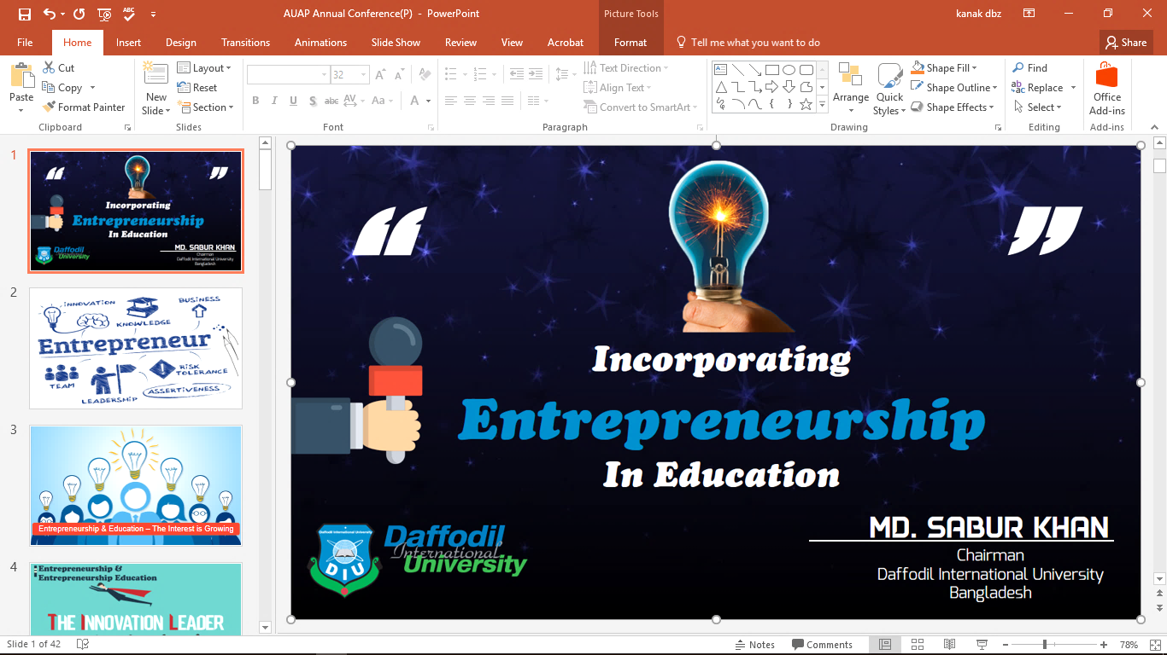

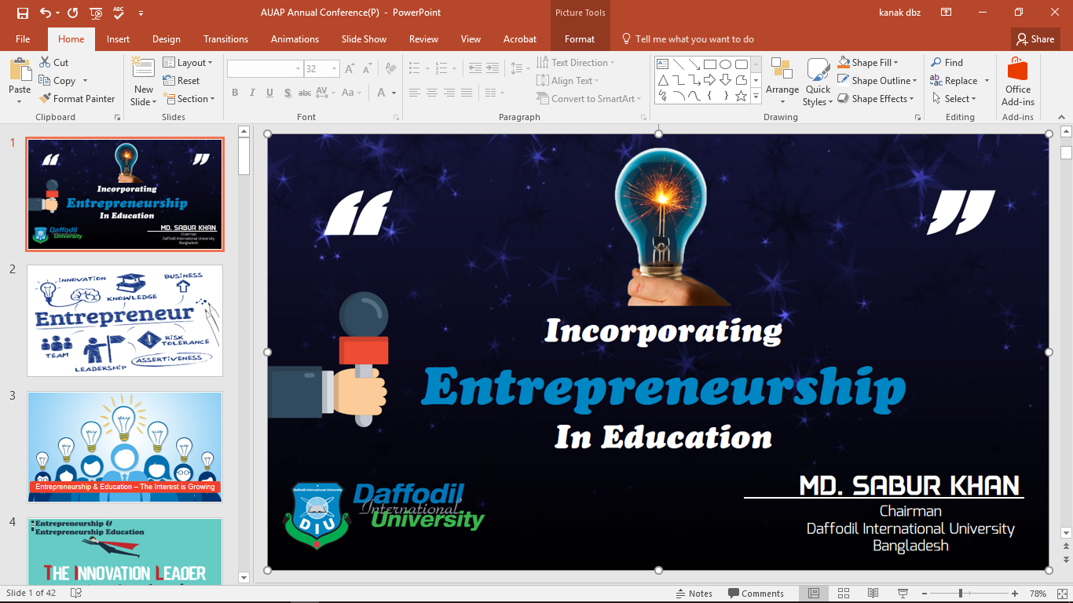

Slide 2


Slide 3

Entrepreneurship & Education – The Interest is Growing

Slide 4


Slide 5

WHY
ENTREPRENEURIAL
EDUCATION?

Slide 6
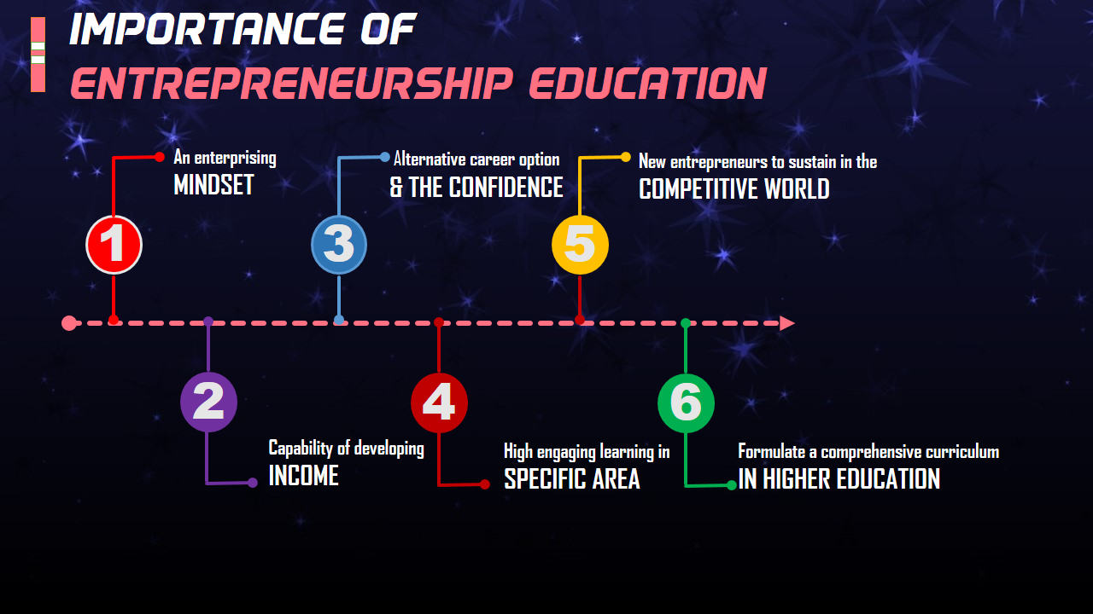

Slide 7
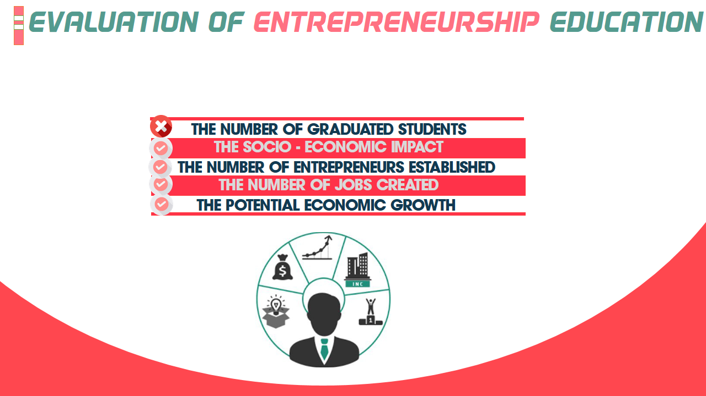

Slide 8


Slide 9
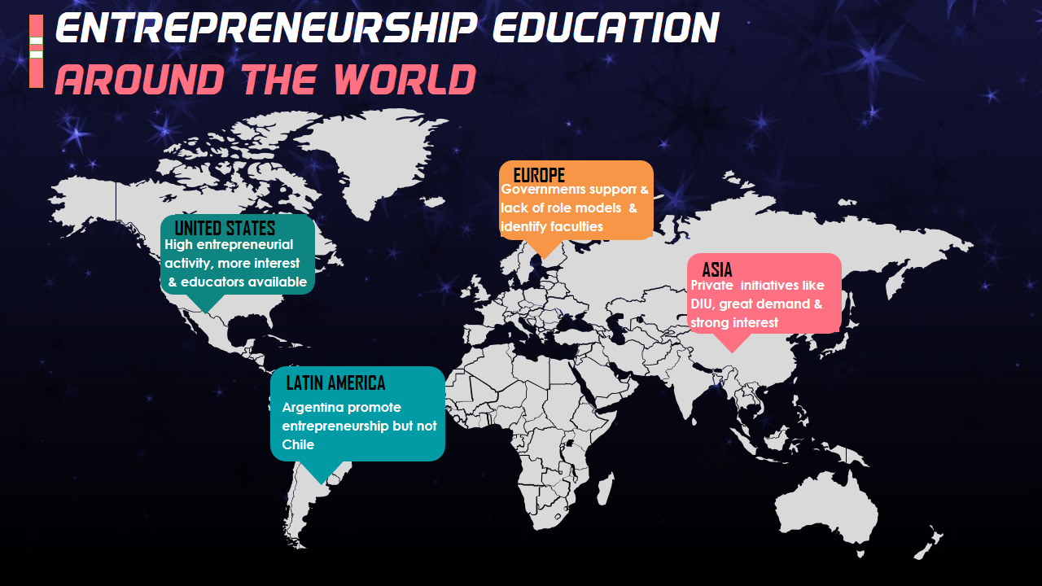

Slide 10
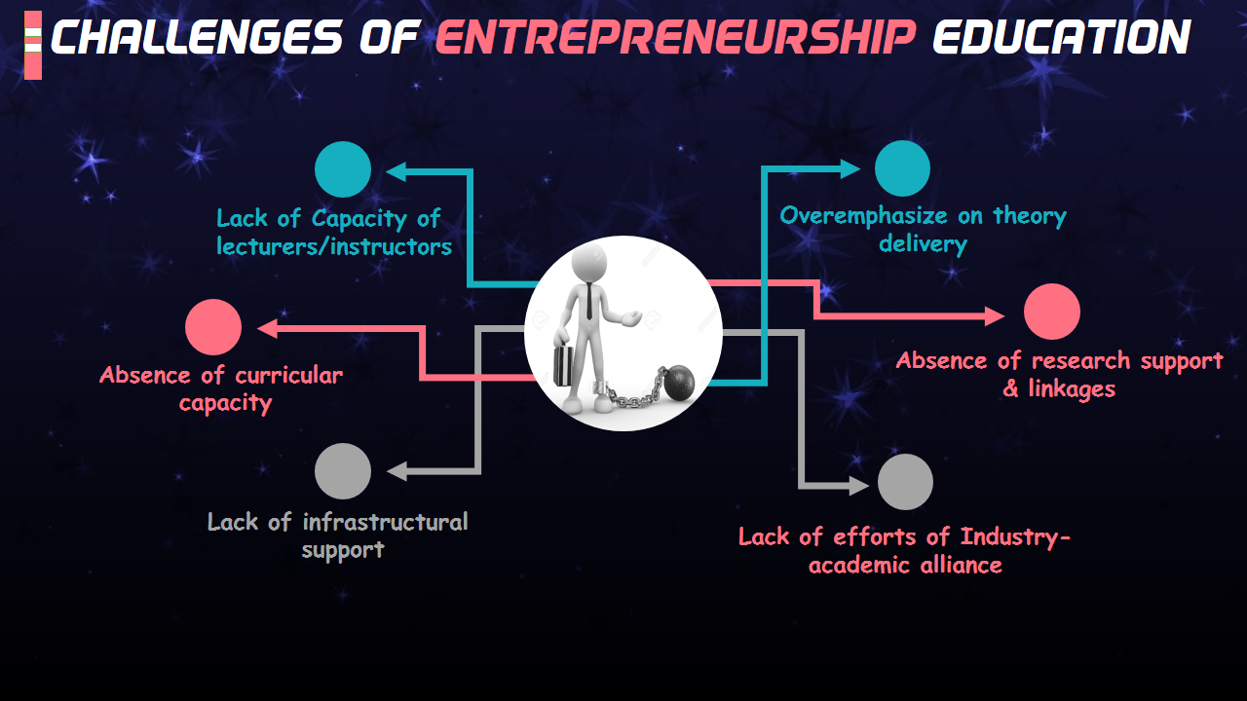

Slide 11


Slide 12
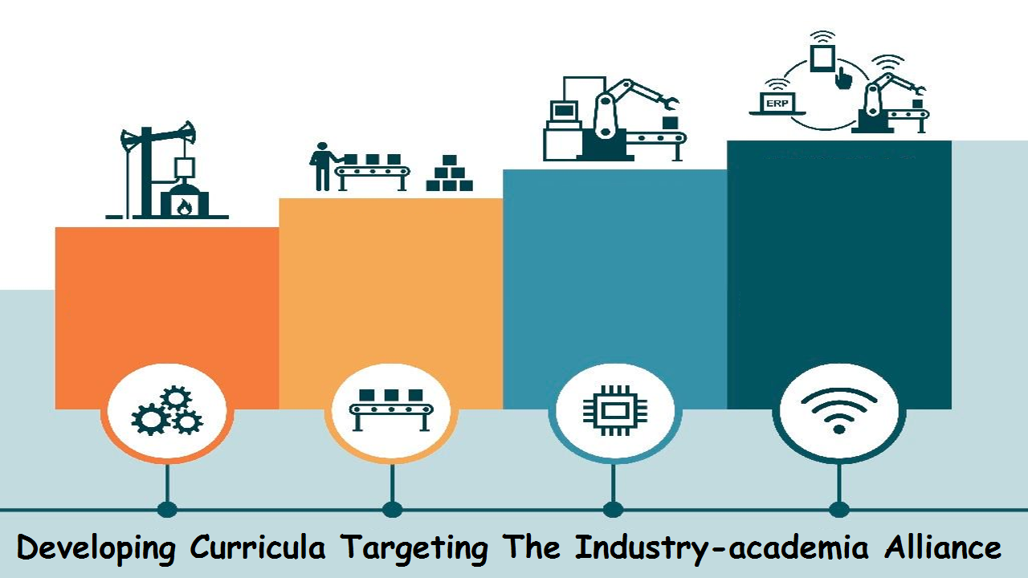

Slide 13


Slide 14


Slide 15
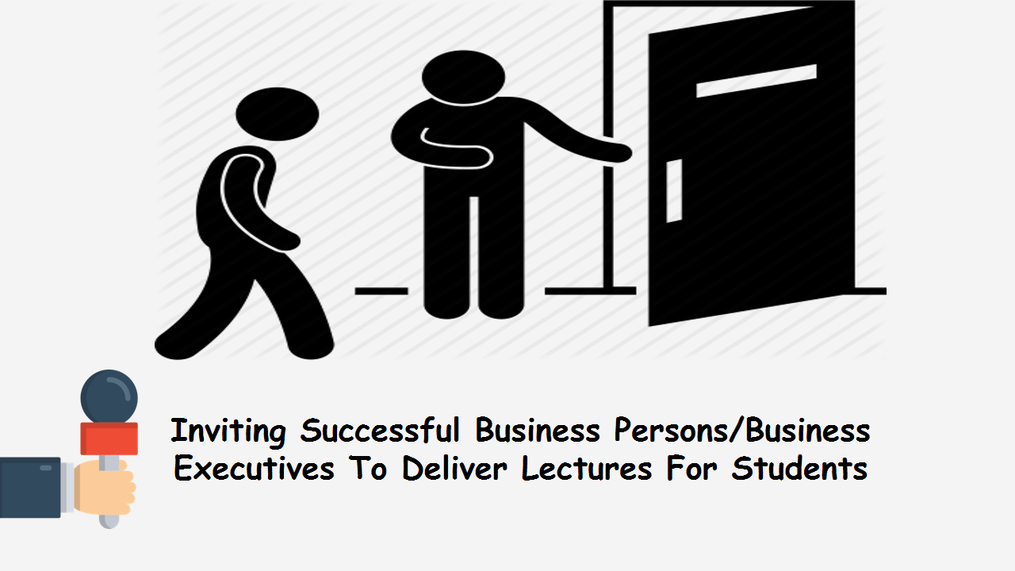

Slide 16


Slide 17


Slide 18


Slide 19


Slide 20
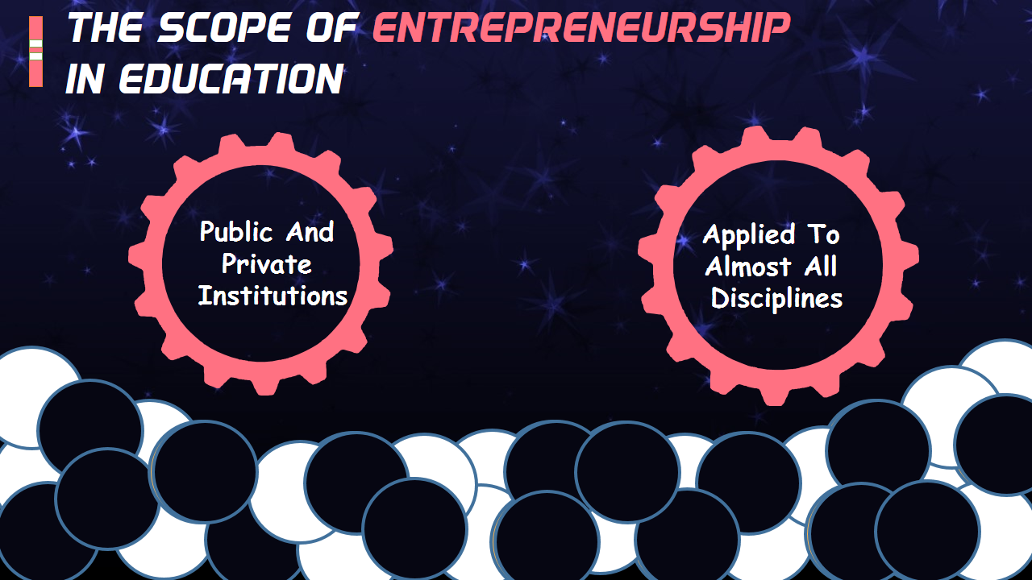

Slide 21
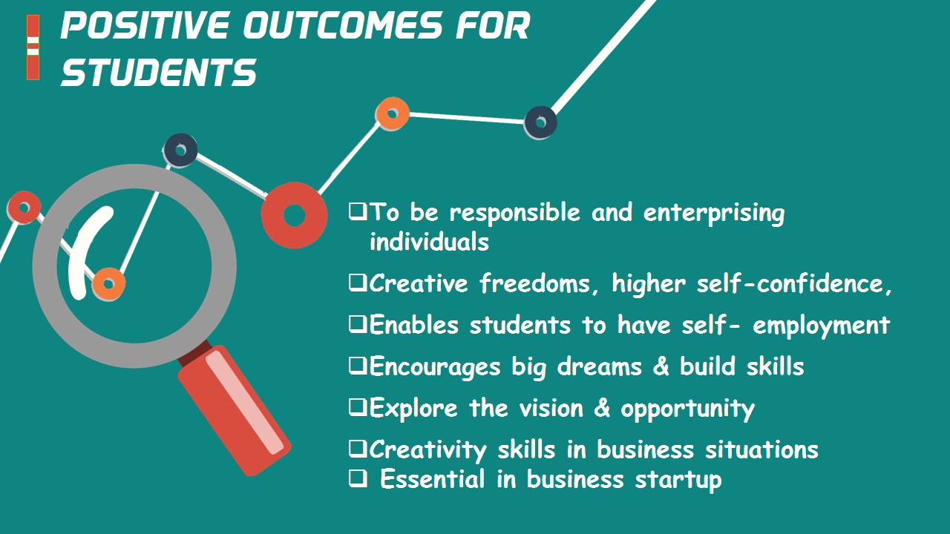

Slide 22


Slide 23


Slide 24


Slide 25


Slide 26


Slide 27


Slide 28


Slide 29


Slide 30


Slide 31
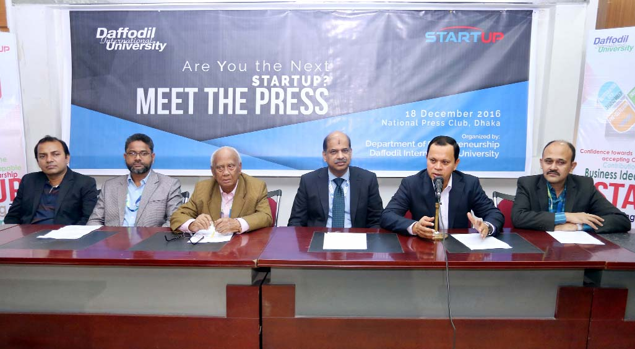
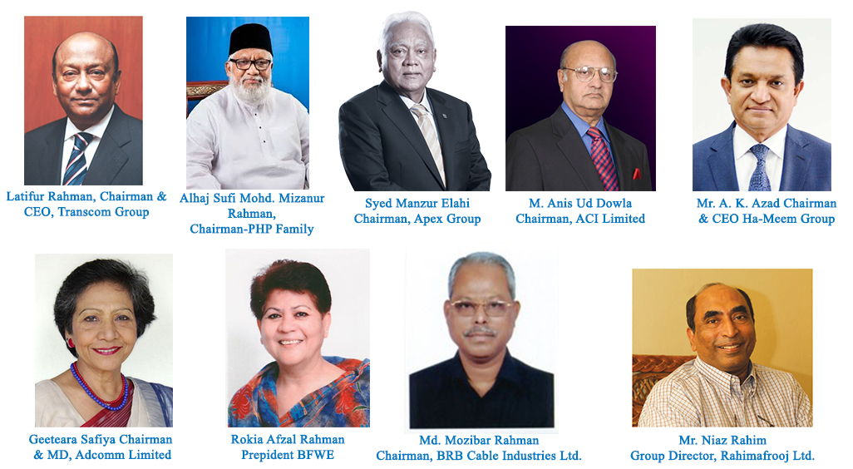
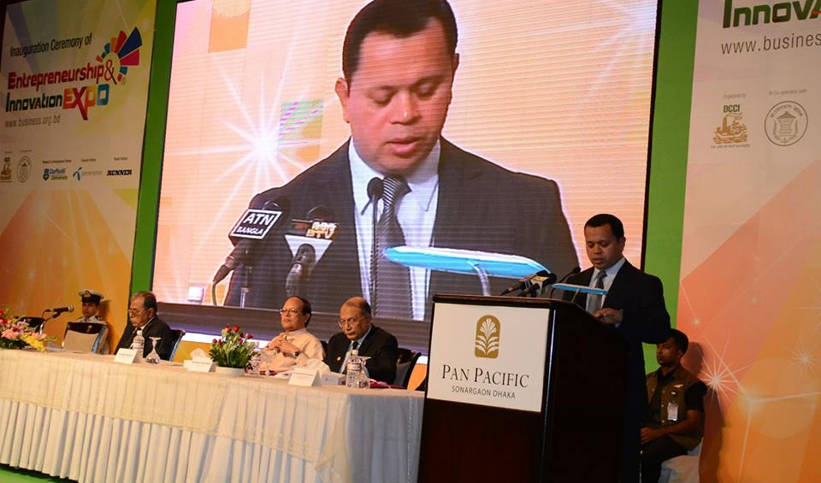
To Create Entrepreneurs
Encouraging students towards entrepreneurship
Department of Entrepreneurship
Industry-Academia Lecture Series
Entrepreneurship and Innovation Expo 2013

Slide 32


Slide 33
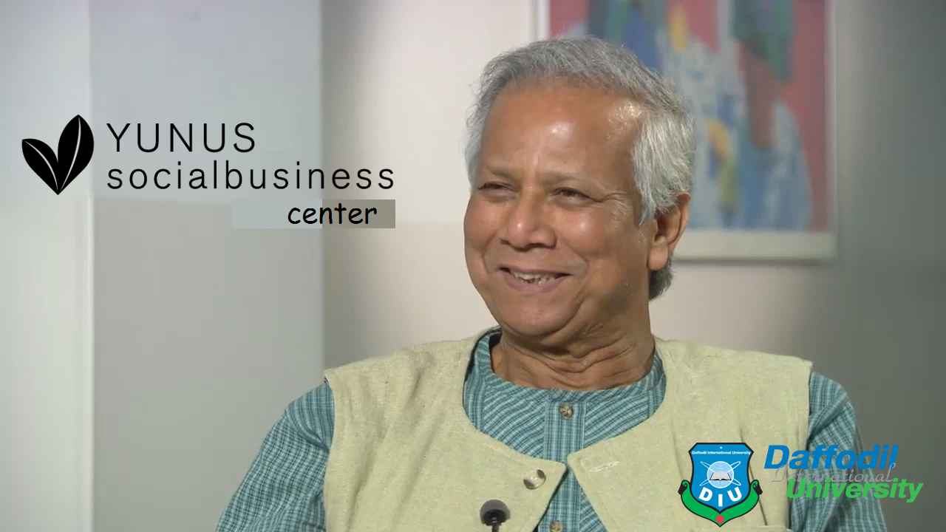

Slide 34
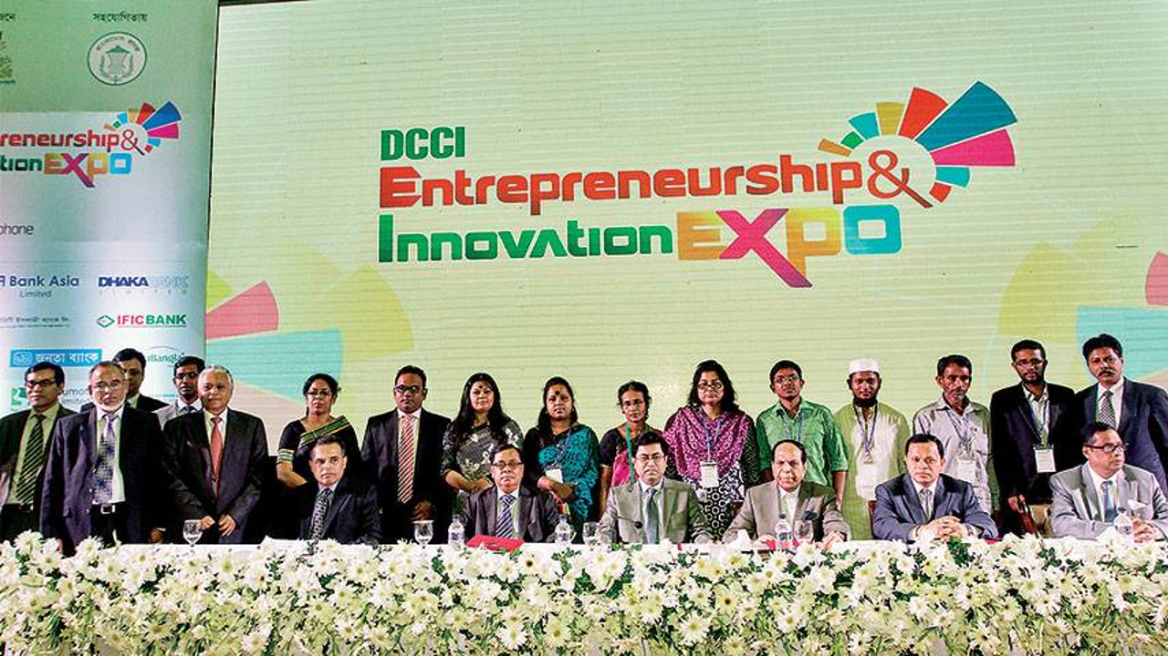

Slide 35


Slide 36


Slide 37


Slide 38


Affiliation

Slide 39
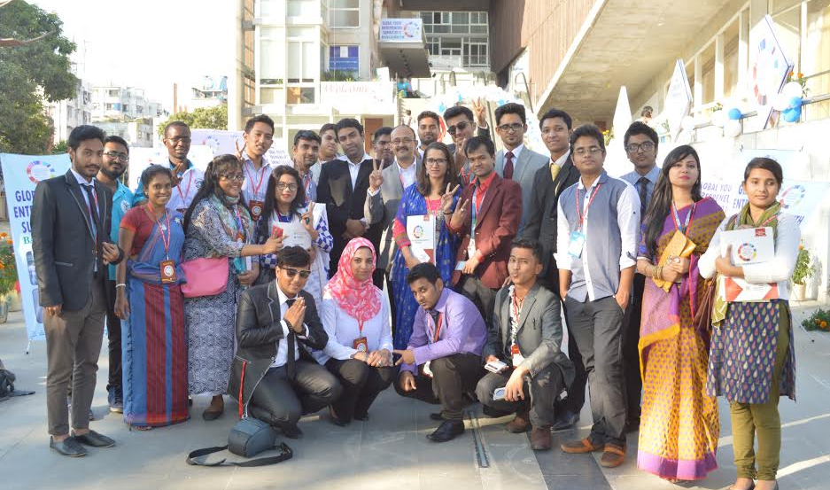


To Create Entrepreneurs
Encouraging students towards entrepreneurship
Global Young Entrepreneurs’ Summit 2015
Global Entrepreneurship Summer Camp 2016 Malaysia
Social Business Creation-2016

Slide 40
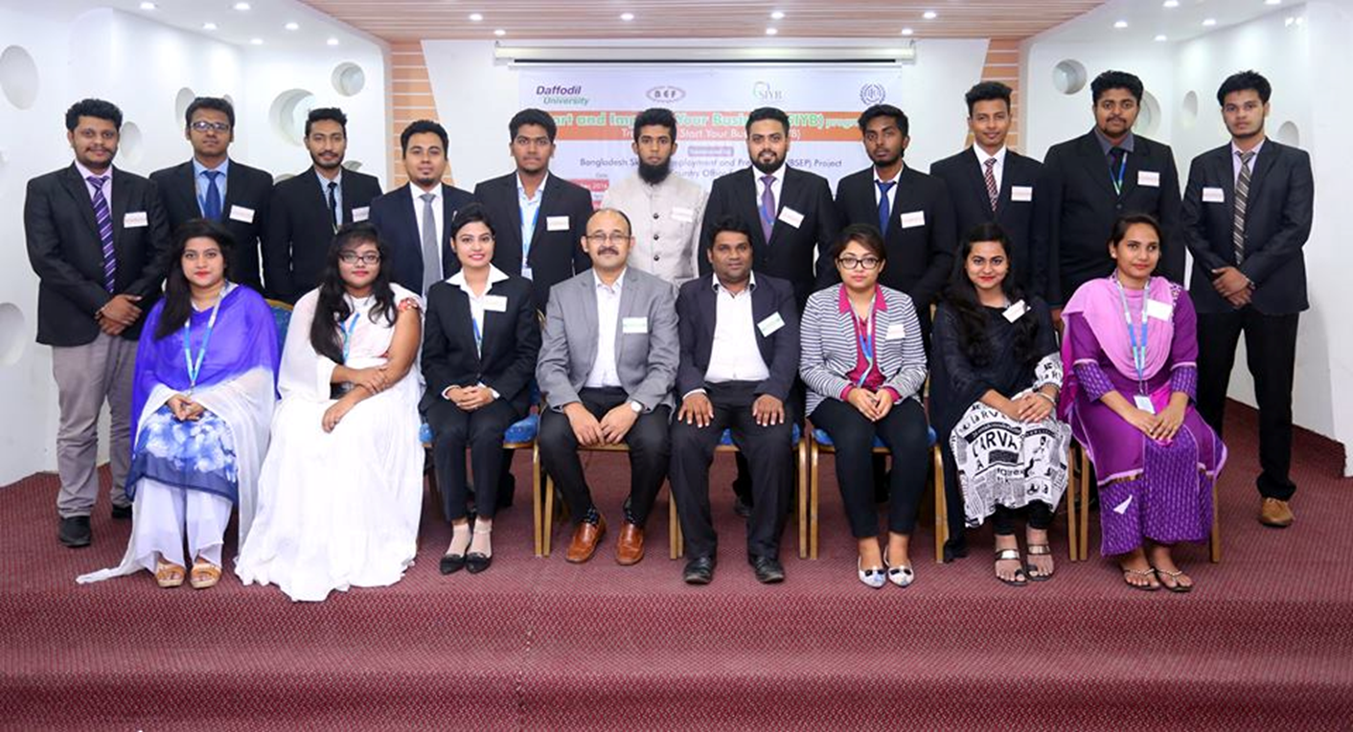
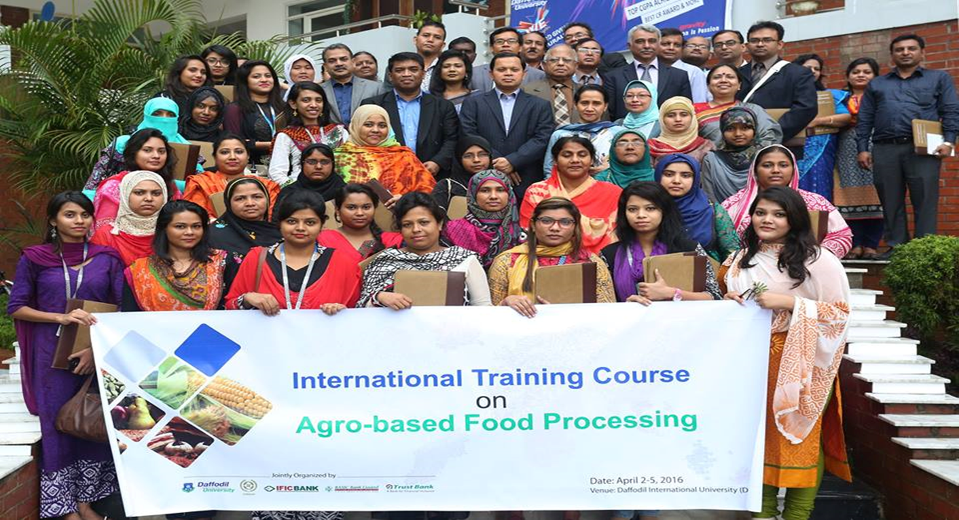
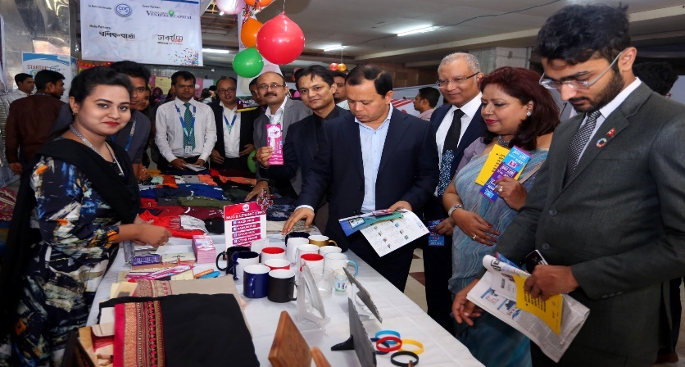
To Create Entrepreneurs
Encouraging students towards entrepreneurship
Start Your Business (SYB), ILO
Training Program for Women Entrepreneurs
Startup Fest 2016

Slide 41

Get in The Ring, National Final 2015

Slide 42


